Slide 1
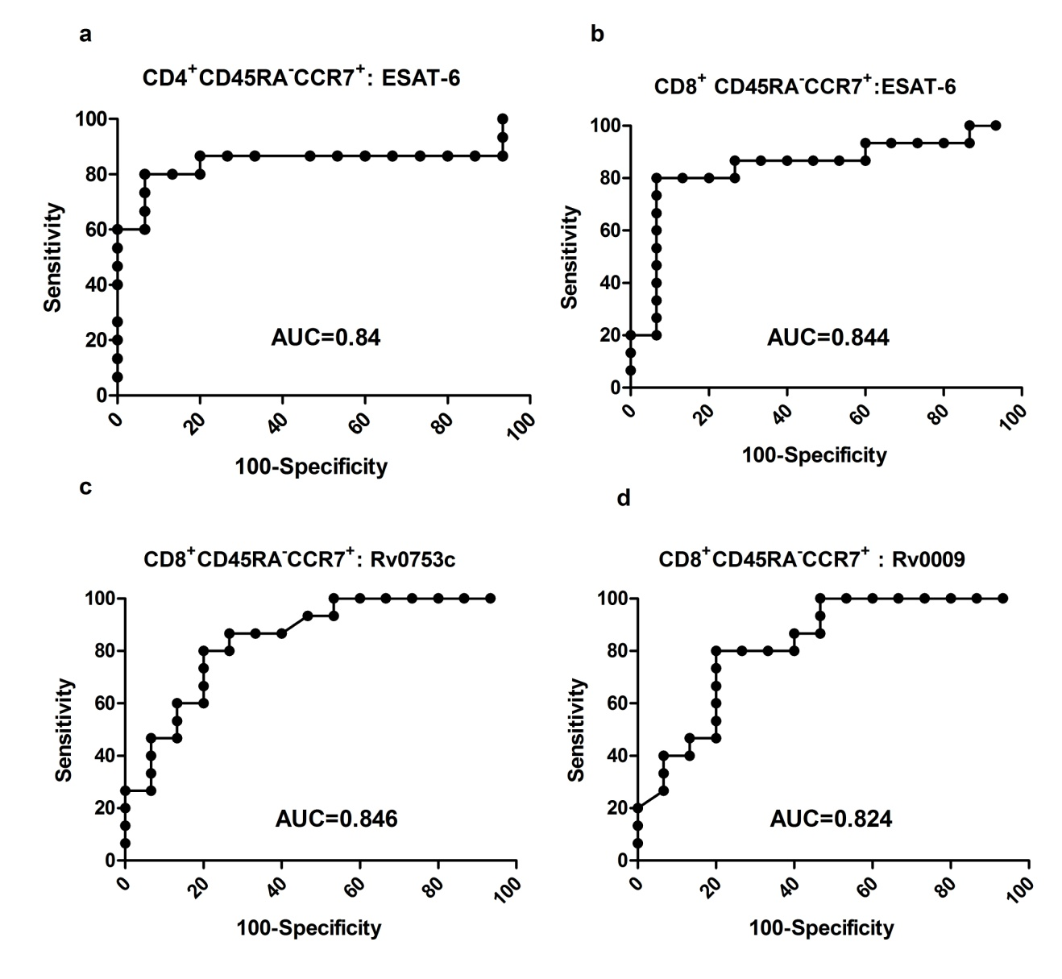
Supplementary Fig: 1
Receiver operating characteristics curve analysis of memory and regulatory T cells:
Continue

Slide 2
