Slide 1
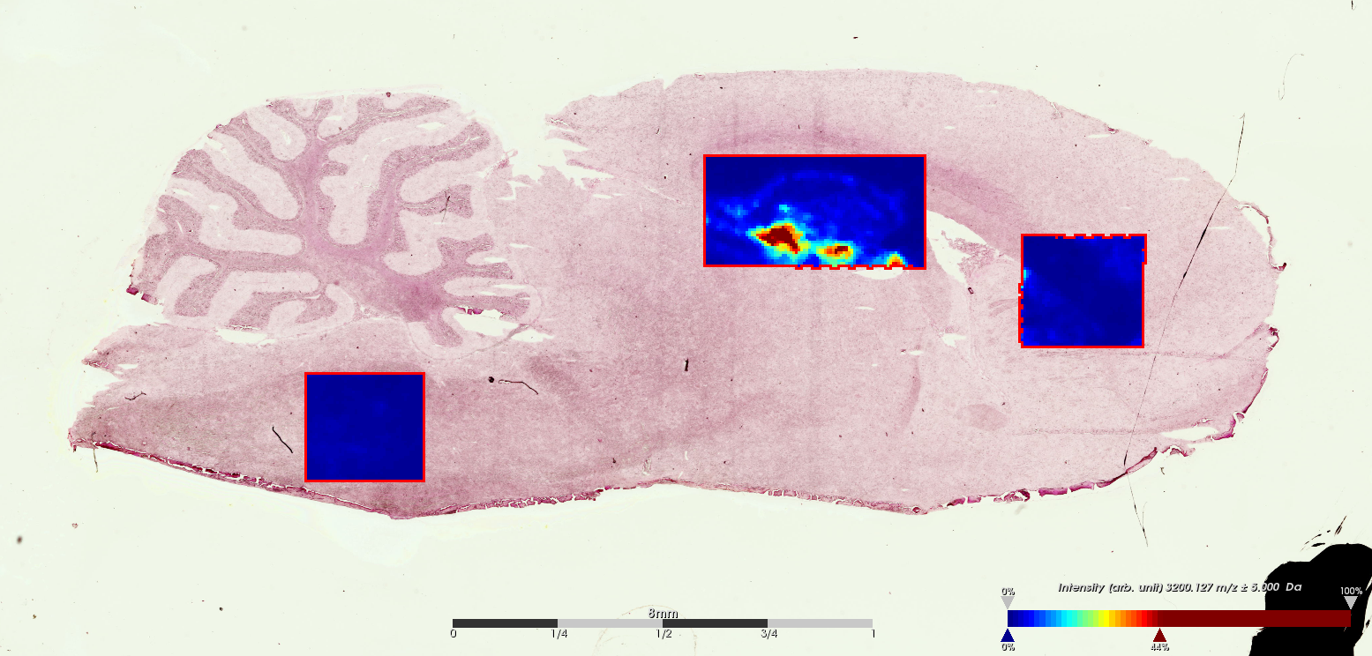
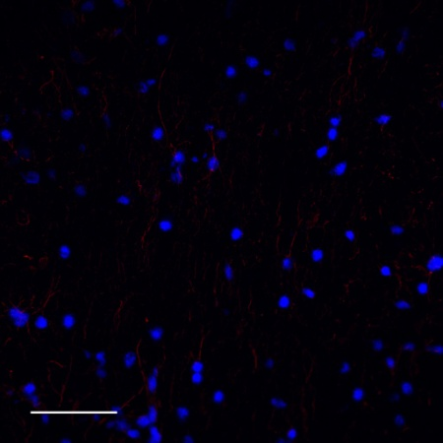
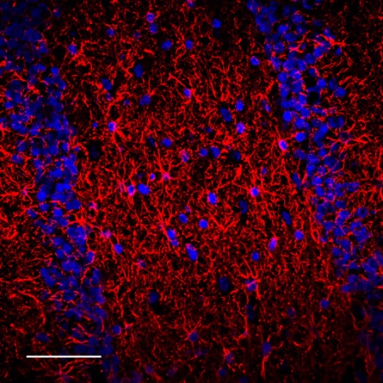
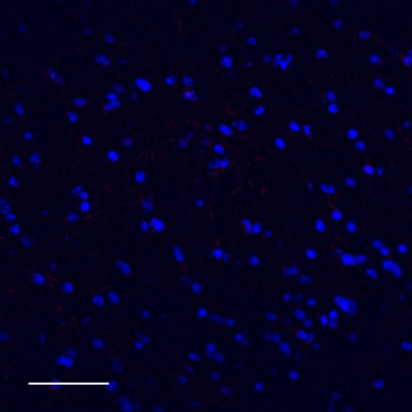
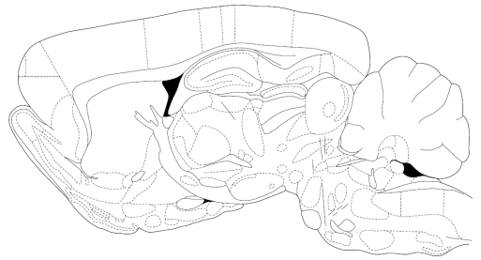
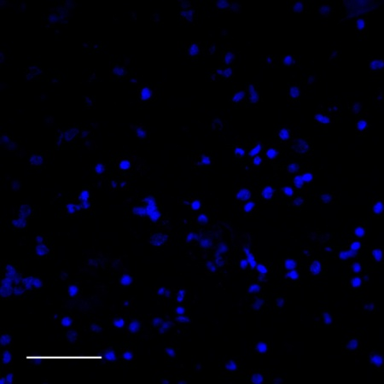
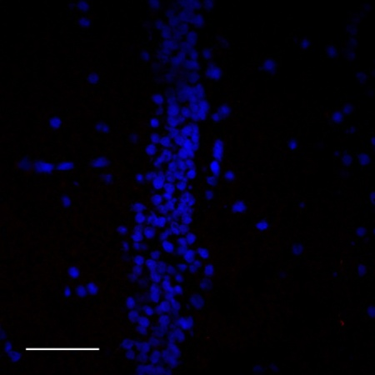
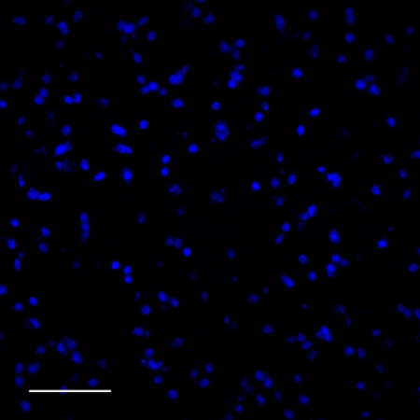
GFAP_RAT, P47819; Glial fibrillary acidic protein
Medulla oblongata
Hippocampus
Corpus callosum
Corpus callosum
Hippocampus
Control
Medulla oblongata
Gfap immunofluorescence (Scale bar = 50 μm)

Slide 2
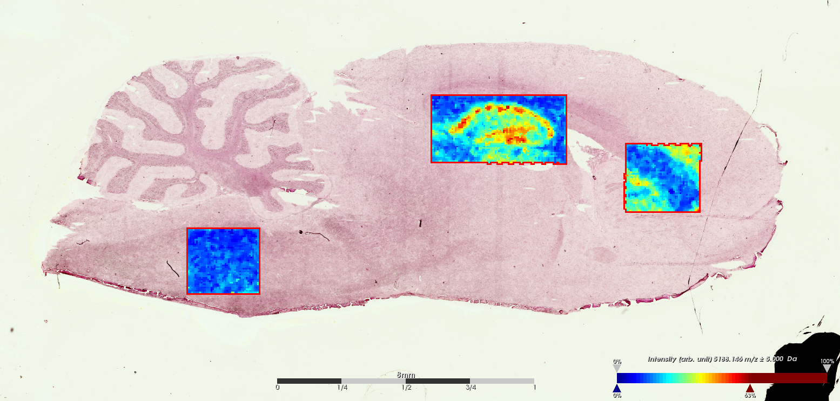
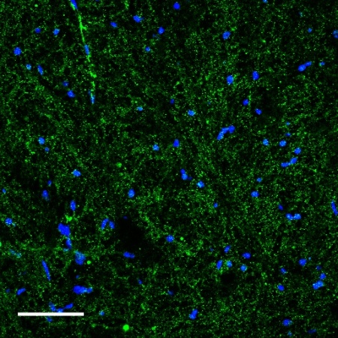
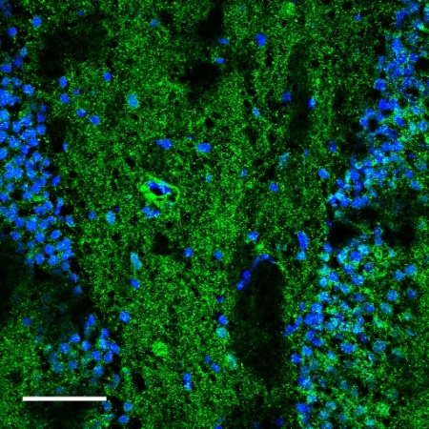
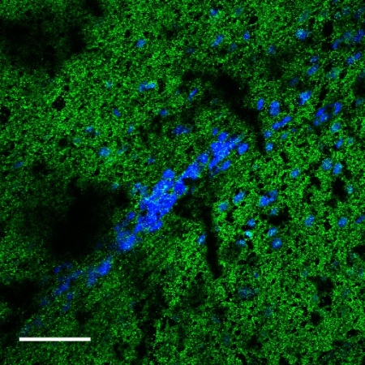
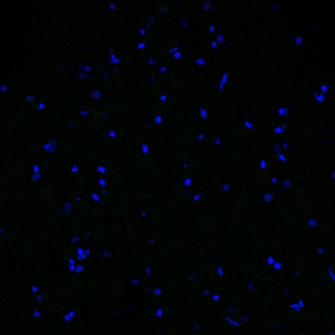
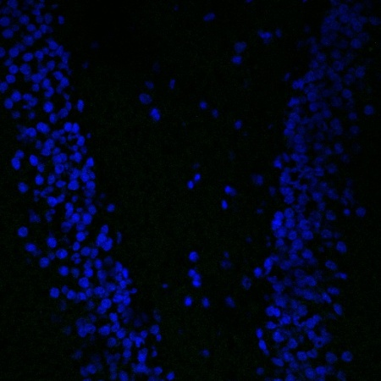
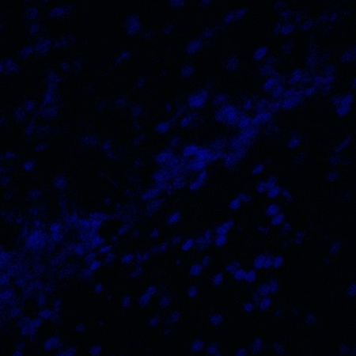
SYUA_RAT, P37377; Alpha-synuclein
Medulla oblongata
Hippocampus
Corpus callosum
Corpus callosum
Hippocampus
Control
Medulla oblongata
Alpha synuclein immunofluorescence (Scale bar = 50 μm)

Slide 3
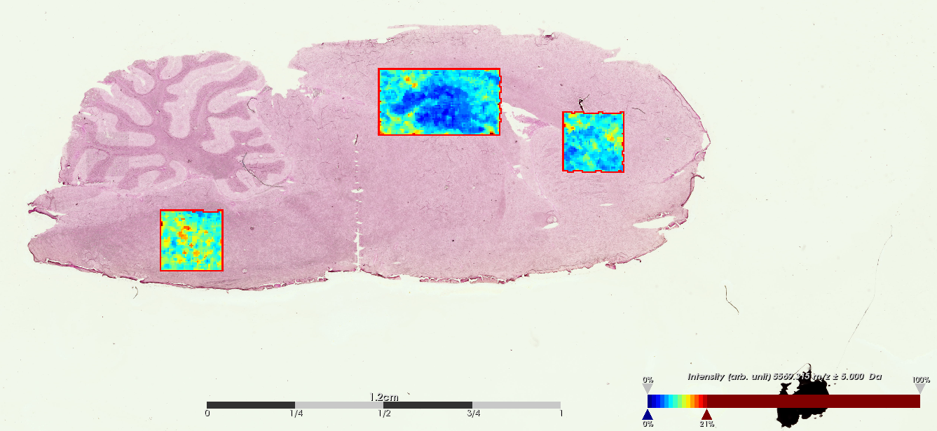
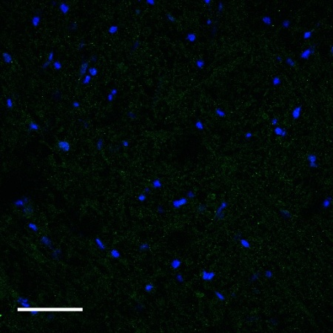
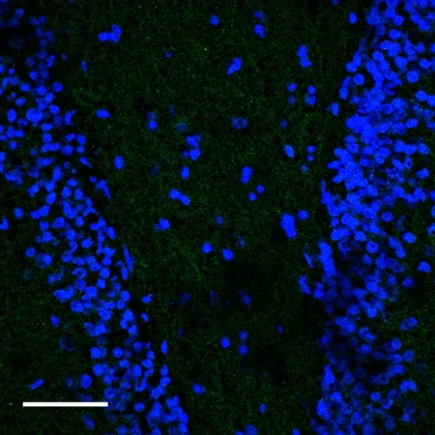
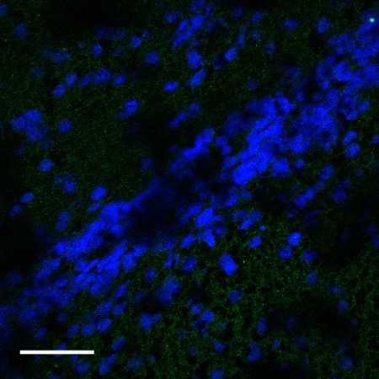
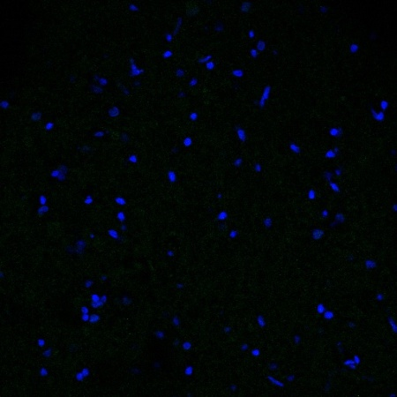
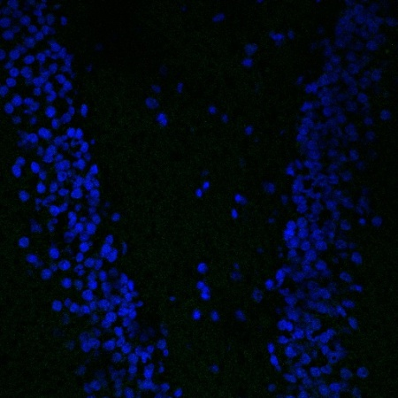

STMN1_RAT, P13668; Stathmin
Corpus callosum
Medulla oblongata
Hippocampus
Corpus callosum
Hippocampus
Control
Medulla oblongata
Stathmin immunofluorescence (Scale bar = 50 μm)

Slide 4
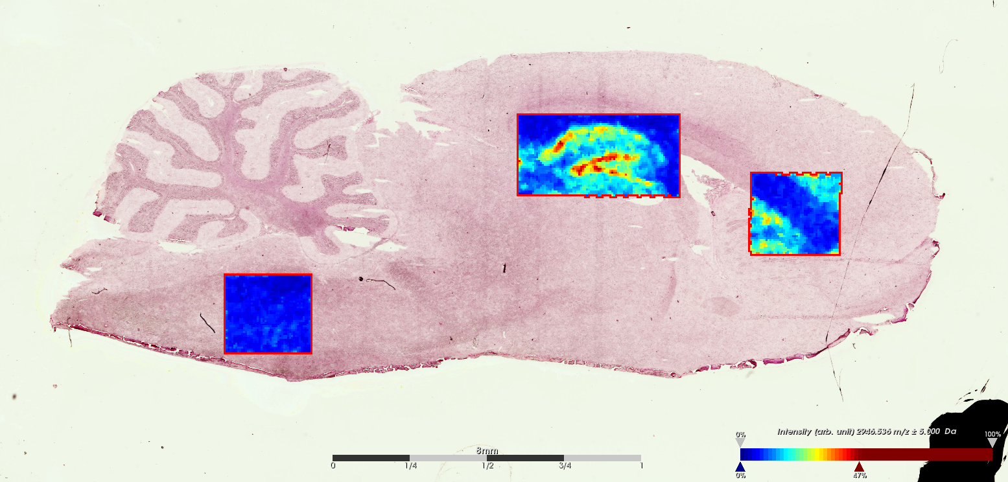
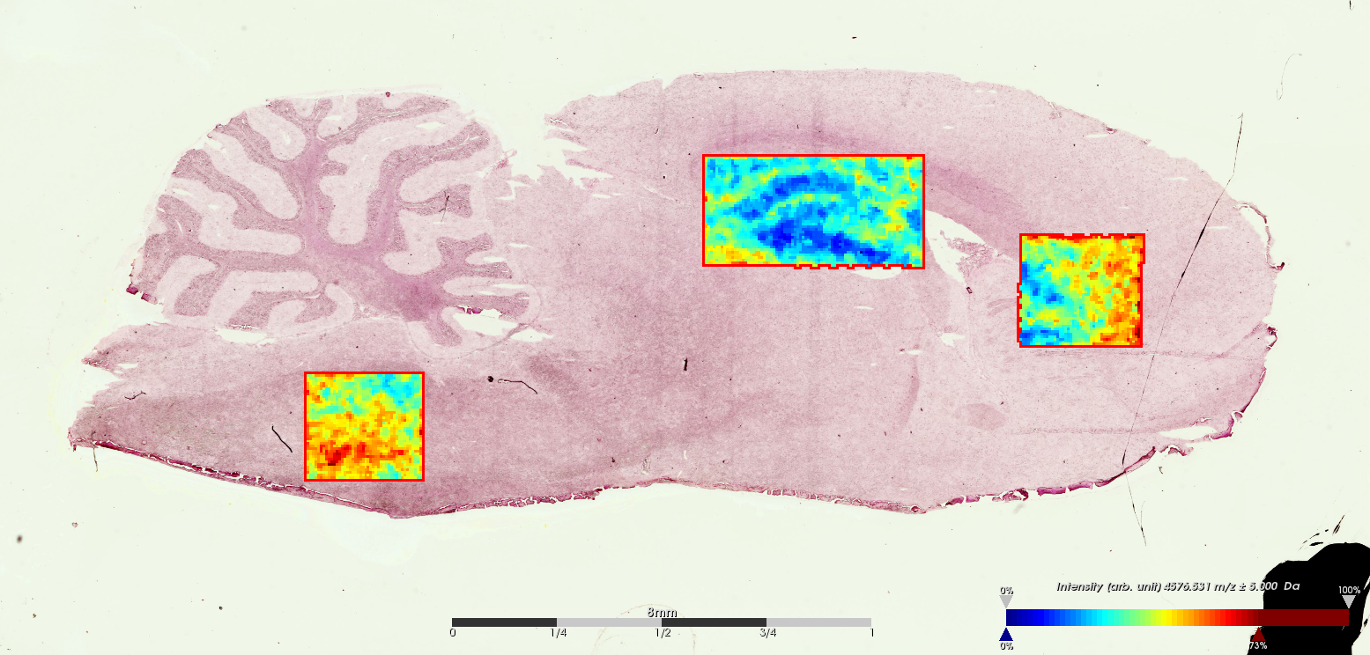
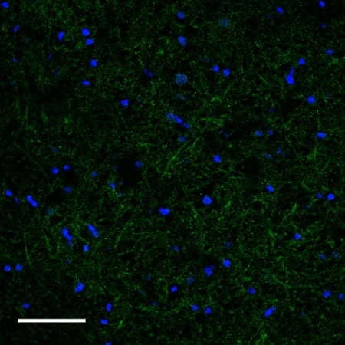
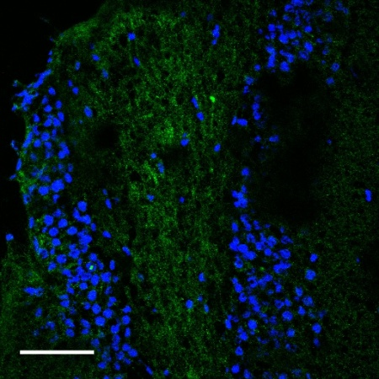
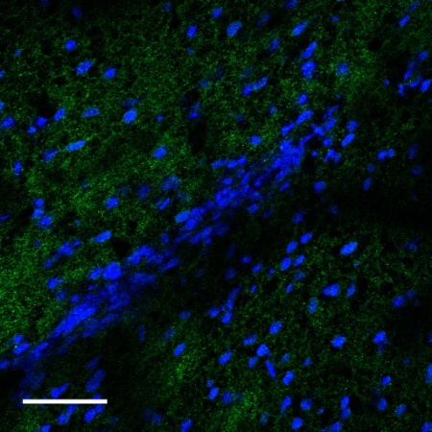
BASP1_RAT, Q05175; Brain acid soluble protein 1
m/z 2942.5
m/z 4568.15
Medulla oblongata
Hippocampus
Corpus callosum
Corpus callosum
Hippocampus
Control
Medulla oblongata
BASP1 immunofluorescence (Scale bar = 50 μm)

