Slide 1
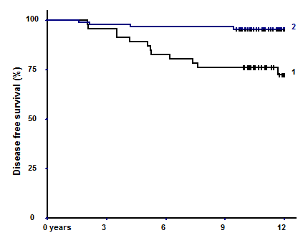
1 – non-solid architectural patterns
2 – solid architectural pattern

