Slide 1
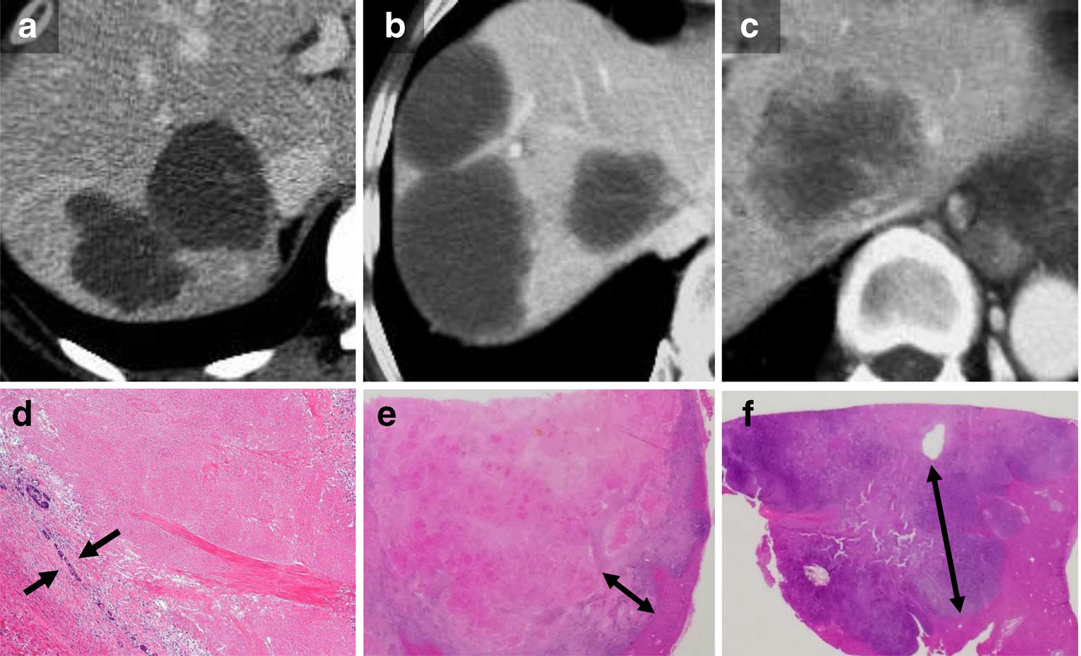
Supplemental figure S1.

