Slide 1
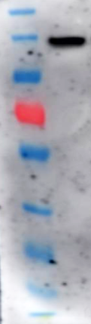
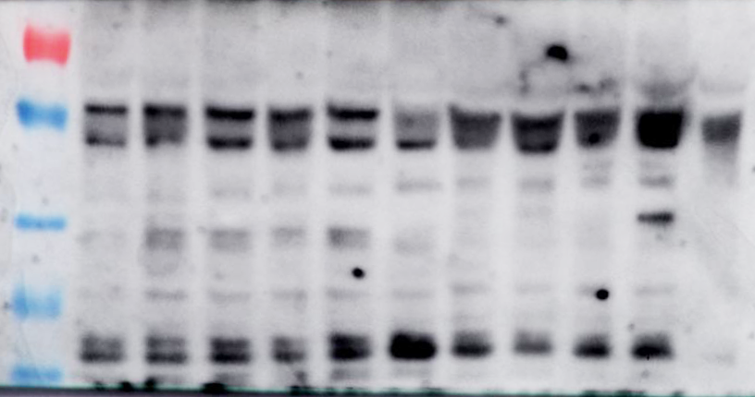
Supplementary Figure 1:
A
170
130
Intact TSHR
100
70
55
40
35
25
15
B
1
2
70
55
Unspecific
40
TSHR A-subunit
35
Unspecific
25

Slide 2
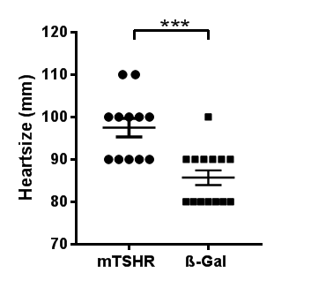
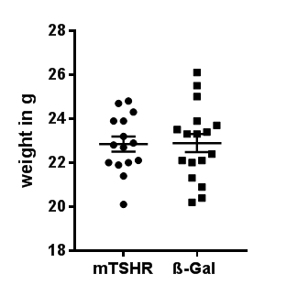
Supplementary Figure 2:
A
B

Slide 3
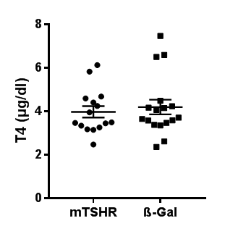
Supplementary Figure 3:
A

Slide 4
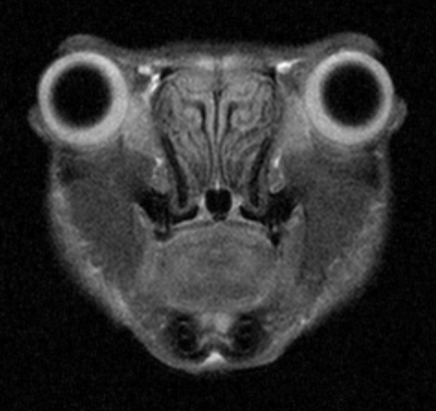
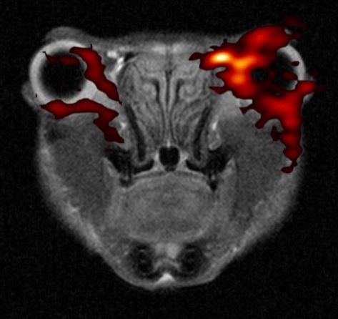
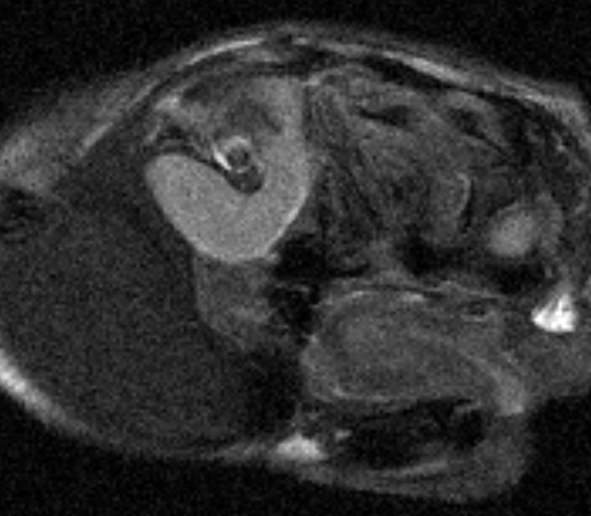
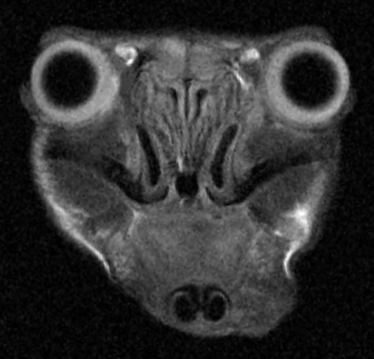
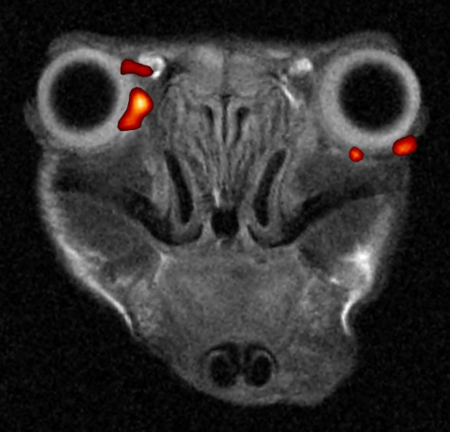
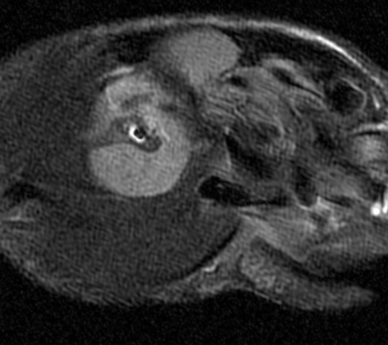
Supplementary Figure 4:
¹H MRI Overview
¹H+¹⁹F MRI
¹H MRI
A
C
E
Adipose tissue
Optic nerve
GO
Hadurian gland
B
D
F
Adipose tissue
Optic nerve
Ctrl
Hadurian gland

Slide 5
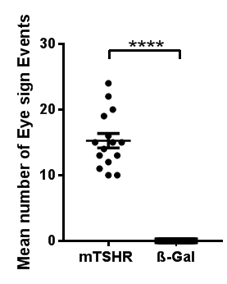
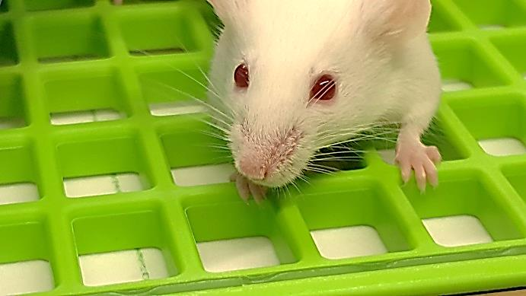
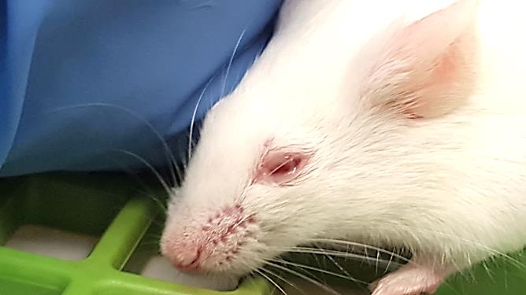
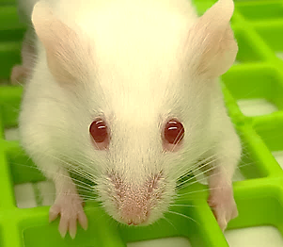
Supplementary Figure 5:
A
B
C
D

