Slide 1
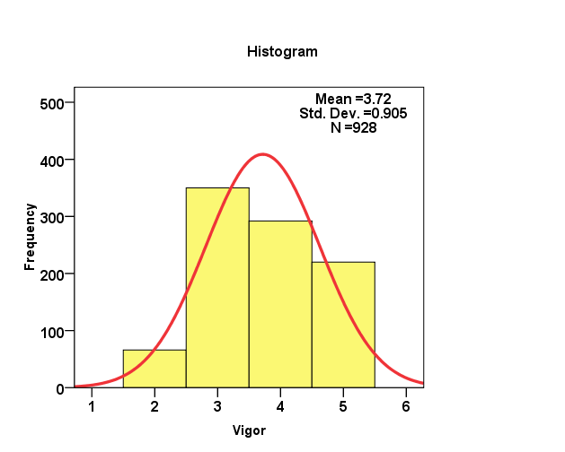
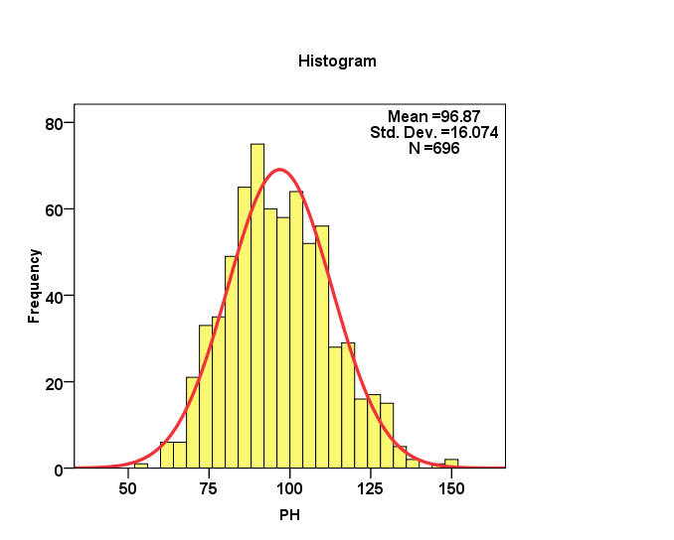
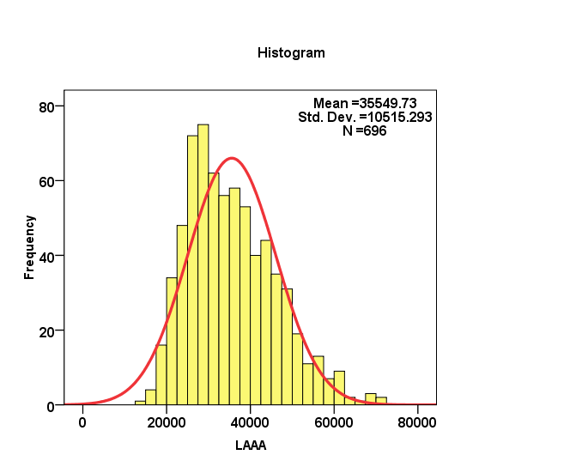
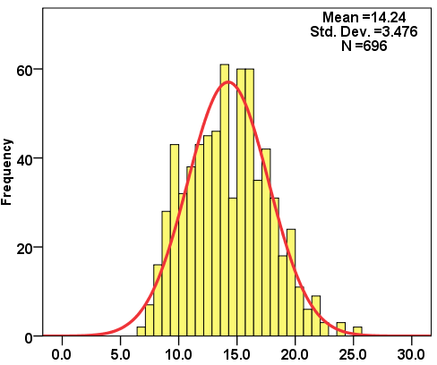
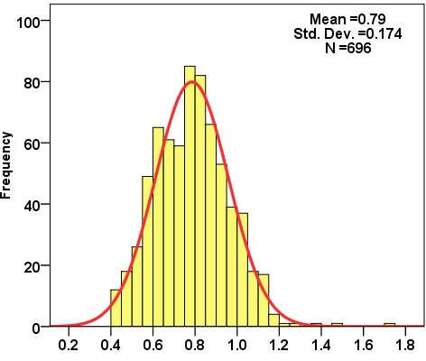
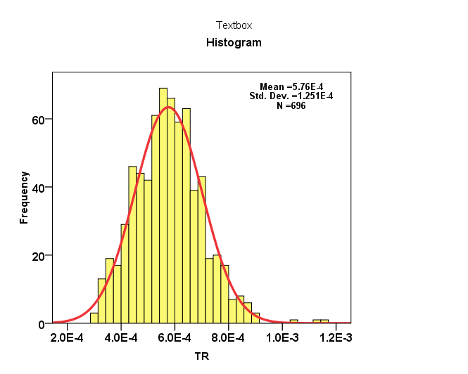
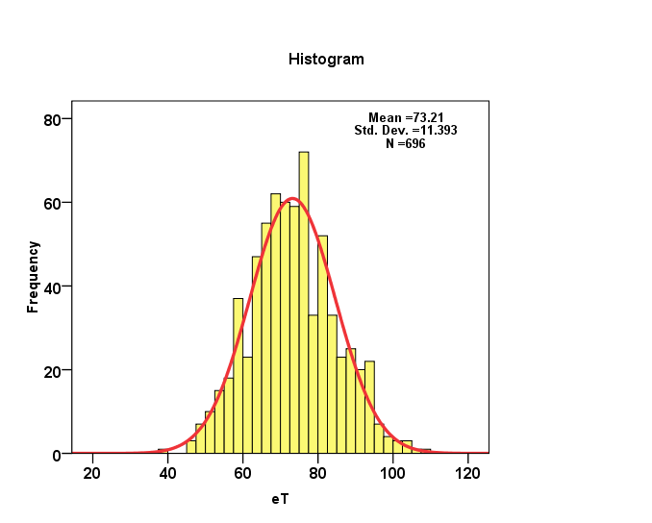
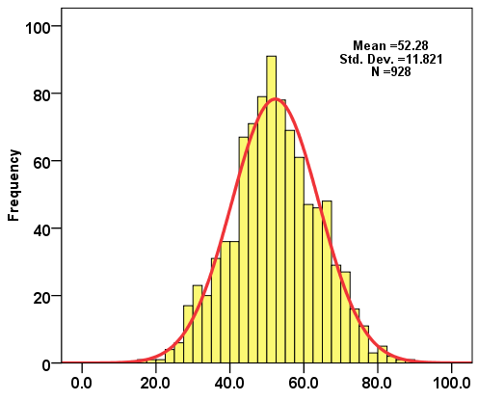
A
Plant vigour score
B
Plant height
C
3D-leaf area
D
Shoot dry weight
P1
P2
P2
P1
P2
P2
P1
P1
E
Transpiration rate
F
Evapotranspiration rate
G
Transpiration
H
Evapotranspiration
P1
P2
P2
P1
P1
P1
P2
P2

