Slide 1
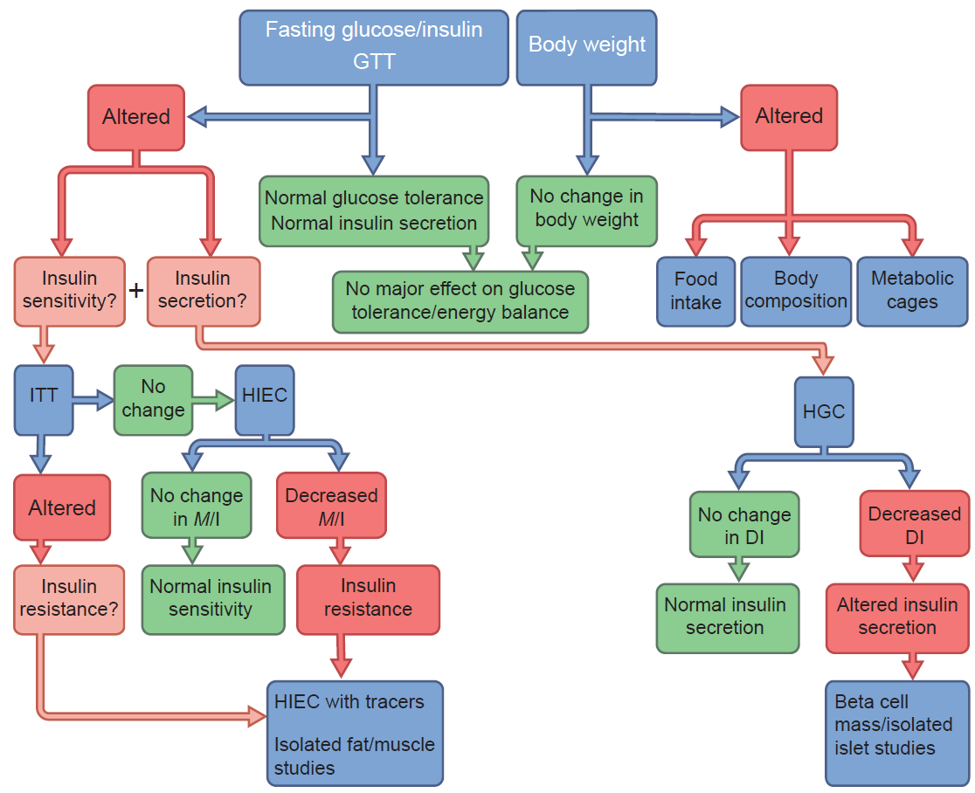
Proposed flowchart for the investigation of glucose and energy homeostasis in mice
Alquier and Poitout (2017) Diabetologia DOI 10.1007/s00125-017-4495-9
© Springer-Verlag GmbH Germany, part of Springer Nature 2017

