Slide 1
a
b
c
d
e
f
g
Supplemental Figure 1

Slide 2
a
b
c
Supplemental Figure 2

Slide 3
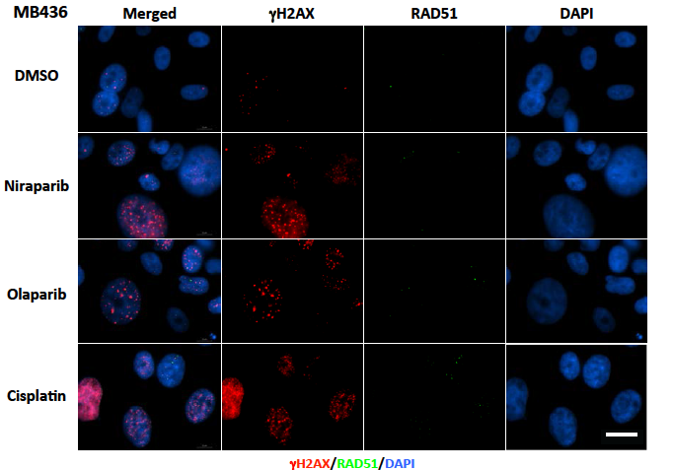
a
b
Supplemental Figure 3a-b

Slide 4
c
d
Supplemental Figure 3c-d

Slide 5
e
f
g
Supplemental Figure 3e-g

Slide 6
a
b
c
d
**
e
f
g
h
ns
ns
Supplemental Figure 4

