Slide 1
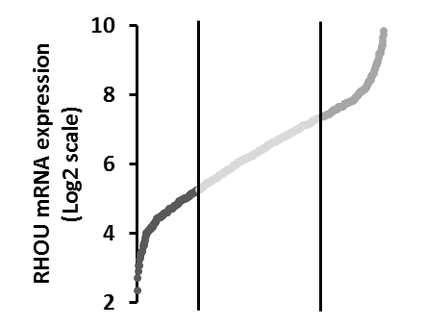
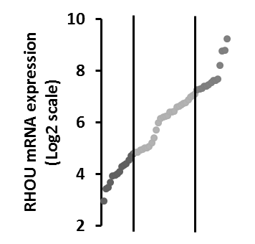
Supplementary Figure S1
a)
b)
4th
1st
c)
d)
4th
1st
Supplementary Figure S1: Patients with high and low RHOU expression have different overall survival. a) Strategy of division in RHOU expression quartiles of untreated MM patients before starting a TT2 or TT3 regimen (n=338; GSE2658) b) Kaplan Meier survival curves of patients on a TT2 or TT3 regimen having 1st and 4th quartiles of RHOU expression. Hazard ratio=1.50, 95% confidence interval=0.86 to 2.62 c) Strategy of division in RHOU expression quartiles of MM patients after various lines of therapy before starting a TT6 regimen (n=55; GSE57317) d) Kaplan Meier survival curves of patients on a TT6 regimen having 1st and 4th quartiles of RHOU expression. Hazard ratio=7.12, 95% confidence interval=1.43 to 35.37; Gehan-Breslow-Wilcoxon test was used to calculate Chi square and p values.

