Slide 1
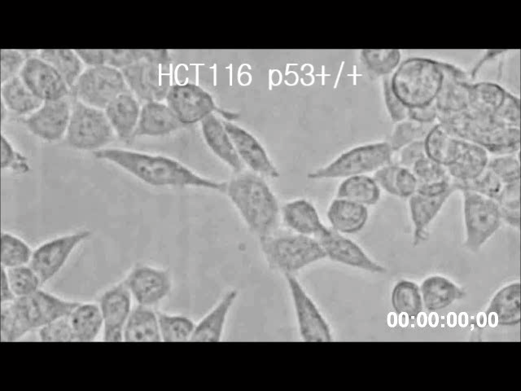
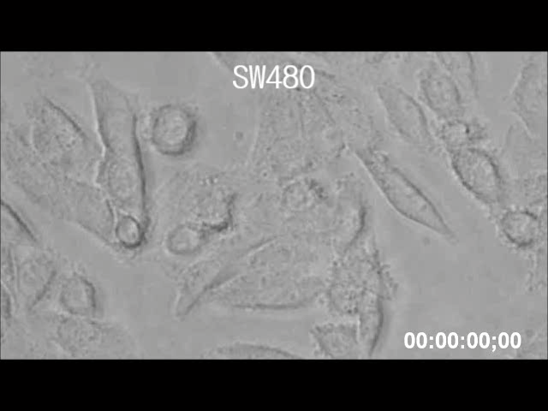
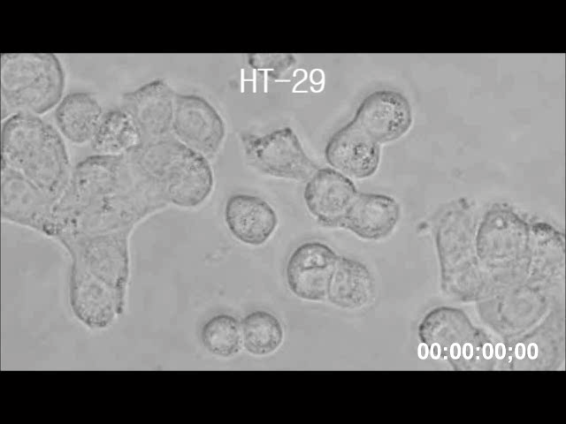
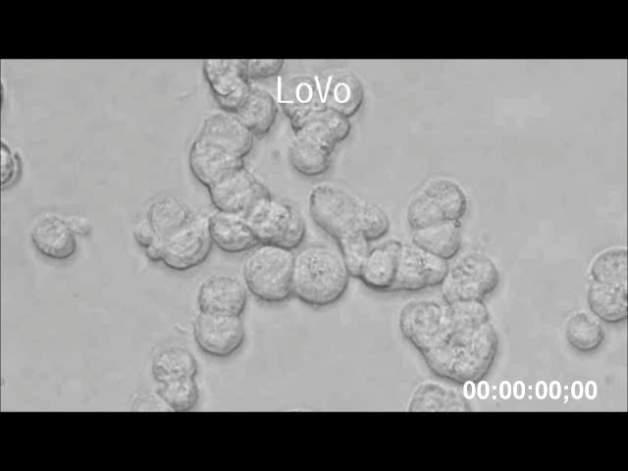
Supplementary Video 1: Morphological changes by HPA3P in colon cancer cells. The indicated cell lines were treated with HPA3P (LoVo and HT-29, 30 μM/ml; SW480 and HCT116 p53^{+/+}, 50 μM/ml) for approximately 20 min. Immediately after treatment, a video was recorded using an Olympus IX71 fluorescence microscope (magnification PlanC N 40X).

