Slide 1
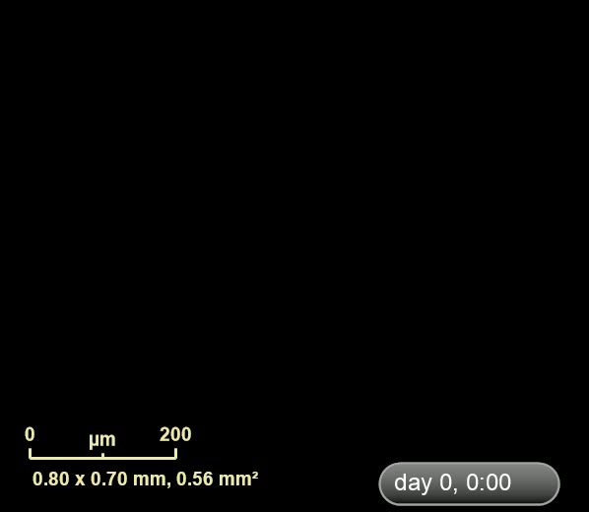
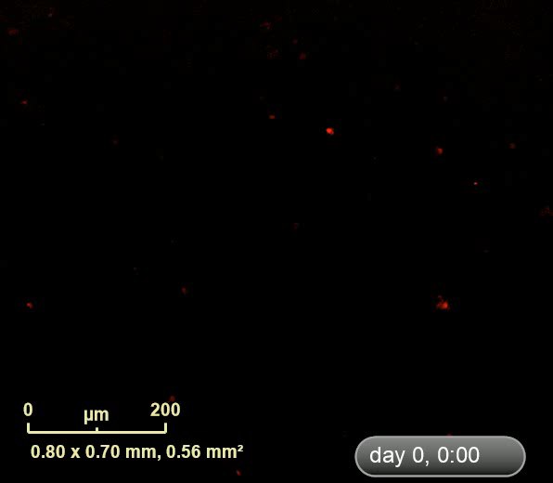
Supplementary Video 2: Penetration of HPA3P into HCT116 p53^{+/+} cells. HCT116 p53^{+/+} cells were treated with 30 μM/ml rhodamine-labelled HPA3P, and then fluorescence was measured for 20 min using an IncuCyte ZOOM imaging system.

