Slide 1

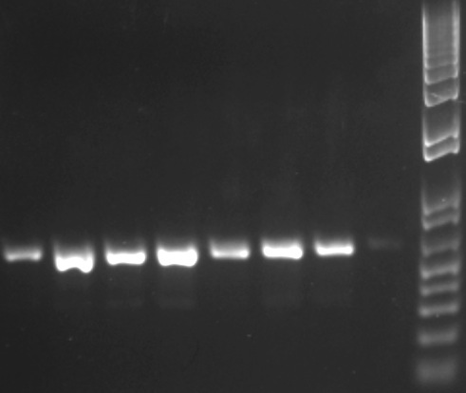
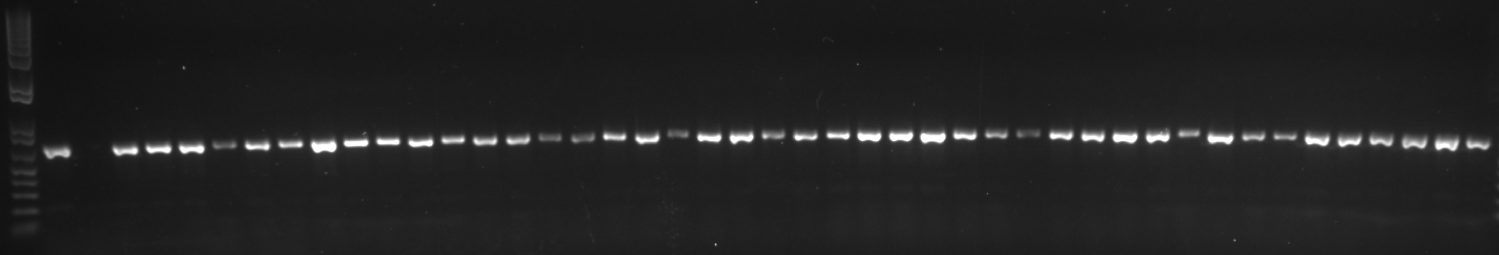
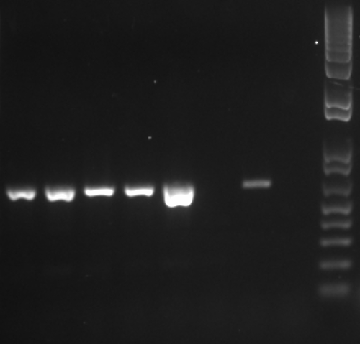
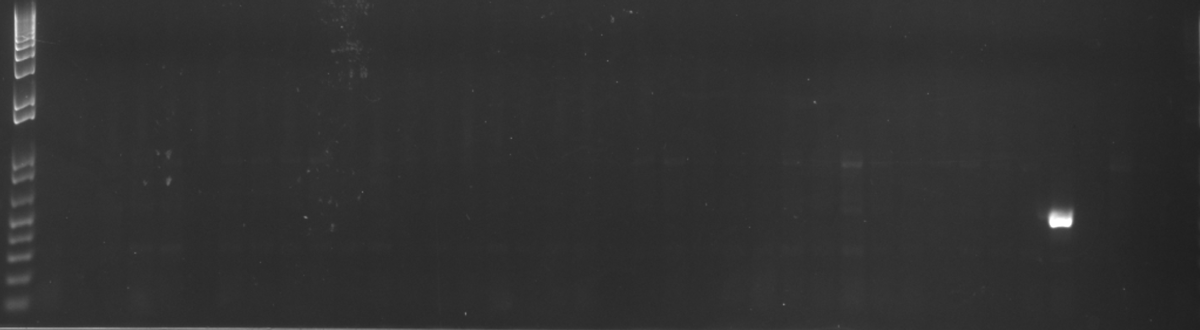
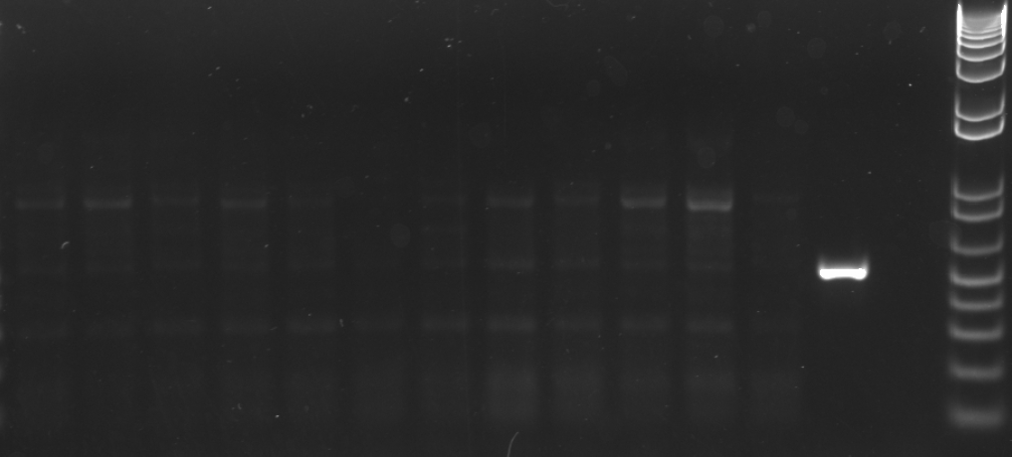

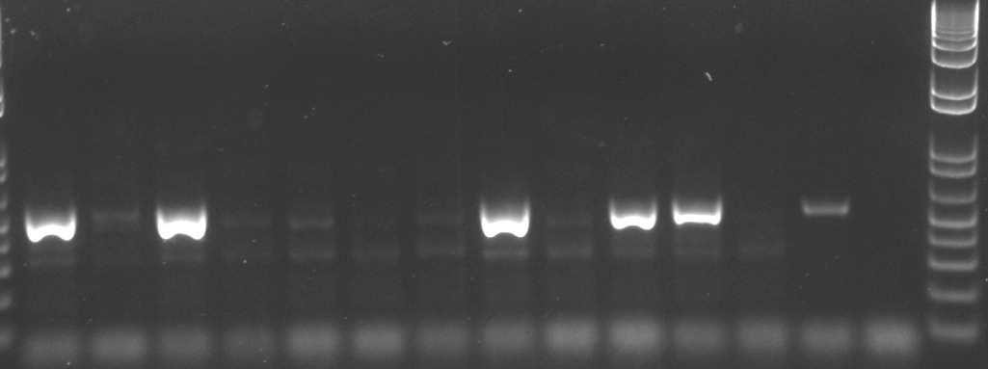
β-tub
M
M
555bp
A B wt C-
1 2 3 4 5 6 7 8 9 10 11 12 13 14 15 16 17 18 19 20 21 22 23 24 25 26 27 18 29 30 31 32 33 34 35 36 37 38 39 40 41 42 43 44
Beta
Paro
M
M
626bp
ABwtPC-
Kan
M
M
512bp
ABwtPC-
Luc
M
M
528bp
A B wtPC-

