Slide 1
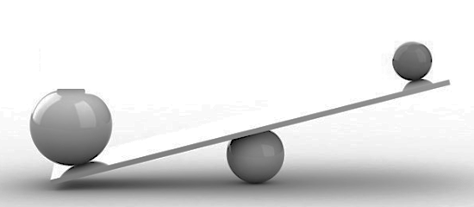
Resilient health lifts
Adaptive Capability
Doing
well (0-1pt)
Managing score
Some
problems (2-3pts)
BPS* health
loads
Many
problems (4-5pts)
Intervention
Levers
Overwhelming problems (6pts)
Helping to maintain low loads, and reduce them
Loads are identified, rendered transparent
Levers are matched to loads
Lifts made weightier to outweigh loads
*Biopsychosocial

