Slide 1
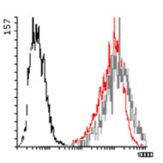
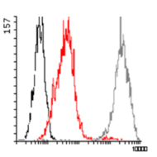
A
β1,3GalT
ST3GAL1
T
Sialyl-T
N-acetylgalactosamine (GalNAc)
Galactose (Gal)
Sialic acid (Sia)
B
C
D
HT1376_{T}
100
500
Cell number
ST3GAL1 activity (nmol/h μg prot)
ST3GAL1 mRNA (⁰/₀₀ of β-actin)
50
250
HT1376_{sT}
0
0
Log fluorescence intensity
HT1376 T
HT1376 sT
HT1376 T
HT1376 sT
Fig. S1. ST3GAL1-overexpression in HT1376 cells.
A: Illustration of the structure and biosynthesis of T and sT carbohydrate structures. Enzymes involved in the biosynthesis include β1,3 galactosyltransferase, β1,3GalT, and sialyltransferase ST3GAL1. Monosaccharides are represented by a yellow square: N-acetylgalactosamine (GalNAc); yellow circle: galactose (Gal); purple diamond; sialic acid (Sia).
B: Characterization by FACS analysis of PNA-FITC-stained HT1376_{sT}, and mock-transduced HT1376_{T.} Black lines: unlabeled cells; red lines: PNA-FITC-labelled cells; grey lines: sialidase-treated and PNA-FITC-labelled cells.
C: ST3GAL1 activity in HT1376_{sT} and HT1376_{T} cells was measured by using benzyl-T as acceptor substrate. Data are the mean ± SD of three experiments.
D: ST3GAL1 transcript abundance was measured by real time RT PCR and expressed as ST3GAL1 mRNA molecules/1000 β-actin molecules. Data are the mean ± SD of three experiments.
Fig. S1

