Slide 1
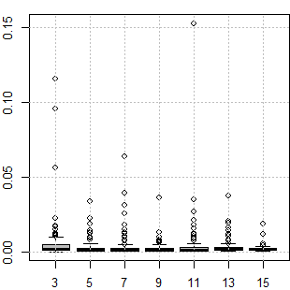
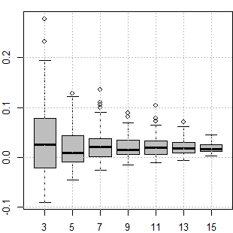
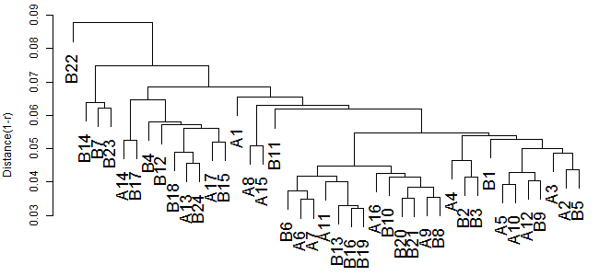
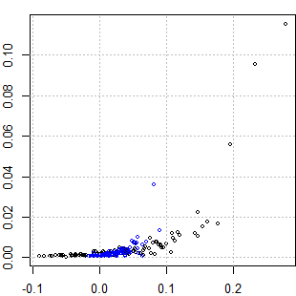
(a)
(b)
percentage of DEGs with 10% FDR (P_{DEG})
average silhouette (AS)
(c)
number of replicates (N_{rep})
number of replicates (N_{rep})
(d)
percentage of DEGs with 10% FDR (P_{DEG})
average silhouette (AS)

Slide 2
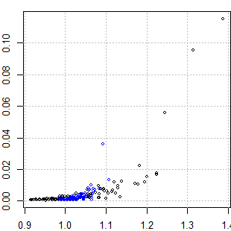
(e)
(f)
percentage of DEGs with 10% FDR (P_{DEG})
percentage of DEGs with 10% FDR (P_{DEG})
signal-to-noise ratio (SNR)
average silhouette (AS)

