Slide 1
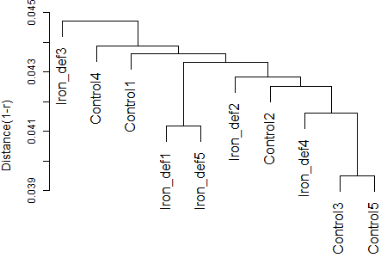
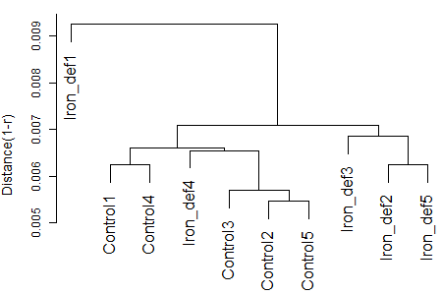
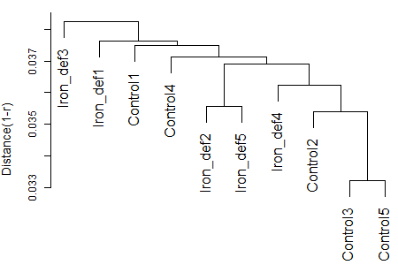
(a) MAS-quantified data
P_{DEG} = 0.02%
AS = 0.005
(b) RMA-quantified data
P_{DEG} = 0.00%
AS = 0.029
(c) RobLoxBioC-quantified data
P_{DEG} = 0.00%
AS = 0.010

