Slide 1
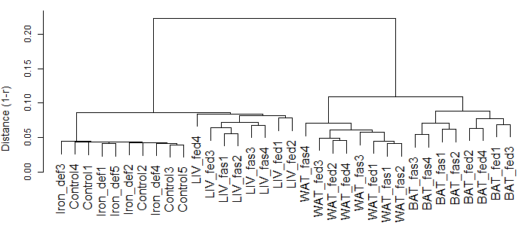
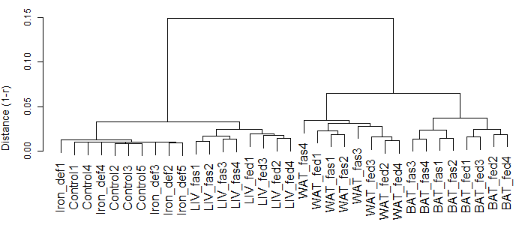
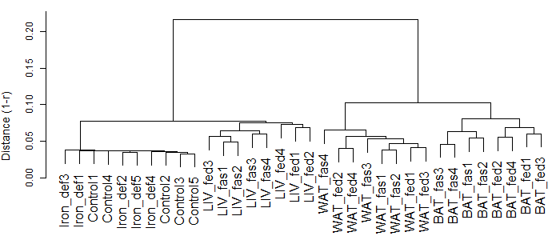
(a) MAS-quantified data
(b) RMA-quantified data
(c) RobLoxBioC-quantified data

