Slide 1
Supplemental Table 1. Primer list of gene primers analyzed by quantitative RT-PCR
Gene | Primer sequence
human β2-MG | forward: 5’-tga ctt tgt cac agc cca aga ta-3’
 | reverse: 5’-aat cca aat gcg gca tct tc-3’
 | probe: FAM-tga tgc tgc tta cat gtc tcg atc cca-TAM
human hepcidin | forward 5’-cag gac aga gct gga gcc a -3’
 | reverse: 5`-gca gca cat ccc aca ctt tg-3`
 | probe: FAM-ctg ctg cgg ctg ctg tca tcg a-TAM
human NOX4 | forward: 5’- cca tat tac ctg tgg tgt tac tat ctg -3’
 | reverse: 5’- aag ttg agg gca ttc acc ag -3’
 | probe UPL # 5 (Roche)
human SOCS3 | forward: 5’- aga ctt cga ttc ggg acc a -3’
 | reverse: 5’- aac ttg ctg tgg gtg acc a -3’
 | probe UPL # 70 (Roche)
Suppl. Table S1

Slide 2
Supplemental Table 2. Antibodies and dilutions
antigen | host species | dilution | Company | cat. no.
pSTAT3 (Tyr705) | rabbit | 1 :1000 | Cell Signaling | 9145
STAT3 | mouse | 1 :1000 | Cell Signaling | 9139
JAK1 | rabbit | 1 :1000 | Cell Signaling | 3344
JAK2 | rabbit | 1 :1000 | Cell Signaling | 3230
IL-6 receptor | rabbit | 1 :1000 | Santa Cruz | Sc-661
HIF1α | mouse | 1 :1000 | BD Biosciences | 610959
PHD-2 | rabbit | 1 :2000 | Abcam | Ab4561-100
β-actin | mouse | 1 :4000 | Sigma | A1978
Prx2 | goat | 1 :5000 | R&D Systems | AF3489
NOX4 | rabbit | 1 :1000 | Abcam | ab133303
rabbit Ig | goat - HRP conj | 1 :3000 | Rockland | 611-1322
goat Ig | rabbit - HRP conj | 1:5000 | Rockland | 605-4313
mouse Ig | goat - HRP conj | 1 :3000 | Abcam | ab6789-1
Suppl. Table S2

Slide 3
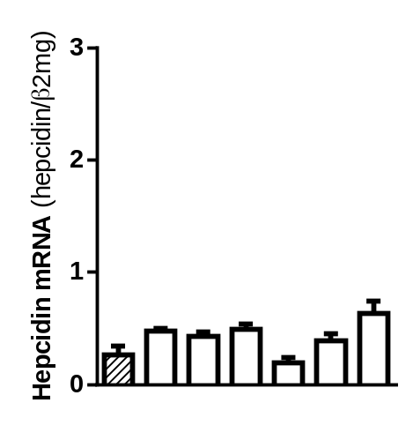
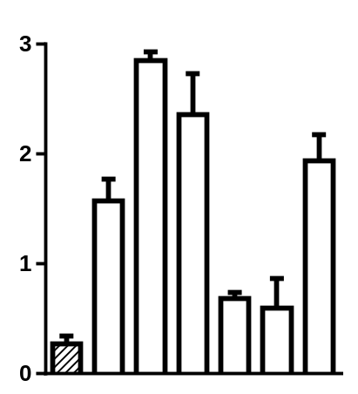
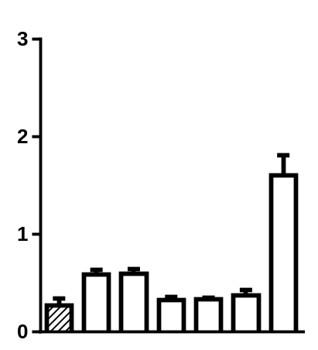




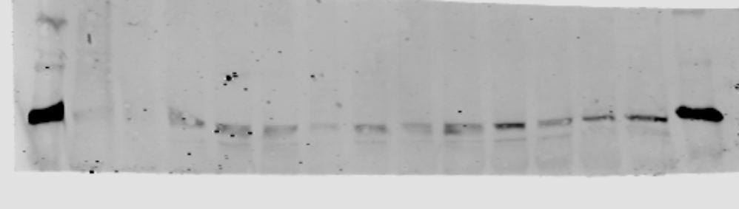

Normoxia 21% O₂
Hypoxia 5% O₂ –
GOX/CAT system
Hypoxia 5% O₂ –
Hypoxia chamber
3
3
3
2
2
2
Hepcidin mRNA (hepcidin/β2mg)
Hepcidin mRNA (hepcidin/β2mg)
Hepcidin mRNA (hepcidin/β2mg)
1
1
1
0
0
0
Prx2
HIF-1α
pSTAT3
STAT3
Time (h)
0
2
4
6
8
12
24
0
2
4
6
8
12
24
0
2
4
6
8
12
24
Supplemental Figure S1: Kinetics of hepcidin and signaling molecules during rapid and slow onset of hypoxia. Hypoxia (5% O₂) was induced in Huh7 cells either by the hypoxia chamber or the enzymatic GOX/CAT system. Changes in hepcidin mRNA levels and protein expression (oxidized Prx2, HIF1α, pSTAT3 and STAT3) are shown for a representative experiment. Hepcidin mRNA was quantified by quantitative real-time PCR and the results are represented as mean of hepcidin mRNA levels normalized to β2-microglobulin ± SD. Representative data of at least three independent experiments are shown for protein data.
Suppl. Figure S1

Slide 4
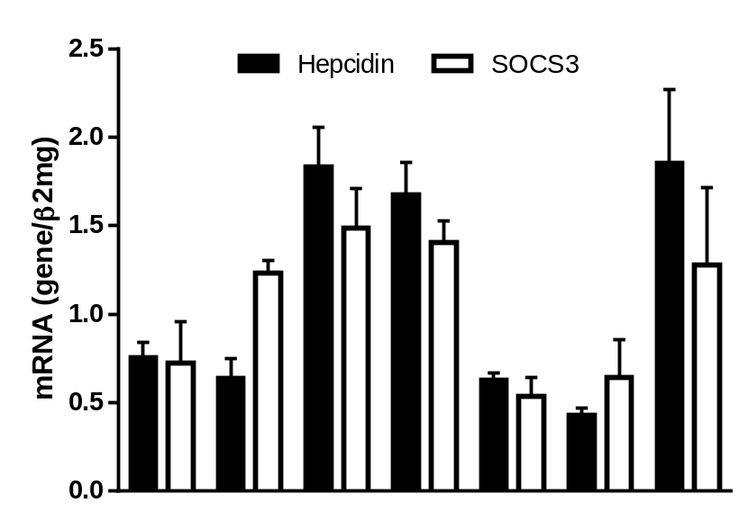
2.5
Hepcidin
SOCS3
2.0
1.5
mRNA (target gene/β2mg)
1.0
0.5
0.0
Time (h)
0
1
2
4
8
12
24
Supplemental Figure S2. Kinetics of hepcidin and SOCS3 mRNA levels during hypoxia. The pSTAT3-mediated co-induction of the STAT3-inhibitor SOCS3 explains the bimodal pattern of hepcidin. Huh7 were exposed to 5% O₂ over 24 hours using the GOX/CAT system. Hepcidin and SOCS3 mRNA was quantified by quantitative real-time PCR and the results are represented as mean of mRNA levels normalized to β2-microglobulin ± SD.
Suppl. Figure S2

Slide 5
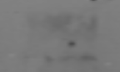

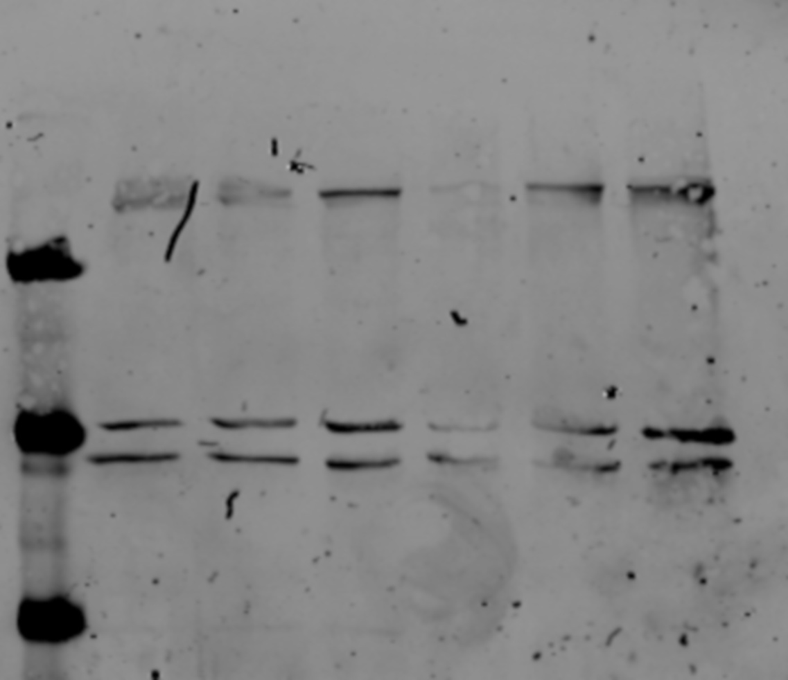
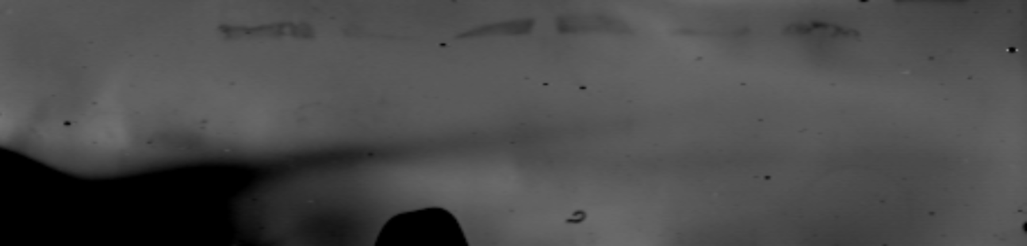

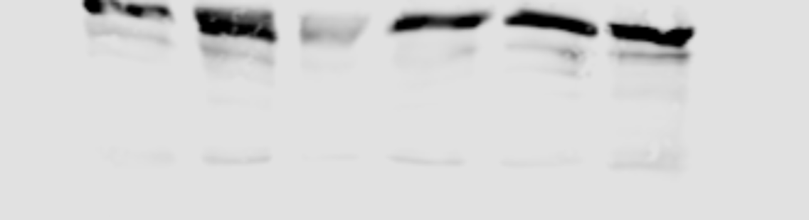
Control
siRNA
KDa
IL-6 R
80
JAK1
130
JAK2
125
STAT3
80
Supplemental Figure S3. Western blot analysis on IL-6 receptor, JAK1, JAK2 and STAT3 to confirm efficient siRNA-mediated silencing. The cells were transfected for 48 h with specifically directed siRNA against individual molecules of the JAK-STAT3 signaling or universal negative siRNA as a control. The dividing lines mark the borders of immunoblots obtained from different sections of a gel.
Suppl. Figure S3

Slide 6
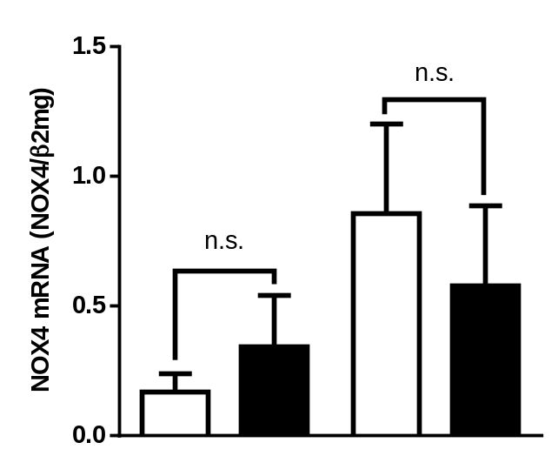
1.5
n.s.
1.0
NOX4 mRNA (NOX4/β2mg)
n.s.
0.5
0.0
O₂ level
21%
5%
Control siRNA
+
-
+
-
STAT3 siRNA
-
+
-
+
Supplemental Figure S4. STAT3 is not involved in the hypoxia-mediated NOX4 induction. Huh7 hepatoma cells were transfected with siRNA against STAT3 or with universal negative siRNA control and conditioned to 21 or 5% O₂ over 24 h. No significant differences in NOX4 mRNA expression were found between control and STAT3 siRNA transfected cells. NOX4 mRNA was analyzed by quantitative real-time PCR and the results are expressed as mean of NOX4 mRNA levels normalized to β2-microglobulin ± SD. n.s.: not significant
Suppl. Figure S4

Slide 7
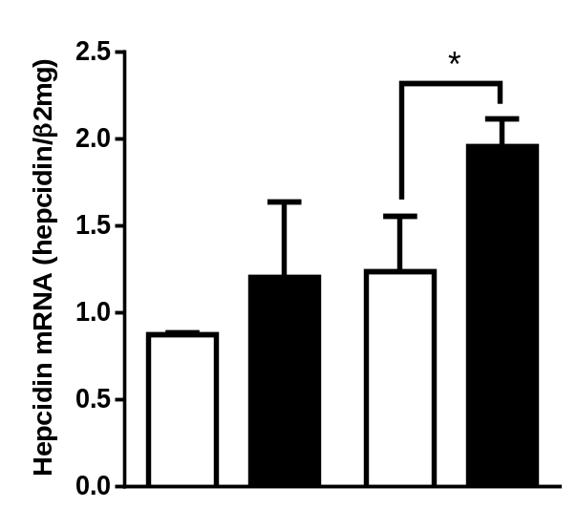
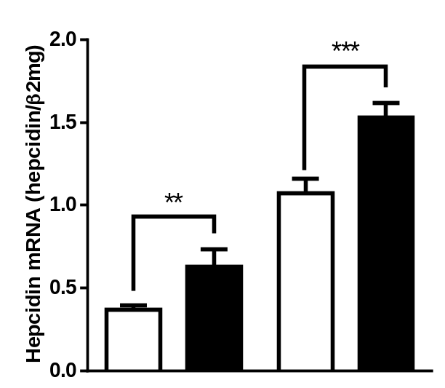
A
B
2.5
*
2.0
***
2.0
1.5
1.5
Hepcidin mRNA (hepcidin/β2mg)
Hepcidin mRNA (hepcidin/β2mg)
1.0
**
1.0
0.5
0.5
0.0
0.0
O₂ level
21%
5%
O₂ level
21%
5%
Rotenone
-
+
-
+
UOX
-
+
-
+
Supplemental Figure S5. Induction of hepcidin by other intracellular H₂O₂-sources under hypoxia. (A) Mitochondrial release of H₂O₂ by Rotenone increases hepcidin mRNA levels. Huh7 cells were conditioned to 21 or 5% O2 and treated for 4 h with rotenone (10 µM). After the treatment with rotenone the induction on hepcidin mRNA levels was potentiated under hypoxic conditions. (B) Overexpression of urate oxidase (UOX) induces hepcidin mRNA expression. The cells were transfected with a UOX promoter construct for 48 h and then conditioned to a 5% O₂ atmosphere for additional 24 h in the presence of 100 µM urate. The cells transfect with UOX promoter construct presented a significantly higher hepcidin mRNA expression and the increase was potentiated under low O2 conditions. Hepcidin mRNA was quantified by quantitative real-time PCR and the results are expressed as mean of hepcidin mRNA levels normalized to β2-microglobulin ± SD. Significant differences are marked by asterisks (*, P < 0.05; **, P < 0.01; ***, P < 0.001).
Suppl. Figure S5

