Slide 1
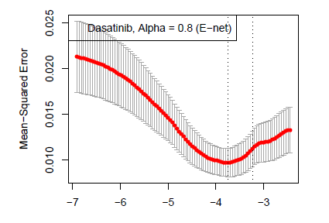
Supplemental Figure 1
Notes:
Supplemental Figure 1: Leave-one-out cross-validation of the elastic net regression model of thyroid cancer dasatinib sensitivity. Tuning parameter λ is plotted on the x-axis. The optimal model (λ = -3.8, marked by dotted line) outperformed the null model (resulted in low mean-squared error).

