Slide 1
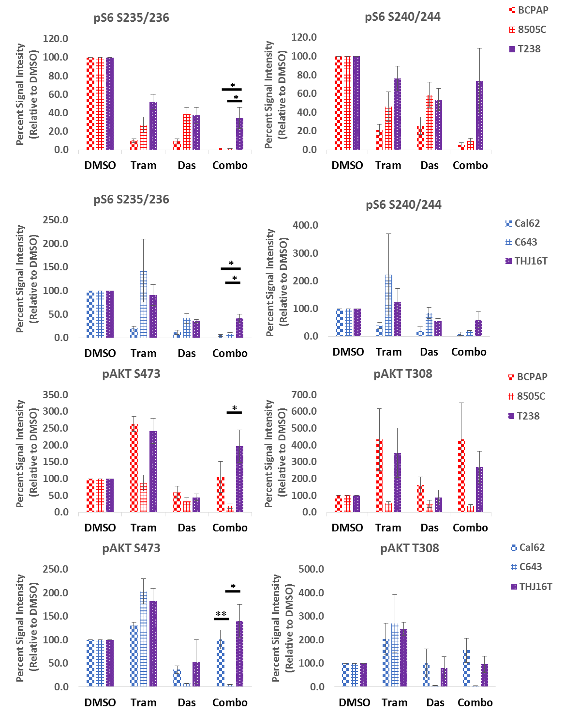
Supplemental Figure 2
A.
B.
Notes:
Figure S2: Quantification of rpS6 phosphorylation. Densitometry quantification of rpS6 phosphorylation at S235/236 and S240/244 in BCPAP, 8505C, T238, Cal62, C643, and THJ16T cell lines following a 24 hour treatment with 100nM trametinib, 100nM dasatinib, the combination, or an equivalent amount of DMSO. Quantification is based on at least 3 independent replicates for each cell line. Data as means +/- SEM (n=3; student t-test; *, P < 0.05).

