Slide 1


KD
p-ERK1/2
42,44
t-ERK1/2
42,44
GAPDH
38
RBE
OCUG
MzCha-1
KKU213
Huh28
HuCCT1
KMCH
Supplemental Figure 1: MAPK pathway status in the panel of 7 human CCA cell lines. p-ERK1/2 expression was detected using Western blotting. Total (t-)ERK1/2 and GAPDH were used as loading control.

Slide 2
A
KMCH
B
KMCH
a
a
a
a
b
b
b
b
a
c
c
b
c
a
a
a
b
b
b
a
b
a
a
c
b
a
b
a
a
b
c
b
b
c
a
a
b
Supplemental Figure 2: Effect of the MEK inhibitors U0126 and PD901 on the cell proliferation and apoptosis of K-Ras wild-type KMCH and Huh28 human CCA cell lines. (A and B) Cell proliferation and apoptosis rates of KMCH cells treated with U0126 (A) or PD901 (B). (C and D) Cell proliferation and apoptosis rates of Huh28 cells treated with U0126 (C) or PD901 (D). Tukey Kramer test, p<0.05, a: vs untreated cells; b: vs DMSO treated cells; c: vs PD901 0.1µM.
C
Huh28
D
Huh28
a
a
a
a
b
a
b
b
a
c
a
b
c
c
a
a
b
b
a
c
a
b
a
b
a
c
a
b
a
b
b
c
b
a

Slide 3
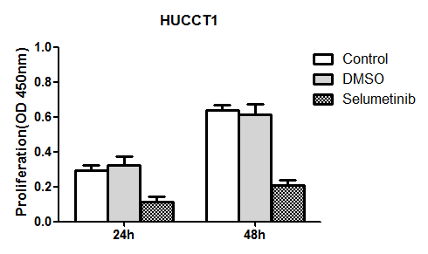
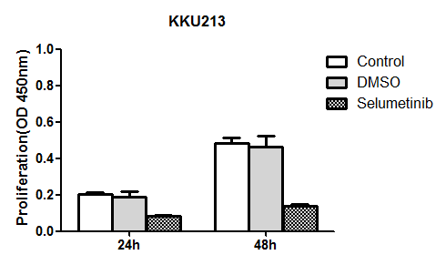
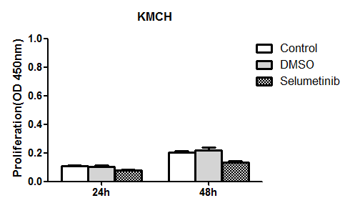
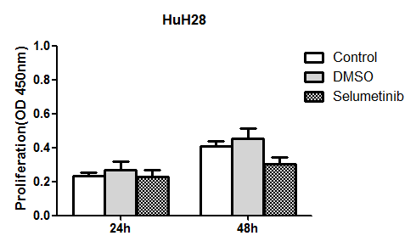
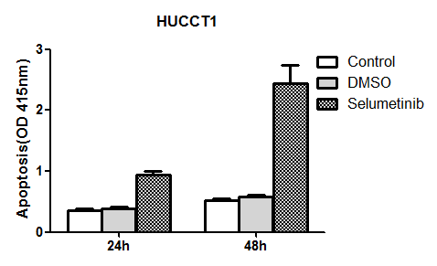
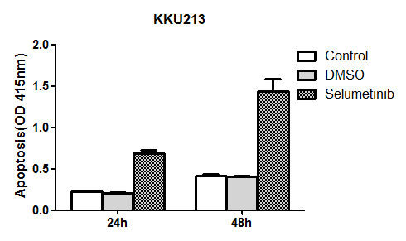
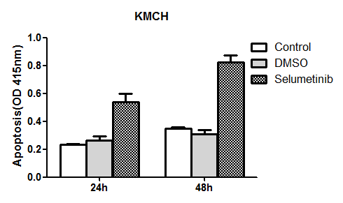
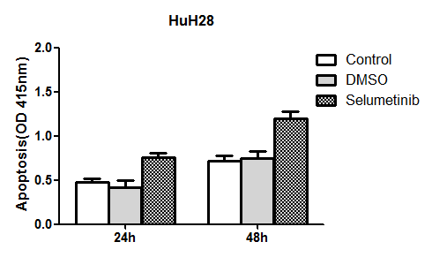
A
a
b
a
b
a
b
a
b
a
b
a
b
a
b
B
a
b
a
b
a
b
a
b
a
b
a
b
a
b
a
b
a
a
a
a
a
a
Supplemental Figure 3. Effect of the MEK inhibitor Selumetinib on the cell proliferation and apoptosis of K-Ras mutant (HUCCT1, KKU213) and wild-type (KMCH, HuH28) human cholangiocarcinoma (CCA) cell lines. (A) Cell proliferation in the four CCA cell lines. (B) Apoptosis. Tukey-Kramer's test: P at least < 0.05; a, vs. control (untreated cells); b, vs. DMSO (solvent).

Slide 4
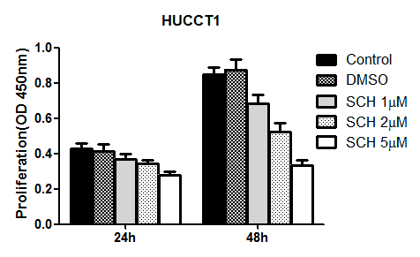
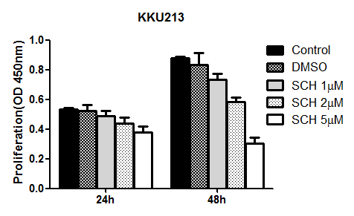
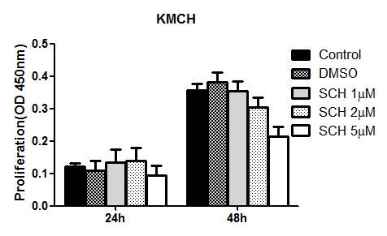
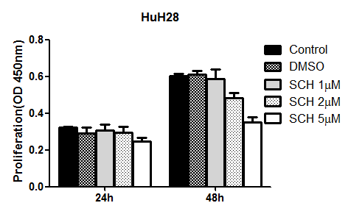
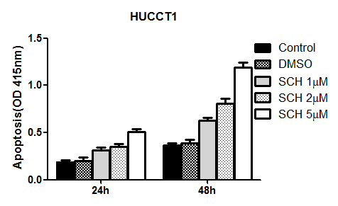
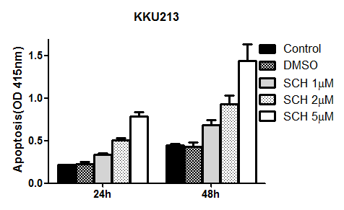
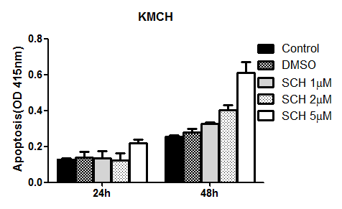
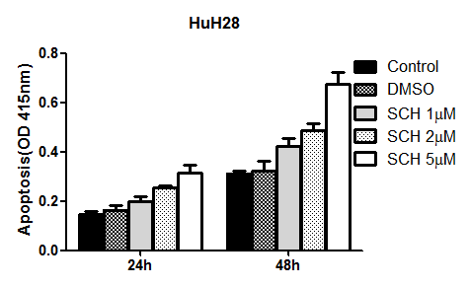
A
a
b
a
b
c
a
b
c
d
a
b
a
b
c
a
a
b
a
b
c
d
a
b
c
a
b
c
d
a
b
c
a
b
c
d
a
b
c
d
a
b
c
a
b
c
d
a
b
c
d
a
b
a
c
d
a
a
B
a
b
c
d
a
b
c
d
a
b
c
d
a
b
c
d
a
b
c
a
b
c
d
a
b
c
a
b
c
a
b
c
d
a
b
c
a
b
c
d
a
b
a
b
a
b
c
d
a
b
c
a
b
a
b
c
a
b
c
a
b
a
b
a
b
a
a
b
a
Supplemental Figure 4. Effect of the ERK1/2 inhibitor SCH772984 on the cell proliferation and apoptosis of K-Ras mutant (HUCCT1, KKU213) and wild-type (KMCH, HuH28) human cholangiocarcinoma (CCA) cell lines. (A) Cell proliferation in the four CCA cell lines. (B) Apoptosis. Tukey-Kramer's test: P at least < 0.05; a, vs. control (untreated cells); b, vs. DMSO (solvent); c, vs. SCH772984 1µM; d, vs. SCH772984 2µM.

