Slide 1
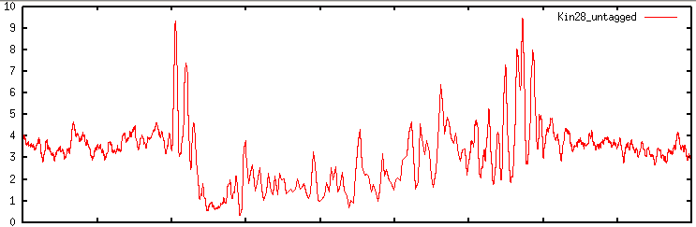
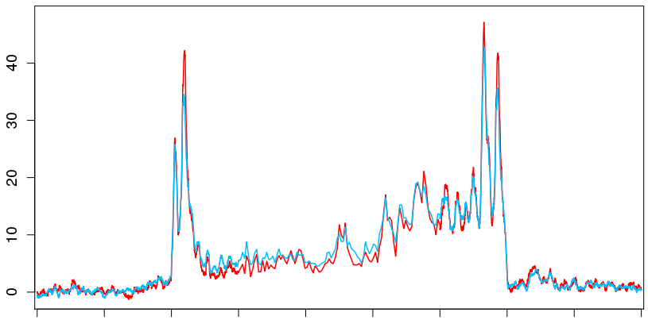

Untagged control kin28-AA yeast
Normalized Occupancy (RPM)
-2kb
0kb
1kb
-1kb
TES
2kb
Average Med15 and Med17 Occupancy in med18∆ kin28-AA yeast
Med15
Med17
Normalized Occupancy (RPM)
-2kb
0kb
1kb
-1kb
TES
2kb
Ty1
Ty1i
S3 Figure
Notes:
Fig S1

