Slide 1
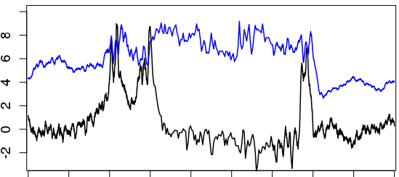
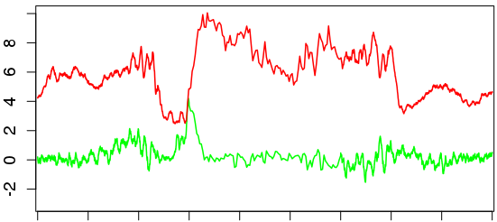
Average Pol II and Med17 (head module) occupancy in wild type and tail module deletion mutants
Med17 WT
Pol II WT
TSS-2kb TSS TSS+1kb TES-1kb TES TES+2kb
Med17 med2∆ med3∆ med15∆
Pol II med3∆ med15∆
TSS-2kb TSS TSS+1kb TES-1kb TES TES+2kb
S4 Figure

