Slide 1
Supplemental Table 1. Details of monoclonal Abs used for cell surface and intracellular cytokine/mediator staining.

Slide 2
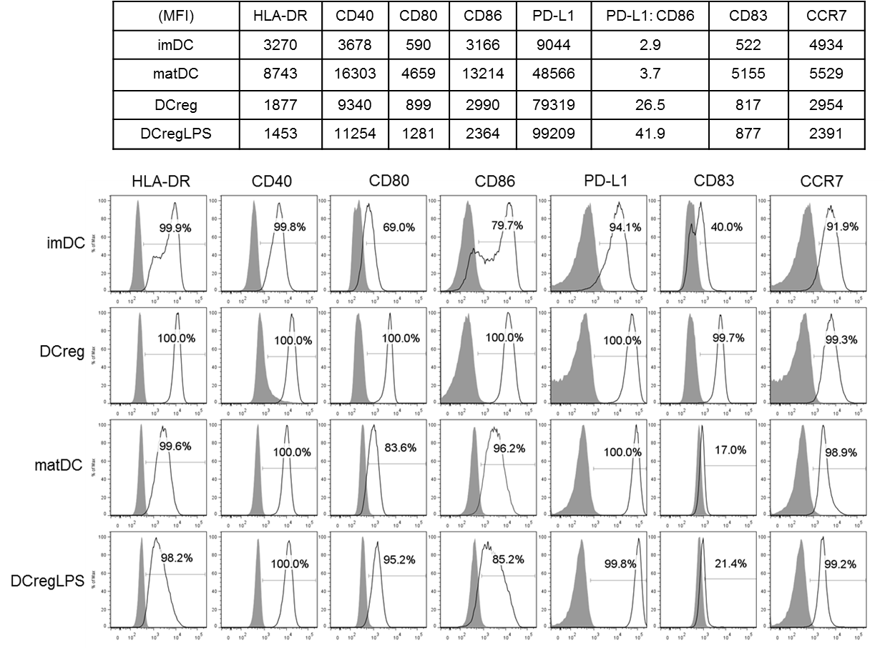
Supplemental Figure 1A. LPS
Suppl. Fig. 1A

Slide 3
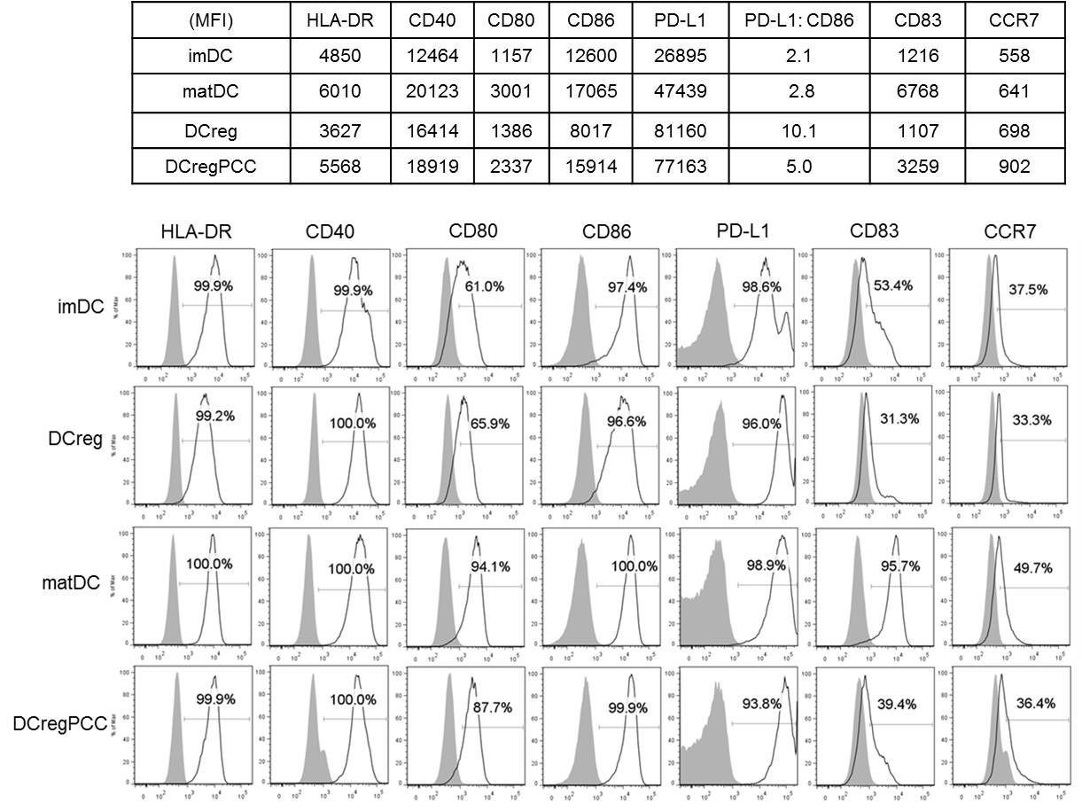
Supplemental Figure 1B. Pro-inflammatory cytokine cocktail
Suppl. Fig. 1B

Slide 4
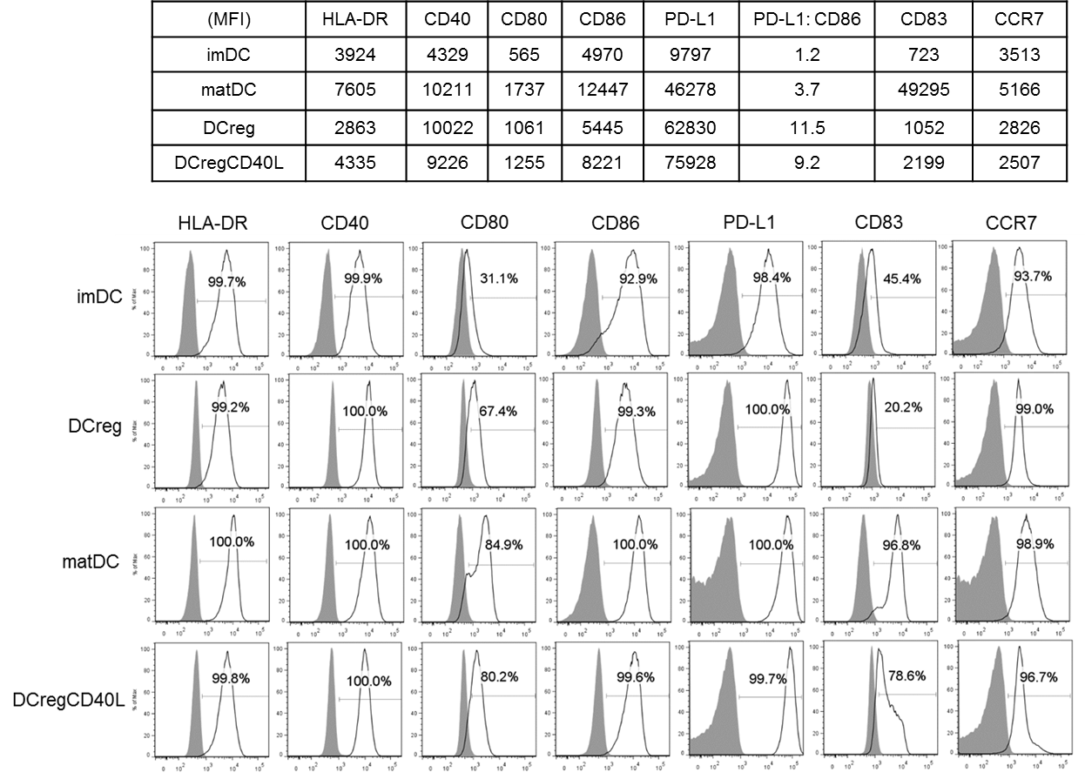
Supplemental Figure 1C. CD40L
Suppl. Fig. 1C

Slide 5
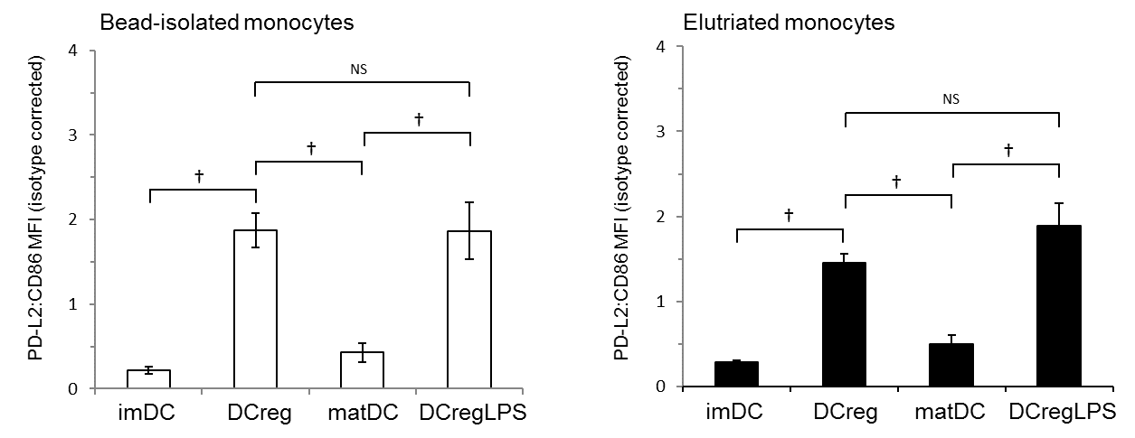
Suppl. Fig. 2

