Slide 1
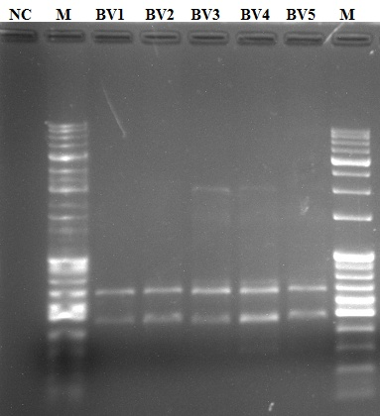
(a)
(b)
Figure 1
17

