Slide 1
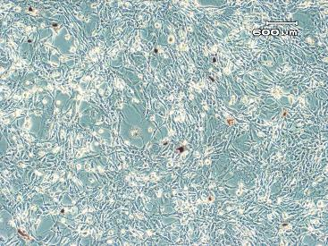
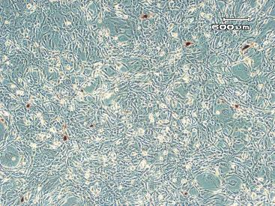
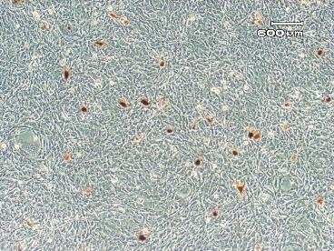
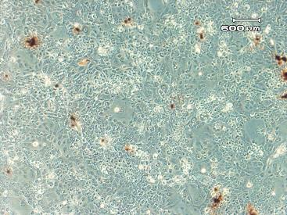
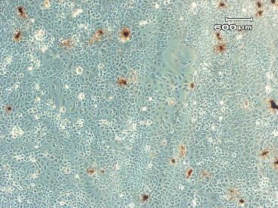
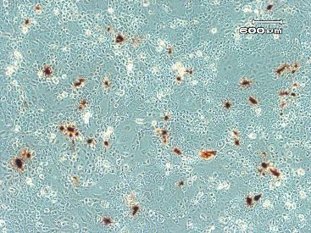
Supplemental online material 1
A
Adhz60
Adhz60 + DMSO
Adhz60 + TMZ
KPCL
TC-1
B
*
*
SOM 1. Temozolomide increases OAd productive replication in murine cancer cells. Detection of hexon expression was performed by immunostaining with a mouse anti-hexon antibody. (A) Hexon-positive cells were visualized by light microscopy. Microphotographs were taken in bright-field at 20x magnification. A representative experiment is shown from three performed. Scale bar = 200 µm. (B) Each point represents the mean of three independent experiments ± (SD; error bars) (*p < 0.05).

