Slide 1
Suppl. Figure 1
a
d
g
p<0.001
j
m
p<0.01
p<0.01
p<0.001
E/A
Tau (ms)
EDLVD (mm)
BP (mmHg)
Distance (m)
b
e
h
p<0.05
k
p<0.001
n
p<0.05
 | Regression Coeff. | p-value
E/A |  | <0.01
E/E’ |  | <0.05
EDPVR |  | n.s.
Tau |  | 0.01
Min Dp/Dt |  | 0.001
LV mass |  | 0.001
EDLVD |  | 0.01
LVEF |  | n.s.
LVFS |  | n.s.
SBP |  | n.s.
HR |  | 0.01
Temperature |  | 0.001
Distance |  | 0.01
r=0.46
E/E’
min Dp/Dt
LVEF (%)
HR (bpm)
r=0.38
r=0.29
r=0.46
p<0.001
r=0.55
r=0.63
c
f
p<0.001
i
l
p<0.001
r=0.40
p=0.06
p<0.05
r=0.07
r=0.05
EDPVR (mmHg/10uL)
LV mass (mg)
r<0.01
LVFS (%)
Body Temperature (Cº)
r=0.39
r=0.75
r=0.45

Slide 2
Suppl. Figure 2
Variable |  | PBS | CDC | p-value PBS vs CDC
Echocardiography
ED-LVD (mm) | Baseline | 7.8 ± 0.5 | 7.6 ± 0.7 | 0.71
 | 1-month | 7.8 ± 0.3 | 7.8 ± 0.4 | 0.43
 | p-value Baseline vs 1-mo | 0.898 | 0.413
ES-LVD (mm) | Baseline | 4.8 ± 0.5 | 4.6 ± 0.6 | 0.78
 | 1-month | 4.9 ± 0.4 | 4.9 ± 0.6 | 0.56
 | p-value Baseline vs 1-mo | 0.81 | 0.112
IVS (mm) | Baseline | 1.4 ± 0.08 | 1.5 ± 0.1 | 0.41
 | 1-month | 1.4 ± 0.2 | 1.3 ± 0.07 | 0.20
 | p-value Baseline vs 1-mo | 0.637 | 0.001
PW (mm) | Baseline | 1.5 ± 0.1 | 1.6 ± 0.1 | 0.21
 | 1-month | 1.6 ± 0.2 | 1.4 ± 0.1 | 0.16
 | p-value Baseline vs 1-mo | 0.630 | 0.002
LV Mass (mg) | Baseline | 651.1 ± 23.2 | 700.6 ± 35.1
 | 1-month | 657 ± 36.1 | 633.3 ± 19.8 | 0.91
 | p-value Baseline vs 1-mo | 0.908 | 0.08
E’ (mm/s) | Baseline | 44.2 ± 12.2 | 42.9 ± 7.2 | 0.75
 | 1-month | 52.4 ± 17.4 | 68.5 ± 20.4 | 0.05
 | p-value Baseline vs 1-mo | 0.33 | 0.009
A (mm/s) | Baseline | 385.5 ± 194.3 | 269.4 ± 103.5 | 0.07
 | 1-month | 453.0 ± 237.7 | 570.9 ± 121.6 | 0.14
 | p-value Baseline vs 1-mo | 0.78 | <0.001
E/A | Baseline | 3.0 ± 1.5 | 4.2 ± 1.8 | 0.08
 | 1-month | 2.9 ± 1.9 | 2.1 ± 0.4 | 0.19
 | p-value Baseline vs 1-mo | 0.61 | 0.002
E/E’ | Baseline | 22.9 ± 7.3 | 22.6 ± 5.2 | 0.89
 | 1-month | 20.5 ± 6.5 | 16.3 ± 4.3 | 0.08
 | p-value Baseline vs 1-mo | 0.53 | 0.05
LV-EF (%) | Baseline | 65.7 ± 4.1 | 67.3 ± 6.2 | 0.46
 | 1-month | 64.2 ± 5.3 | 67.0 ± 10.0 | 0.42
 | p-value Baseline vs 1-mo | 0.33 | 0.89
LV-FS (%) | Baseline | 37.5 ± 3.1 | 38.9 ± 5.0 | 0.39
 | 1-month | 36.5 ± 4.2 | 39.3 ± 8.1 | 0.32
 | p-value Baseline vs 1-mo | 0.39 | 0.61
Hemodynamic
Tau (ms) | Baseline | 24.6 ± 5.9 | 23.4 ± 4.1 | 0.57
 | 1-month | 26.9 ± 6.0 | 22.2 ± 3.5 | 0.04
 | p-value Baseline vs 1-mo | 0.28 | 0.68
Min Dp/Dt | Baseline | -4,475.8 ± 1125.9 | -4,169.6 ± 951.9 | 0.13
 | 1-month | -3,945.8 ± 1328.4 | -4,664.4 ± 1503.2 | 0.25
 | p-value Baseline vs 1-mo | 0.96 | 0.59
Max Dp/Dt | Baseline | 4,518.8 ± 1332.7 | 4,961.8 ± 888.7 | 0.28
 | 1-month | 4,583.5 ± 1290.7 | 5,067.1 ± 1188.9 | 0.38
 | p-value Baseline vs 1-mo | 0.91 | 0.83
EDPVR (mmHg/10uL) | Baseline | 3.9 ± 3.3 | 5.2 ± 1.7 | 0.31
 | 1-month | 4.6 ± 5.5 | 2.1 ± 1.1 | 0.12
 | p-value Baseline vs 1-mo | 0.77 | 0.01
Treadmill
Max Distance | Baseline | 123.6 ± 23.7 | 107.8 ± 25.5 | 0.50
 | 1-month | 116.4 ± 19.8 | 128.6 ± 12.4 | 0.01
 | p-value Baseline vs 1-mo | 0.51 | 0.04
Max Speed | Baseline | 14.7 ± 1.5 | 14.1 ± 1.6 | 0.47
 | 1-month | 14.1 ± 1.3 | 15.7 ± 1.5 | 0.02
 | p-value Baseline vs 1-mo | 0.44 | 0.04
ED-LVD: end-diastolic left ventricular diameter; ES-LVD: end-systolic left ventricular diameter; IVS: interventricular septum; PW: posterior wall; LV: left ventricule; EF: ejection fraction; FS: fractional shortening; EDPVR: end-diastolic pressure-volume relationship. Significant p-values are highlighted in red and borderline values – in blue. Values are mean ± SD.
Notes:
Suppl. Fig. 2. Table summarizing LV structural changes measured by echocardiography in both groups, CDC-transplanted (n=11) and PBS-injected (n=11) rats.

Slide 3
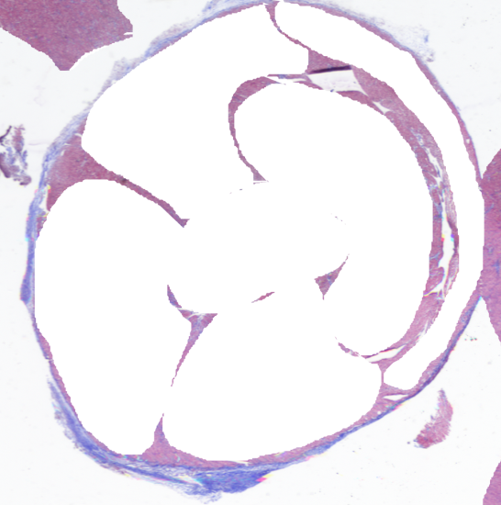
Suppl. Figure 3
AW
AW
IVS
RV
IVS
RV
LW
LW
PW
PW
Notes:
Suppl. Fig. 3. Schematic representation of heart wall distribution for fibrosis analyses.

Slide 4
Suppl. Figure 4
A
B
 | Old-PBS (n=4) | Old-CDC (n=5)
Cr baseline (mg/dL) | 1.9 ± 0.05 | 1.97 ± 0.11
Cr 1mo (mg/dL) | 1.79 ± 0.08 | 1.72 ± 0.17*
BUN baseline (mg/dL) | 10.3 ± 1.3 | 10.0 ± 0.7
BUN 1mo (mg/dL) | 11.8 ± 1.6 | 9.9 ± 1.0
* p=0.04 vs Cr at baseline
C
D
p<0.01
p<0.001
S-Cr (mg/dL)
BUN (mg/dL)
Young
Young
N 4 9
N 4 7
Notes:
Suppl. Fig. 4. Serum levels of cytokines and renal function-related markers.

Slide 5
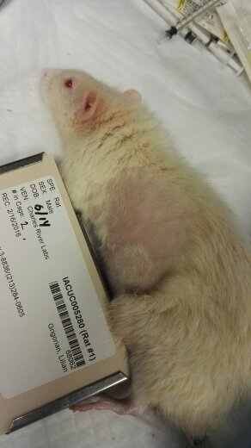
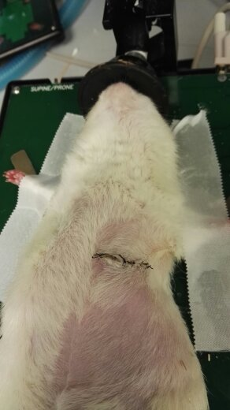
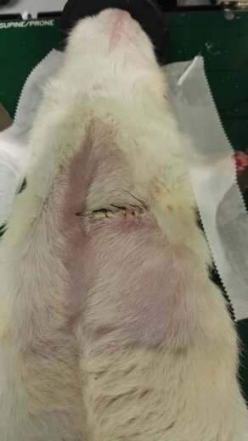
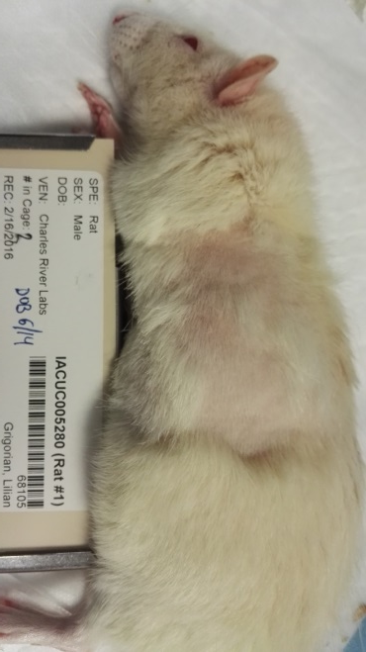
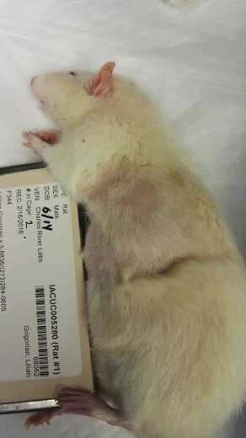
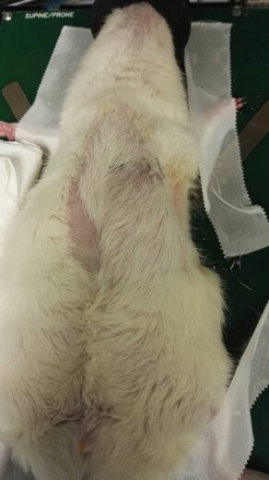

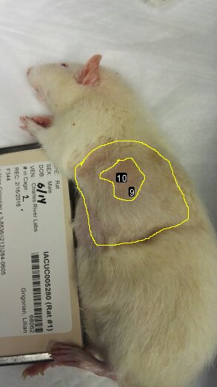
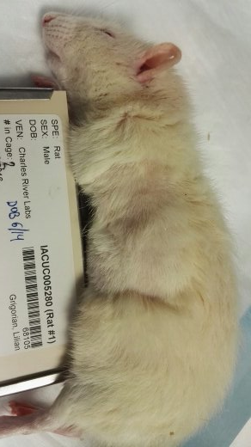
Suppl. Figure 5
A
C
Rat 1
Rat 2
Rat 3
Rat 4
B
Rat 5
Rat 6
Rat 7
Rat 8
Notes:
Suppl. Fig. 5. Hair regrowth after 3 weeks of shaving in PBS-injected (A) and CDC-transplanted (B) rats. C. Schematic representation of the estimation of the impaired hair regrowth area.

Slide 6
Suppl. Figure 6
p=ns
Serum GDF-11 (pg/mL)
N 4 12 9 11

Slide 7
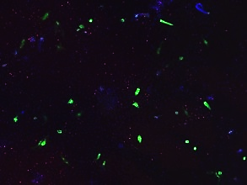
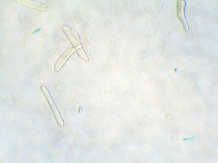
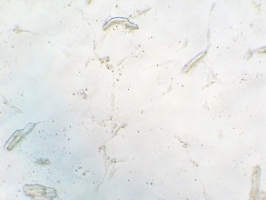
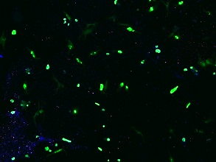
Suppl. Figure 7
A
B
C
Serum Free
CDC-XO
p=0.06
Serum Free
p=0.01
p<0.01
Fold Change of Telomerase Activity
nºcell / field
CDC-XO
p=0.01
α-SA / DAPI
Fold Change of SA-GAL ⁺ cells
0 h 72 hs

