Slide 1
Online Resource 4
Article title: Sex Differences in Alcohol Effects on Cognitive Decline and Brain Pathology in a Cohort of Octogenarians
Journal name: Psychopharmacology
Author names: Casia Wardzala, Charles Murchison M.S., Jennifer M. Loftis Ph.D., Katie J. Schenning M.D., Nora Mattek M.P.H., Randall Woltjer M.D., Ph.D., Jeff Kaye M.D., Joseph F. Quinn M.D., Clare J. Wilhelm Ph.D.
Affiliation and e-mail address of the corresponding author:
Clare Wilhelm, Ph.D.
VA Portland Health Care System
3710 SW US Veterans Hospital Rd. (R&D 17)
Portland, OR 97239
503-220-8262 x58020
wilhelmc@ohsu.edu
Description: Graphs of neuropsychological measures that did not differ significantly between men and women as a function of alcohol.

Slide 2
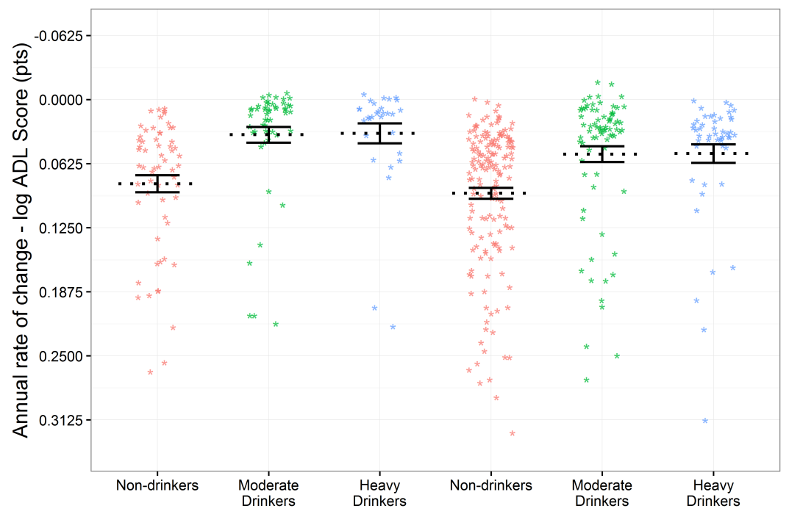
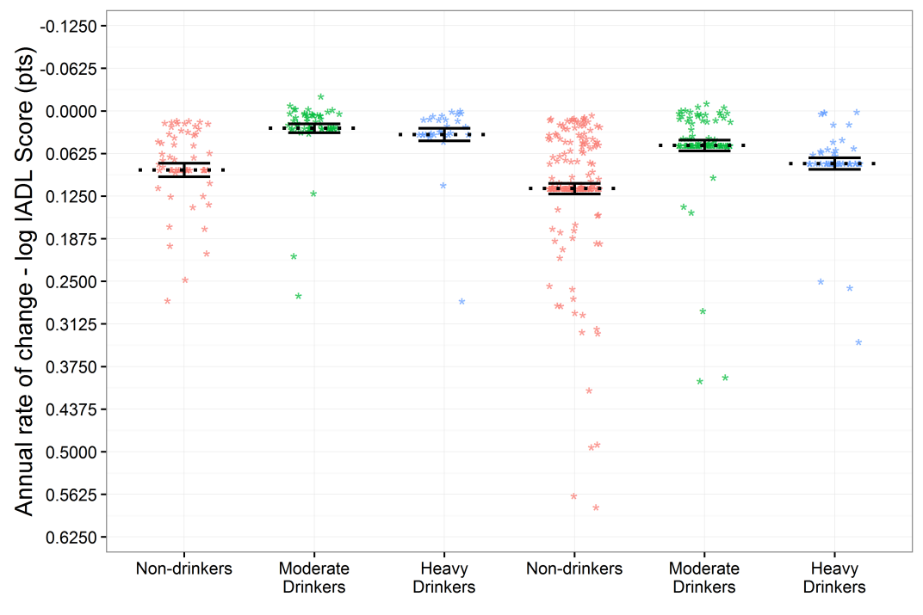
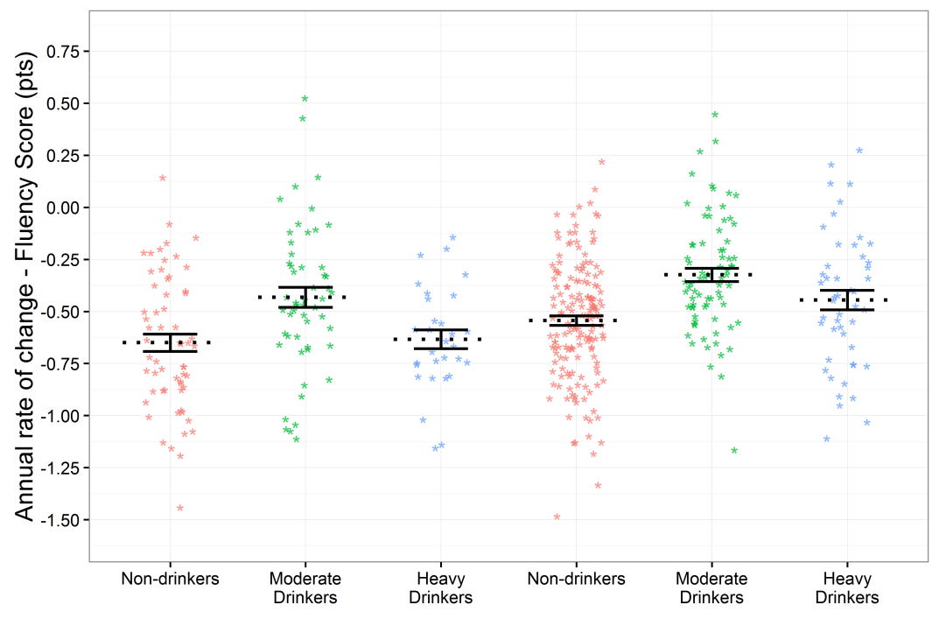
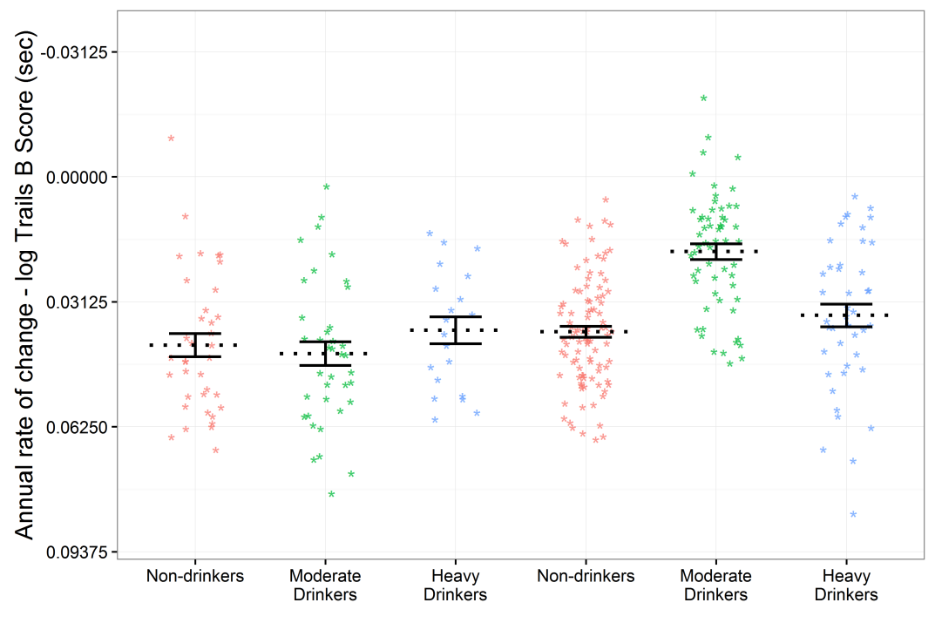
Figure S1. Neuropsychological Measures
A
*
B
*
Rare/never
Drinkers
Moderate
Drinkers
Heavy
Drinkers
Rare/never
Drinkers
Moderate
Drinkers
Heavy
Drinkers
Rare/never
Drinkers
Moderate
Drinkers
Heavy
Drinkers
Rare/never
Drinkers
Moderate
Drinkers
Heavy
Drinkers
Men
Women
Men
Women
C
D
*
*
Rare/never
Drinkers
Moderate
Drinkers
Heavy
Drinkers
Rare/never
Drinkers
Moderate
Drinkers
Heavy
Drinkers
Rare/never
Drinkers
Moderate
Drinkers
Heavy
Drinkers
Rare/never
Drinkers
Moderate
Drinkers
Heavy
Drinkers
Men
Women
Men
Women

Slide 3
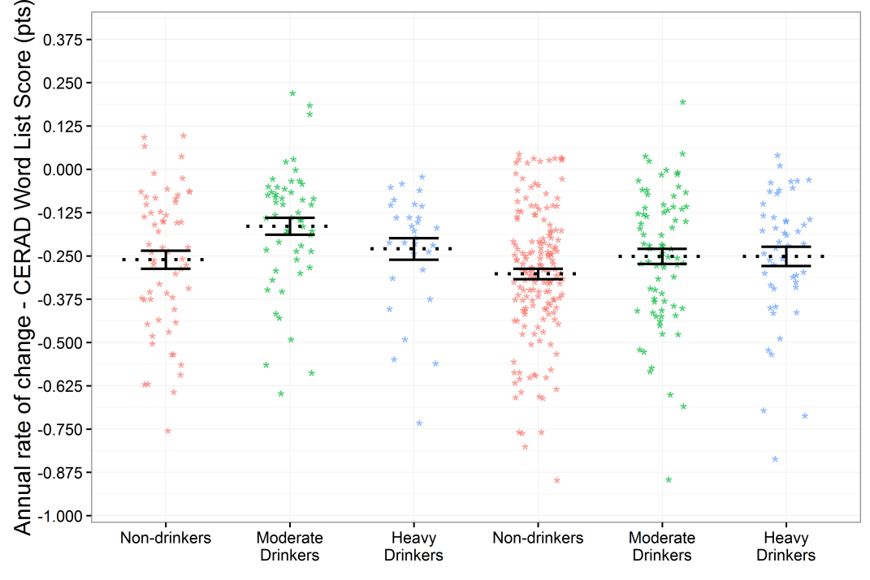
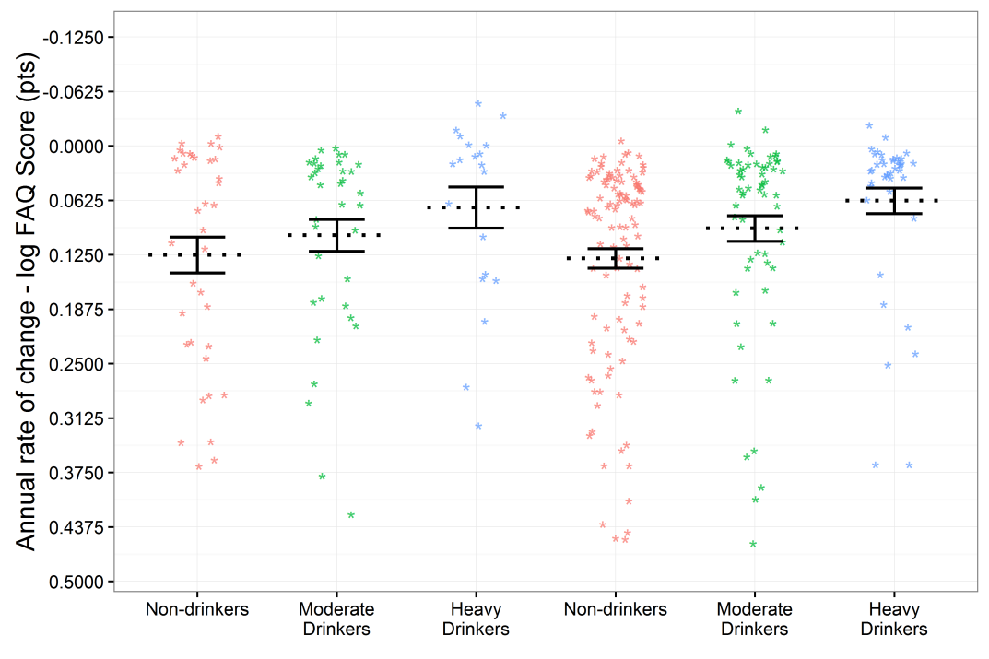
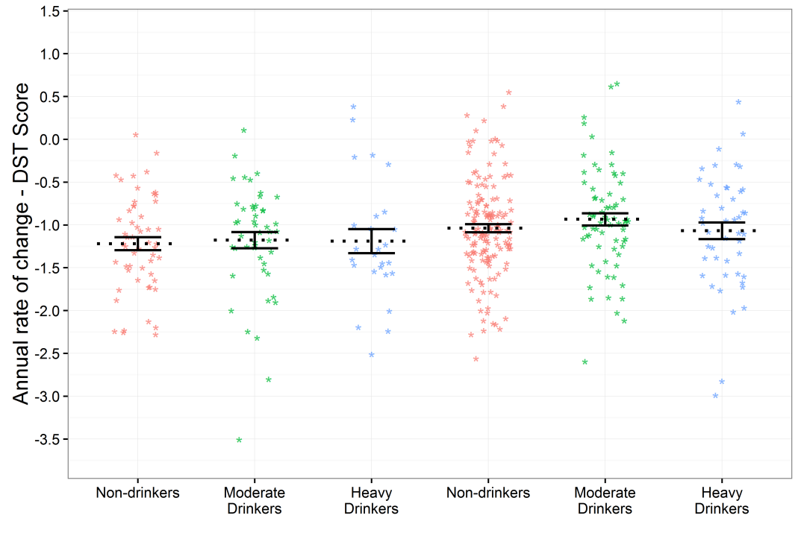
Figure S2. Neuropsychological Measures
A
B
Rare/never
Drinkers
Moderate
Drinkers
Heavy
Drinkers
Rare/never
Drinkers
Moderate
Drinkers
Heavy
Drinkers
Rare/never
Drinkers
Moderate
Drinkers
Heavy
Drinkers
Rare/never
Drinkers
Moderate
Drinkers
Heavy
Drinkers
C
Men
Women
Men
Women
Rare/never
Drinkers
Moderate
Drinkers
Heavy
Drinkers
Rare/never
Drinkers
Moderate
Drinkers
Heavy
Drinkers
Men
Women

Slide 4
Figure S1. Moderate alcohol groups exhibit reduced decline in different tasks in men and women. Annual rates of decline on the (A) Older American Resources and Services (OARS) Activities of Daily Living (ADL), (B) Instrumental Activities of Daily Living (IADL), (C) Category Fluency Test (Animals) and (D) Trail Making Test Part B (Trails B) over time for individual subjects. Annualized rates of change are taken from the mixed-effects models with subject-specific random effects included and fixed-effects rates indicated for each group. Men in the moderate drinking group exhibited decreased rates of decline in the ADL, IADL and Category Fluency tasks and women in the moderate drinking group had decreased rates of decline on the Trails B task. * p < 0.05 comparing same-sex rare/never drinkers to moderate drinkers.
Figure S2. Measures unaffected by alcohol. Annual rates of decline on the (A) Consortium to Establish a Registry for Alzheimer’s Disease (CERAD) Word List Delayed Recall, (B) Functional Activities Questionnaire (FAQ) and (C) Digit Symbol Test (DST) over time for individual subjects. Annualized rates of change are taken from the mixed-effects models with subject-specific random effects included and fixed-effects rates indicated for each group. No significant effects of alcohol were observed.

