Slide 1
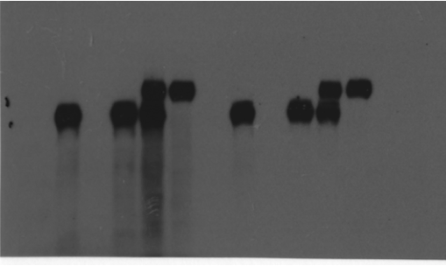
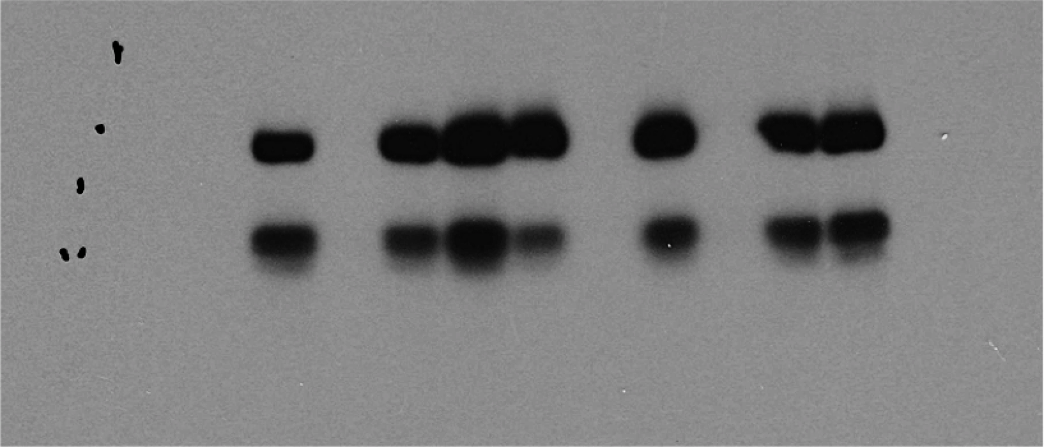
Source Data Fig 3C
PC-9P and PC-9GR
EGFRmut-tGFP
+ EGFRi#1
EGFRmut-tGFP
+ EGFRi#1
EGFRmut-tGFP
EGFRmut-tGFP
scrambled
empty vector
scrambled
empty vector
EGFRi#1
EGFRi#1
197kDa
tGFP-tagged
170kDa
EGFR
PC-9GR
PC-9P
EGFRmut-tGFP
+ EGFRi#1
EGFRmut-tGFP
+ EGFRi#1
EGFRmut-tGFP
EGFRmut-tGFP
scrambled
empty vector
scrambled
empty vector
EGFRi#1
EGFRi#1
125kDa
68kDa
PC-9GR
PC-9P
SREBP1

