Slide 1
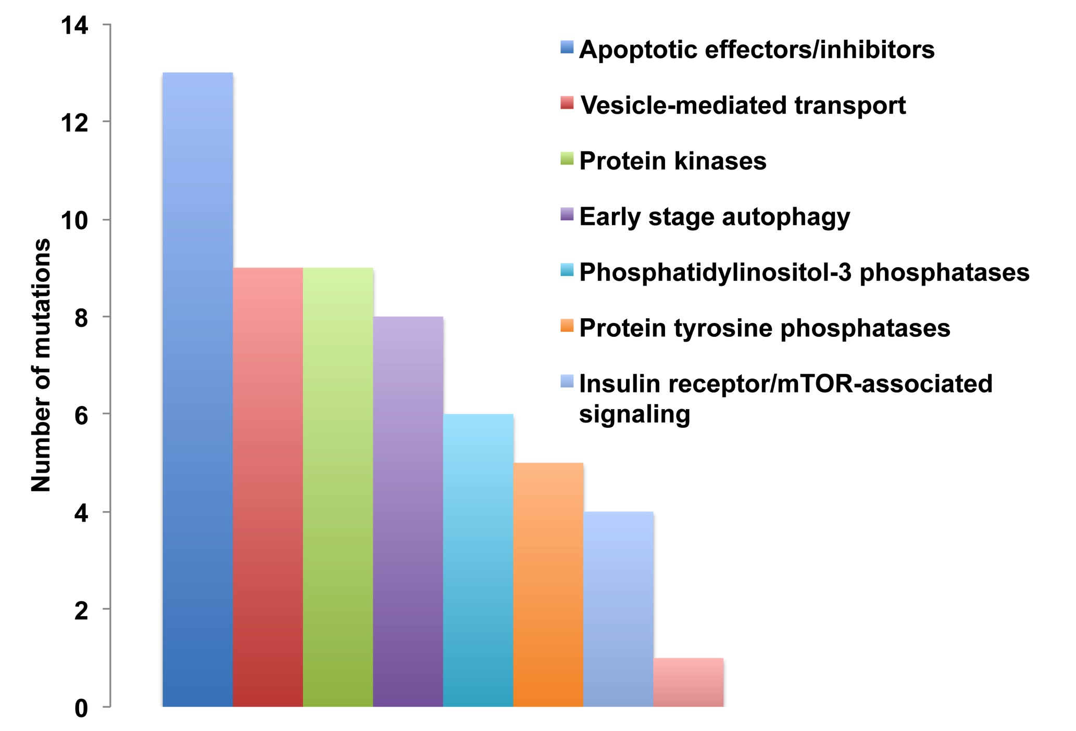
Supplemental figure 1
A
B
Pathway

