Slide 1
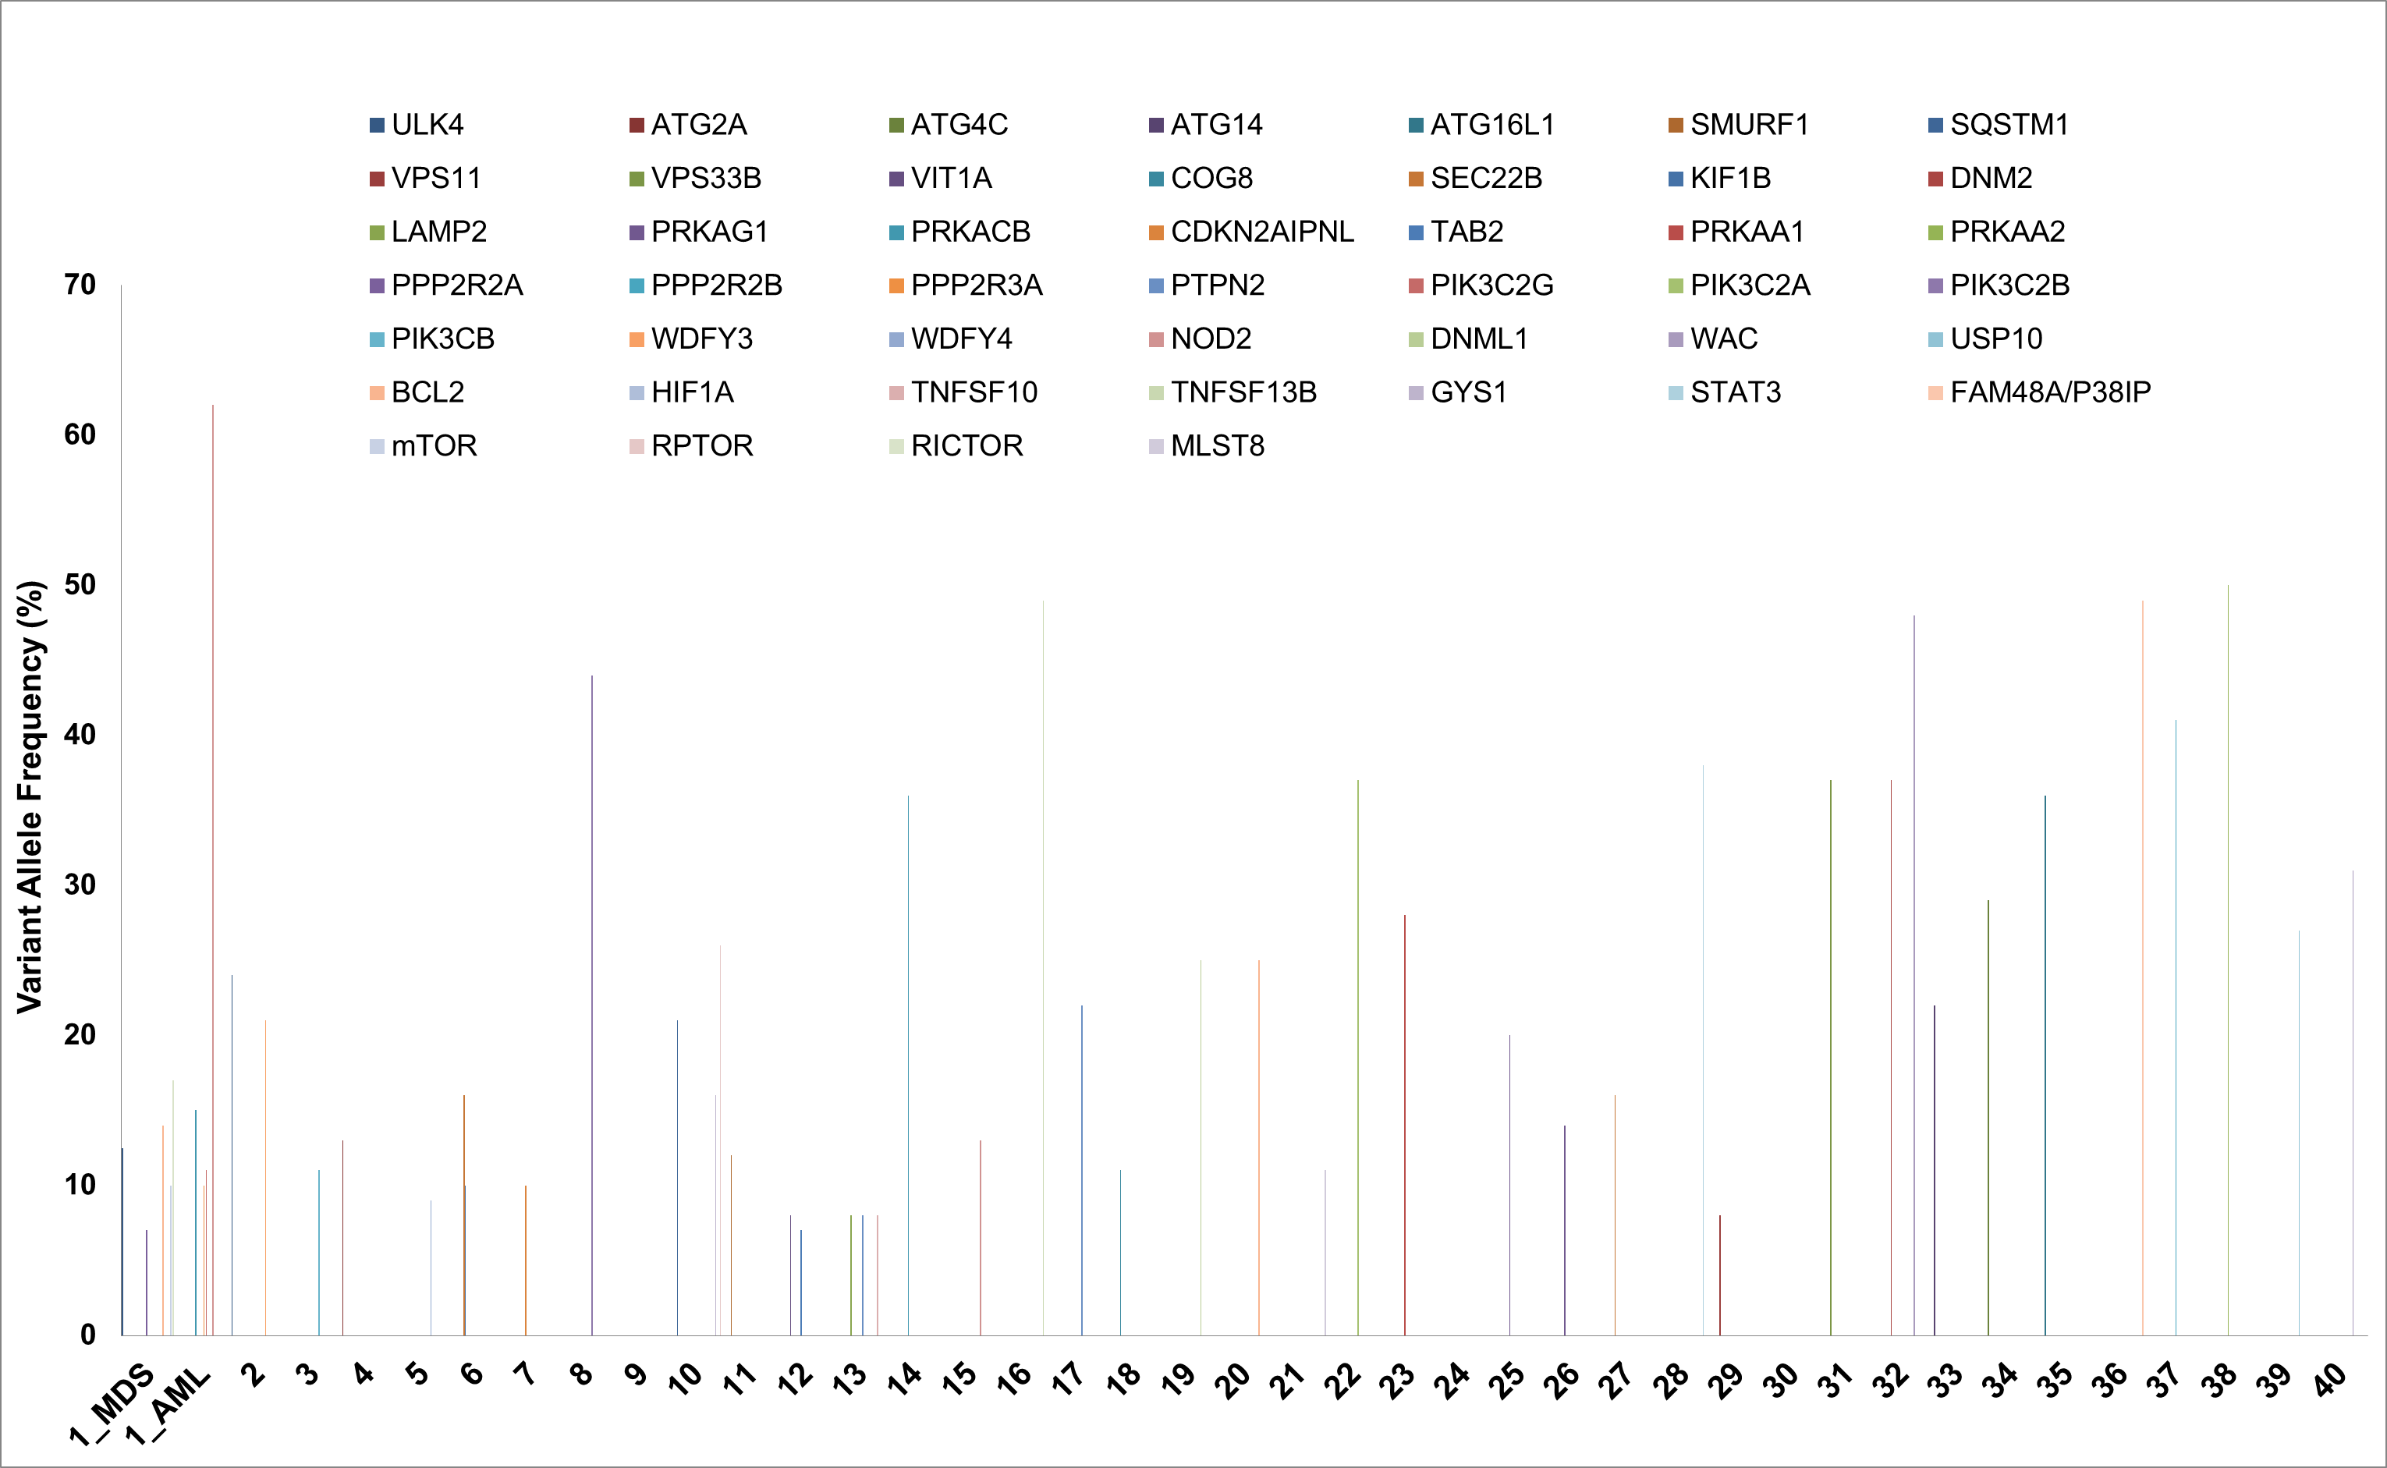
Supplemental figure 3

