Slide 1
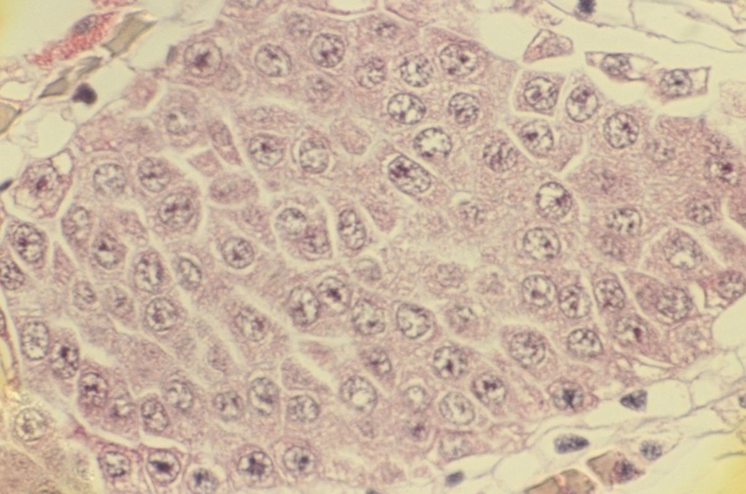
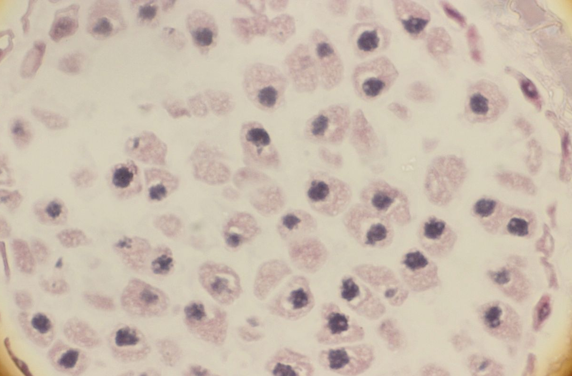
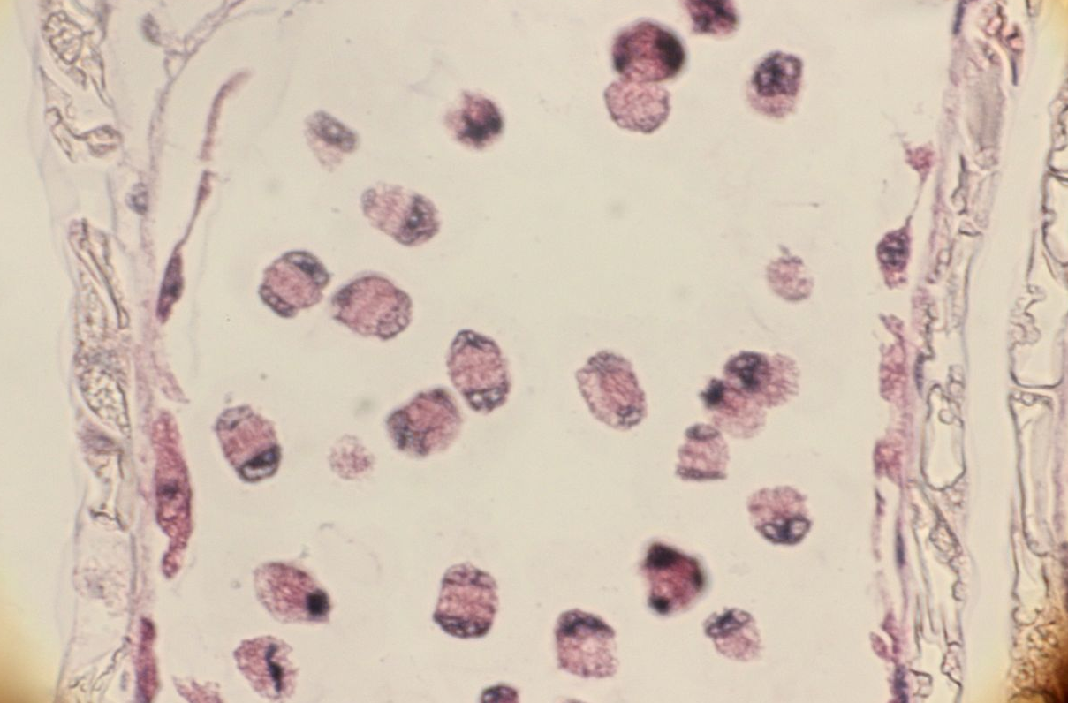
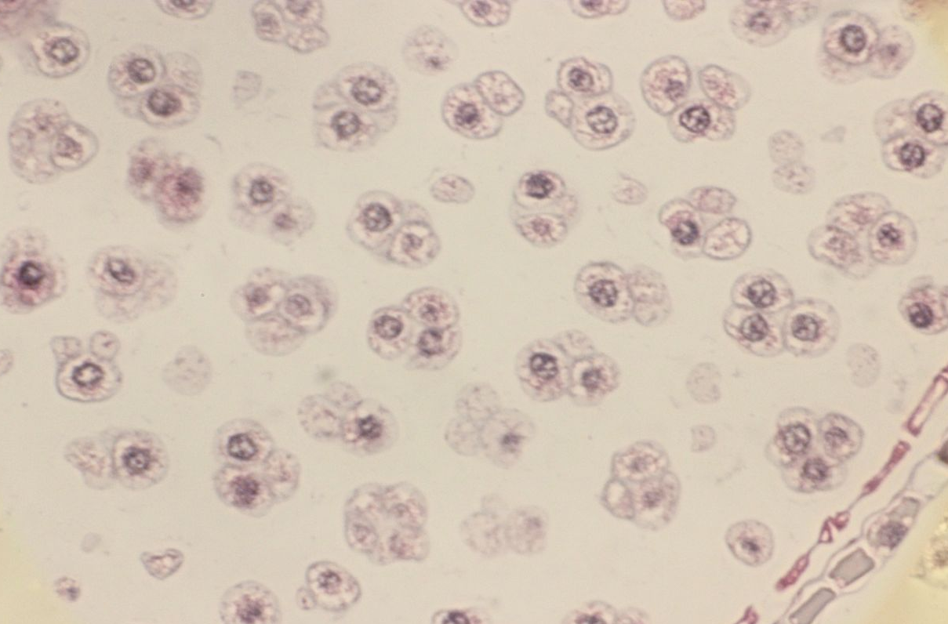
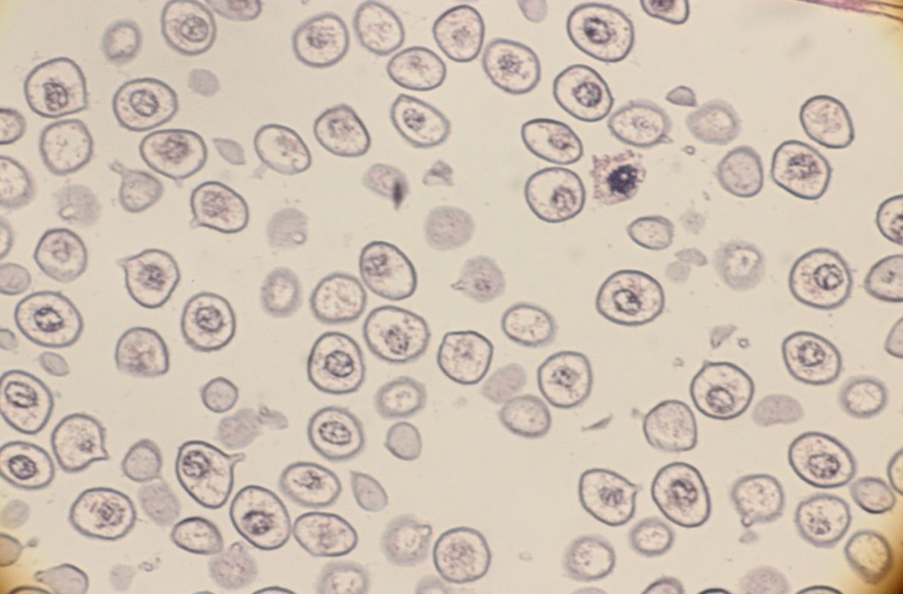
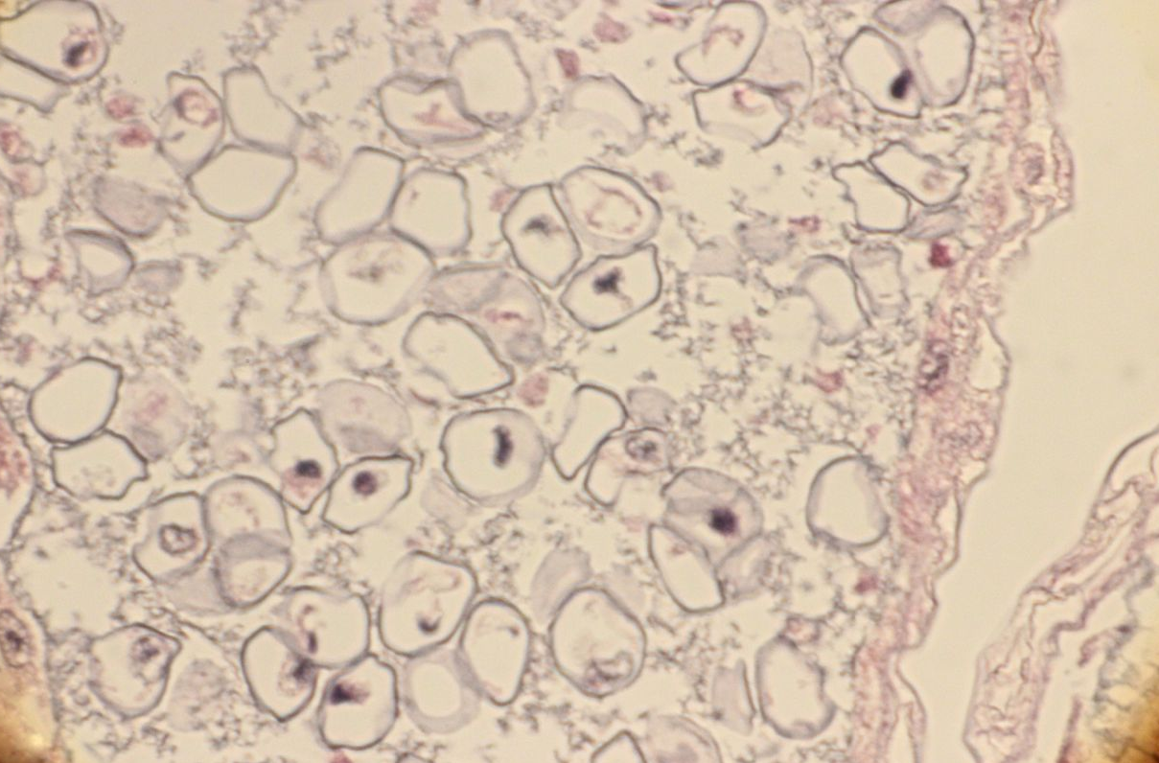
a
b
c
d
e
f
S1 Fig. Light micrographs of pollen development. a. Early microsporocyte stage, b. Pre-meiotic stage, c. Meiotic stage, d. Tetrad stage, e. Microspore stage. f. Unseparated tetrads in a male sterile individual (MS04) at microspore stage.

