Slide 1
JAMA Ophthalmology Journal Club Slides:
Risk of Uveitis Among People With Psoriasis
Chi C-C, Tung T-H, Wang J, et al. Risk of uveitis among people with psoriasis: a nationwide cohort study. JAMA Ophthalmol. Published online April 13, 2017. doi:10.1001/jamaophthalmol.2017.0569

Slide 2
Introduction
Importance:
  Uveitis has been associated with psoriatic arthritis, but to our knowledge, the relationship between uveitis and psoriasis is unsettled among researchers.
Objective:
  To evaluate the risk of incident uveitis among people with psoriasis.

Slide 3
Methods
Study Design, Setting, and Participants:
  This nationwide, retrospective cohort study conducted in Taiwan from January 1, 2000, to December 31, 2012, included 147 954 people with psoriasis (including 10 107 with concomitant psoriatic arthritis and 137 847 without psoriatic arthritis) and 147 954 nonpsoriatic controls.
Main Outcomes and Measures:
  Risk of incident uveitis among people with psoriasis compared with nonpsoriatic controls.
Limitations:
  Misclassification in the presence or absence of psoriatic arthritis and the severity of psoriasis.

Slide 4
Results
The mean (SD) age of the 295 908 study participants was 44.4 (19.8) years, and 41.2% (n = 121 878) were women.
We found that the group with severe psoriasis with psoriatic arthritis had the greatest risk of incident uveitis compared with the nonpsoriatic controls (adjusted hazard ratio, 2.40; 95% CI, 1.90-3.02).
The group with severe psoriasis without psoriatic arthritis and the group with mild psoriasis with psoriatic arthritis also had an increased risk of incident uveitis (adjusted hazard ratio, 1.42; 95% CI, 1.23-1.64; and 1.42; 95% CI, 1.03-1.96; respectively).
However, an increased risk for incident uveitis with mild psoriasis without psoriatic arthritis was not identified (adjusted hazard ratio, 1.09; 95% CI, 1.00-1.20).

Slide 5
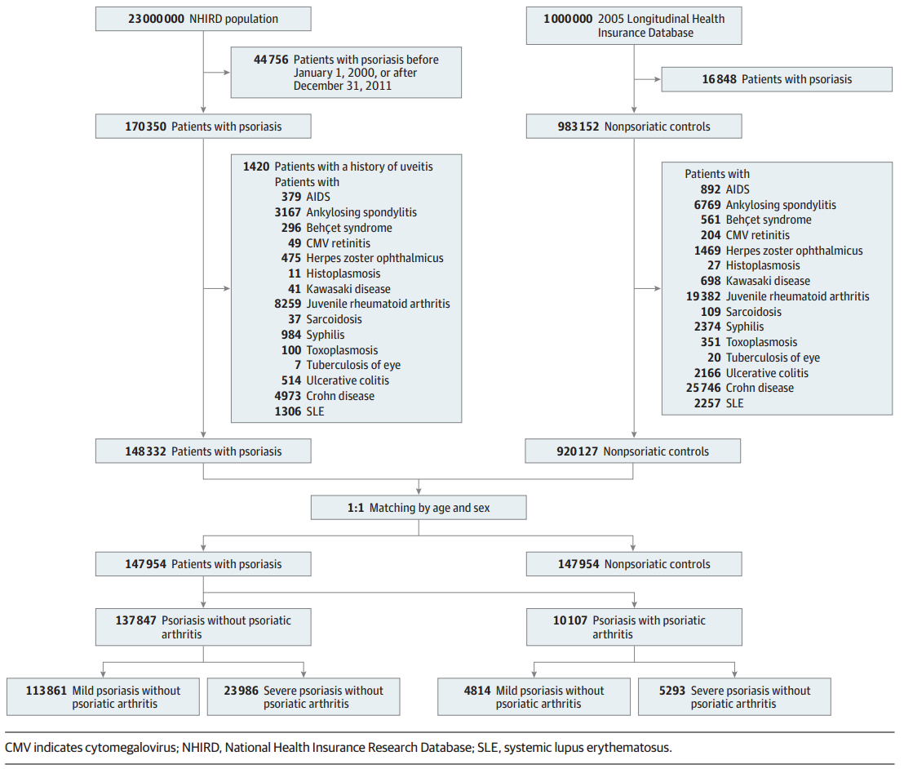
Results
Flowchart of the Selection of the Study Population

Slide 6
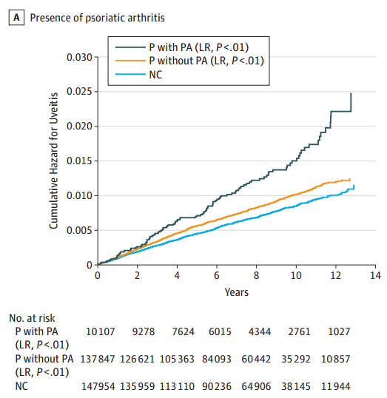
Results
Cumulative Incidence Curves for Uveitis
Classified based on the presence of psoriatic arthritis. LR indicates log rank; MP, mild psoriasis; NC, nonpsoriatic controls; P, psoriasis; PA, psoriatic arthritis; SP, severe psoriasis.

Slide 7
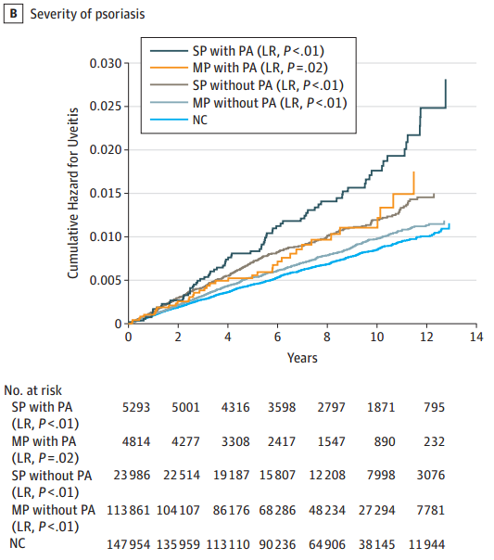
Results
Cumulative Incidence Curves for Uveitis
Classified based on the severity of psoriasis. LR indicates log rank; MP, mild psoriasis; NC, nonpsoriatic controls; P, psoriasis; PA, psoriatic arthritis; SP, severe psoriasis.

Slide 8
Comment
This study found that people with concurrent severe psoriasis and psoriatic arthritis have the highest risk of incident uveitis, while those with mild psoriasis and psoriatic arthritis and those with severe psoriasis but without psoriatic arthritis have a moderately increased risk of incident uveitis. An increased risk of incident uveitis with mild psoriasis but without psoriatic arthritis was not found.
Clinicians may use this finding as a guide for uveitis risk stratification among patients with different inflammatory presentations on the spectrum of psoriatic disease.
These findings suggest patients with psoriasis should be educated about the increased risk and manifestations of uveitis.

Slide 9
Contact Information
If you have questions, please contact the corresponding author:
  Shu-Hui Wang, MD, MS, Department of Dermatology, Far Eastern Memorial Hospital, 21, Sec 2, Nanya S Road, Banciao, New Taipei 22060, Taiwan (dermawang@hotmail.com).
  Funding/Support
This study was supported in part by grant CMRPG6F0031 from the Chang Gung Medical Hospital, Chiayi.
Conflict of Interest Disclosures
All authors have completed and submitted the ICMJE Form for Disclosure of Potential Conflicts of Interest and none were reported.

