Slide 1
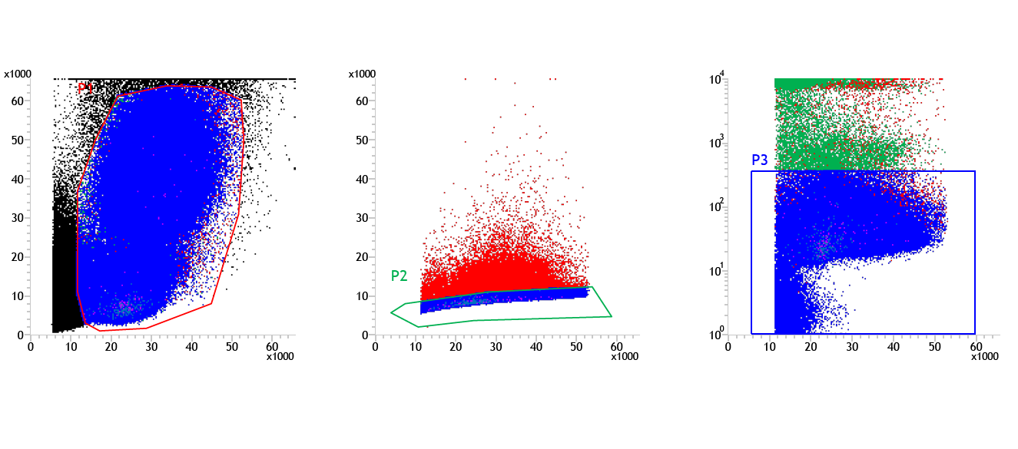
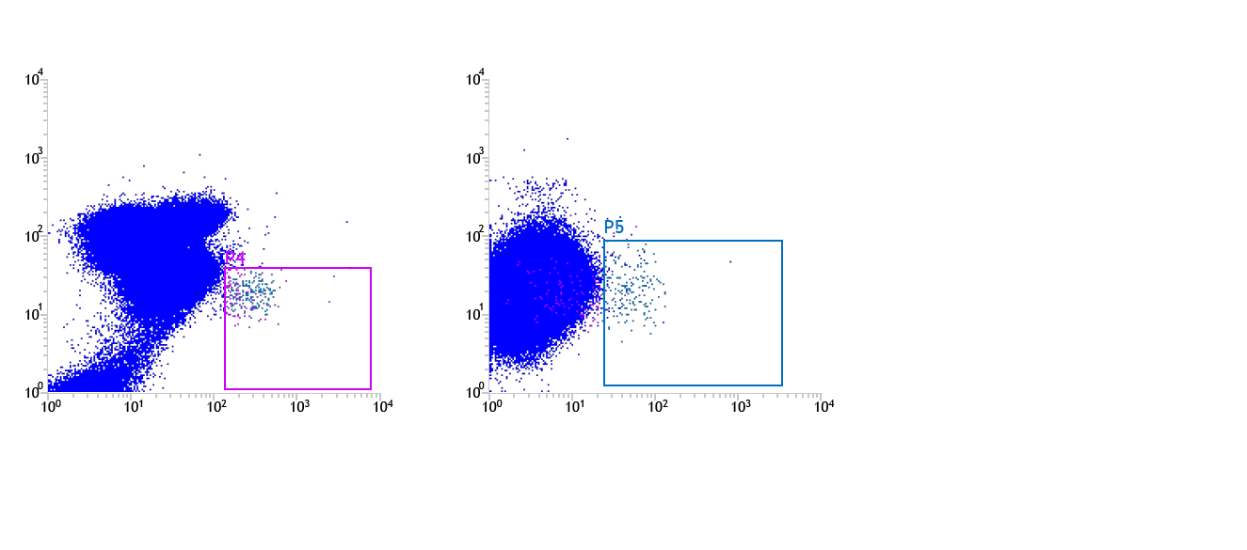
Supplementary Figure S8
A
B
C
P1: Total PB cells
P2: Singlets
P3: Live cells
SSC
Pulse Width
DAPI
FSC
FSC
FSC
D
E
F
P4: CD34+ cells
P5: CD34+CD133+ cells
Runx1 expression
CD45/CD14-BV421
VEGFR2-PE
CD34-Alexa Fluor 488
CD133-APC

