Slide 1
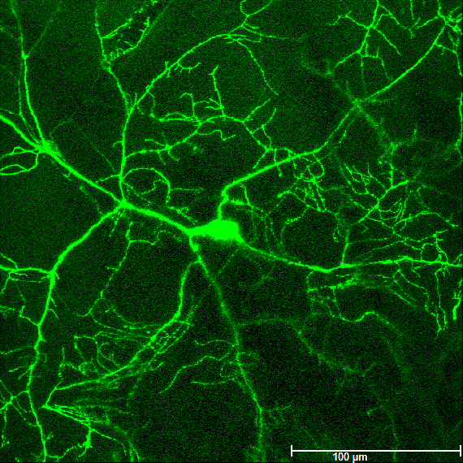
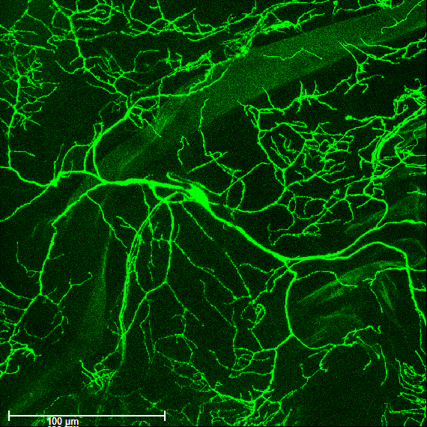
Additional file 4 : Fig S2
Ppk-tdGFP
+/+
duox ^{MI11852}/+

