Slide 1
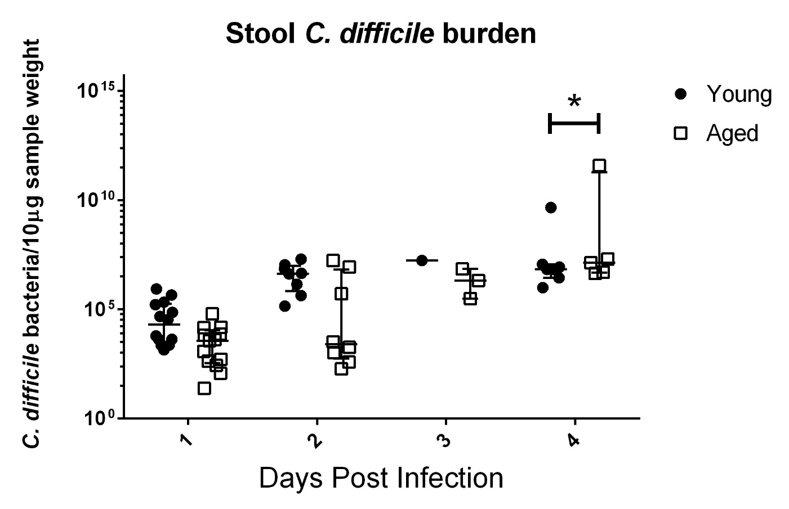
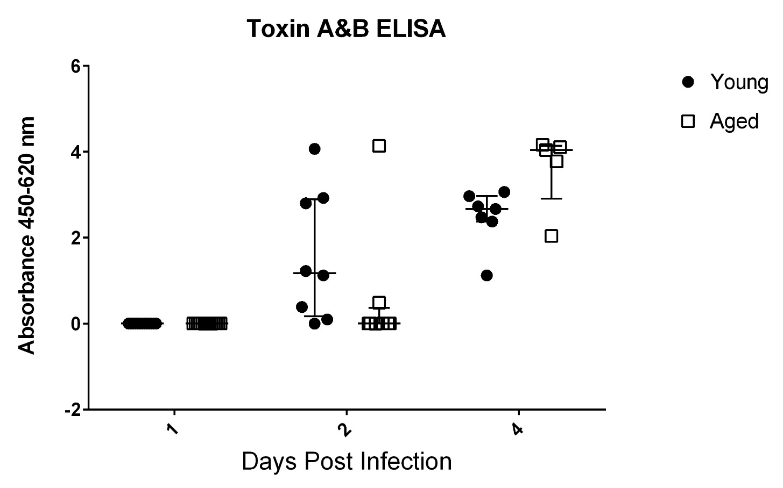
A
B
Supplementary Figure 4. Stool C. difficile Burden

Slide 2
Supplementary Figure 4. Stool C. difficile Burden
Stool samples from day 1 to 4 were used to measure infection burden. Stool C. difficile burden measured using qPCR of Toxin B gene (tcdB) (A) was not different between young and aged mice at day 1, 2, and 3 post infection. At day 4 infection burden became significantly higher in aged mice. Toxin A&B ELISA (B) did not reveal any difference between young and aged mice from day 1 to 4 post infection.

