Slide 1
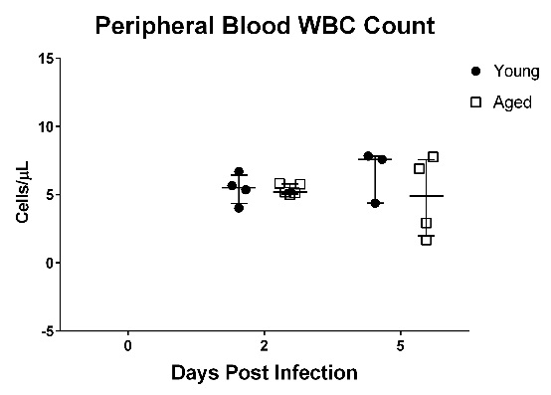
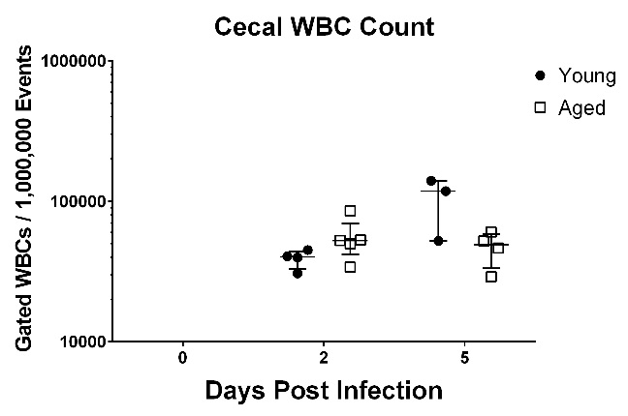
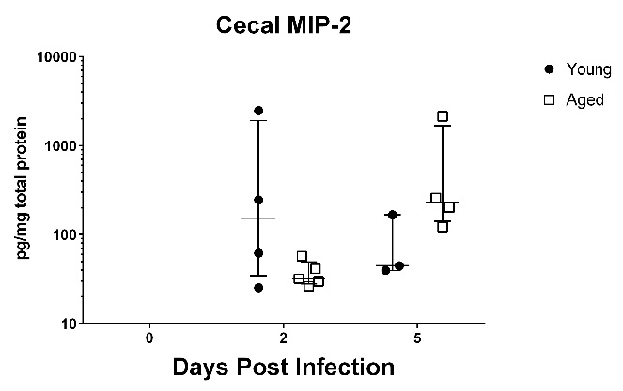
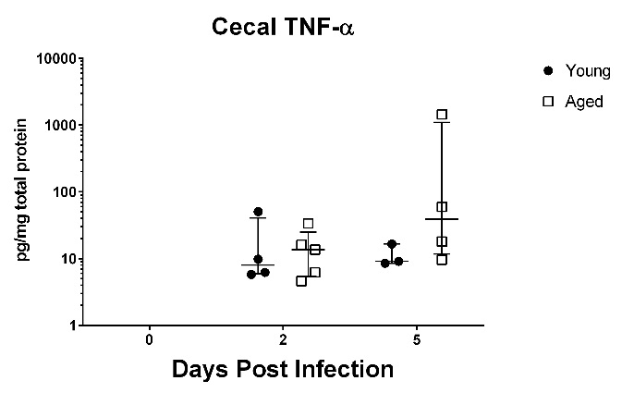
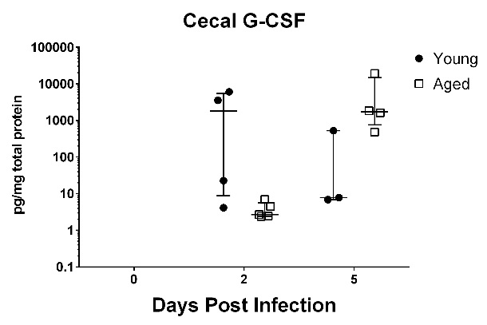
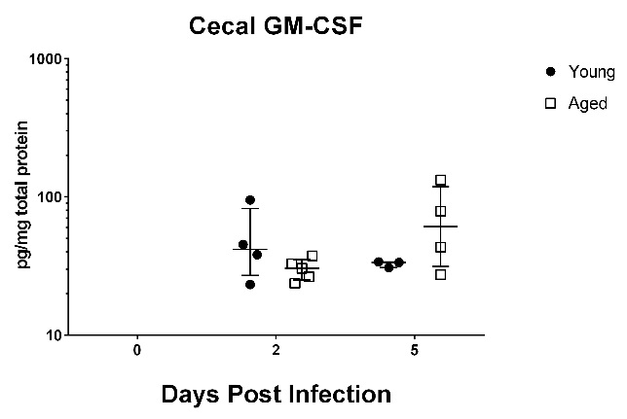
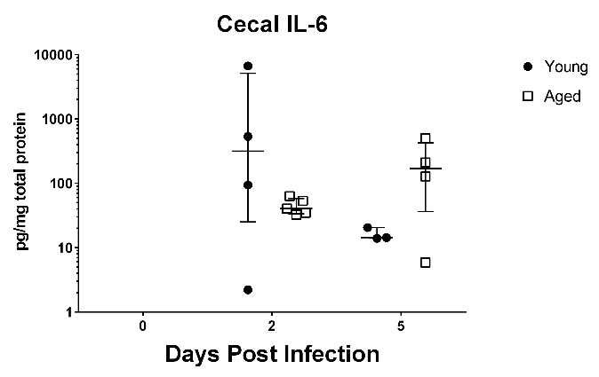
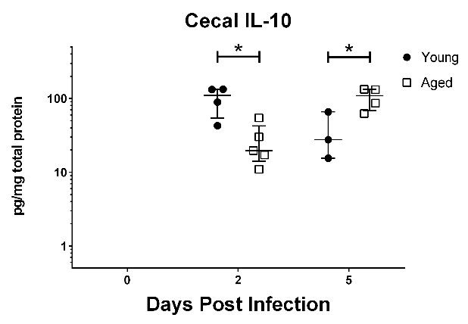
A
B
C
D
E
F
G
H
Supplementary Figure 5. Immune Response after Cage Switching in Aged and Young Mice

Slide 2
Supplementary Figure 5. Immune Response after Cage Switching in Aged and Young Mice
With cage switching, total WBC count measured in both the peripheral blood and in the cecal tissue were not different between aged and young mice (A,B). The showed a trend towards lower number at day 2 but there was no statistically significant difference (B). With the granulocyte count in peripheral blood and with cecal neutrophils, there was no difference between aged and young mice on day 2 and on day 5 in contrast to the previous experiment (Figure 4). Cytokines that demonstrated lower day 2 responses in aged mice – KC (Figure 4), IL-1β (Figure 4), MIP-2 (C), TNF-α (D), G-CSF (E), and GM-CSF (F) – still showed a trend toward lower levels in aged mice on day 2 and higher levels on day 5 but did not reach statistical significance. IL-6 (G) still showed no significant difference, while and IL-10 (H), which did not show any difference between aged and young mice at baseline, was lower at day 2 and higher at day 5 in aged mice. Student’s t-test was used to compare young and aged mice at each time point. (*p-value <0.05)

