Slide 1
S1 File. Primers location and the alignment of their gene sequences with homologous genes from other plants.

Slide 2
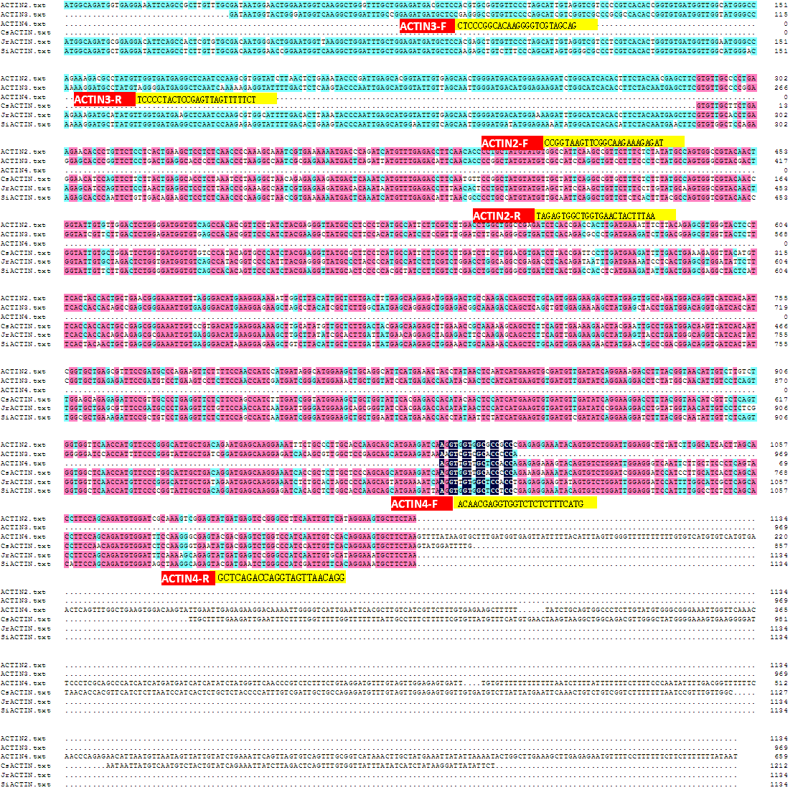
ACTIN2
ACTIN3
ACTIN4

Slide 3
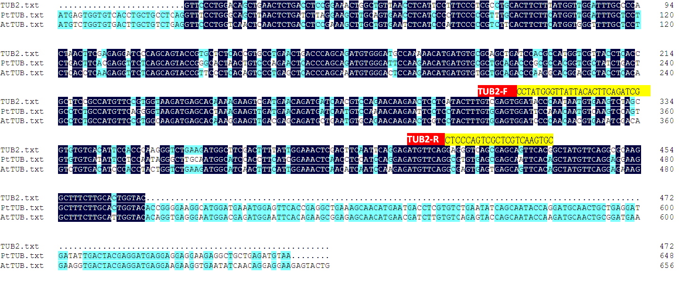
TUB2

Slide 4
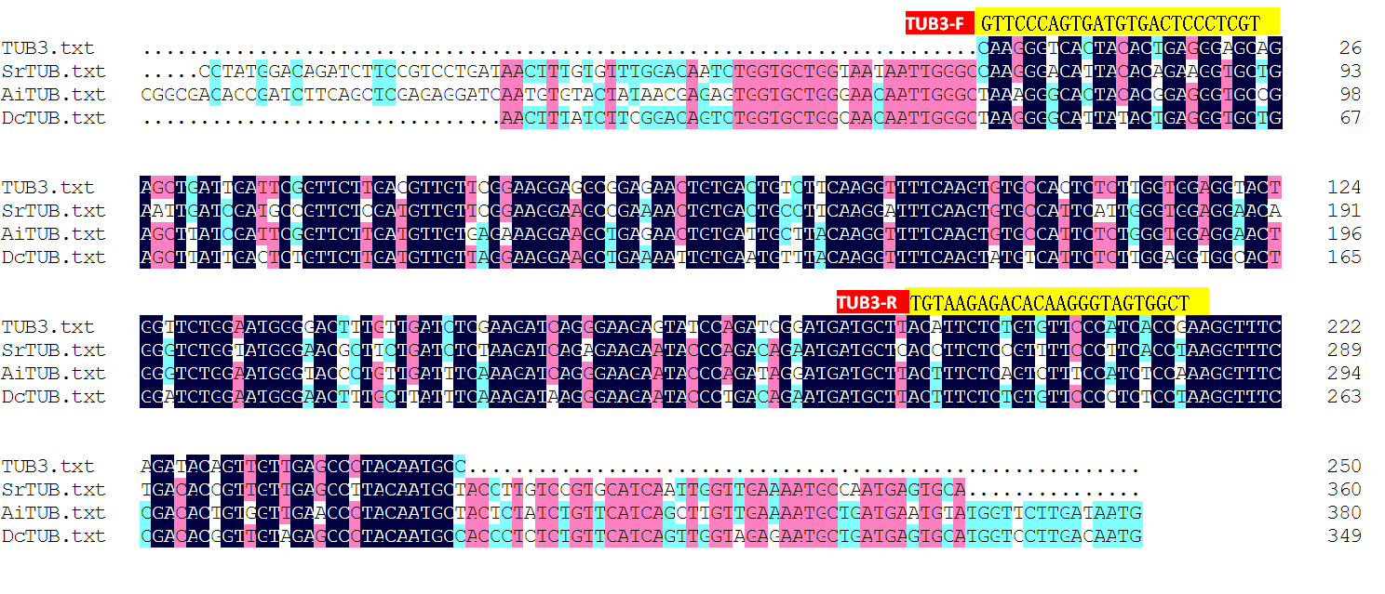
TUB3

Slide 5
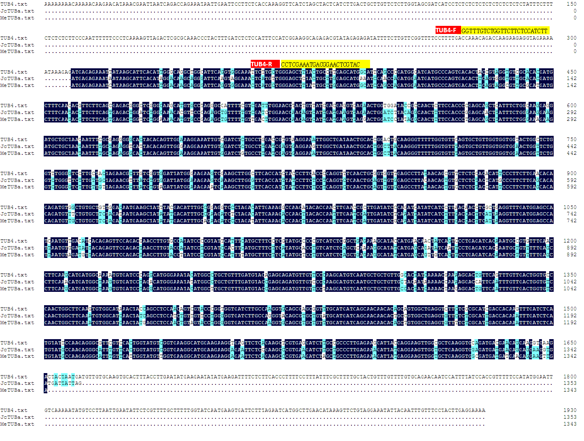
TUB4

Slide 6
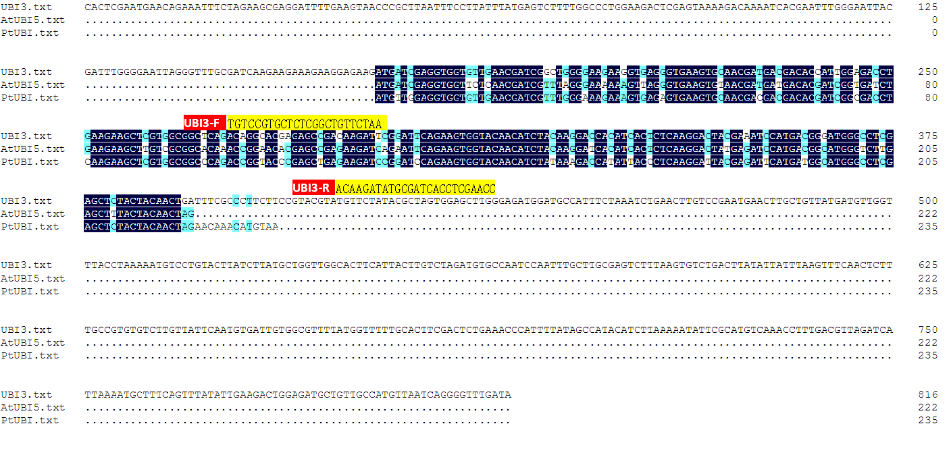
UBI3

Slide 7
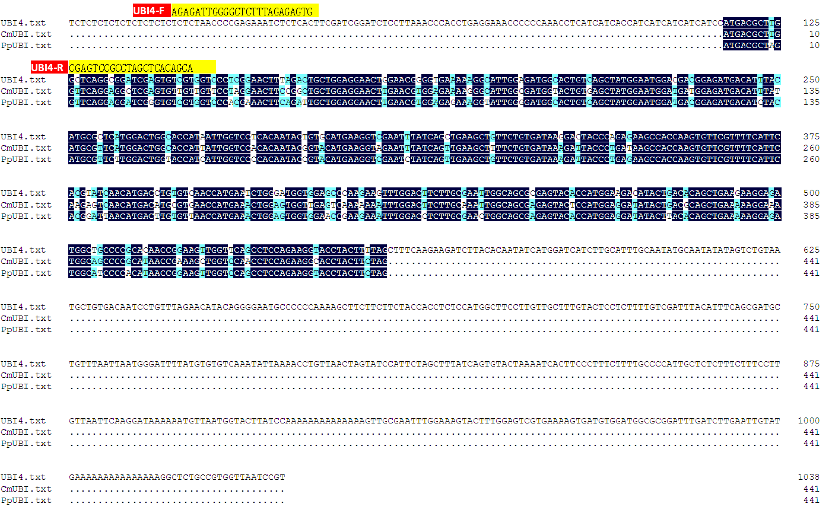
UBI4

Slide 8
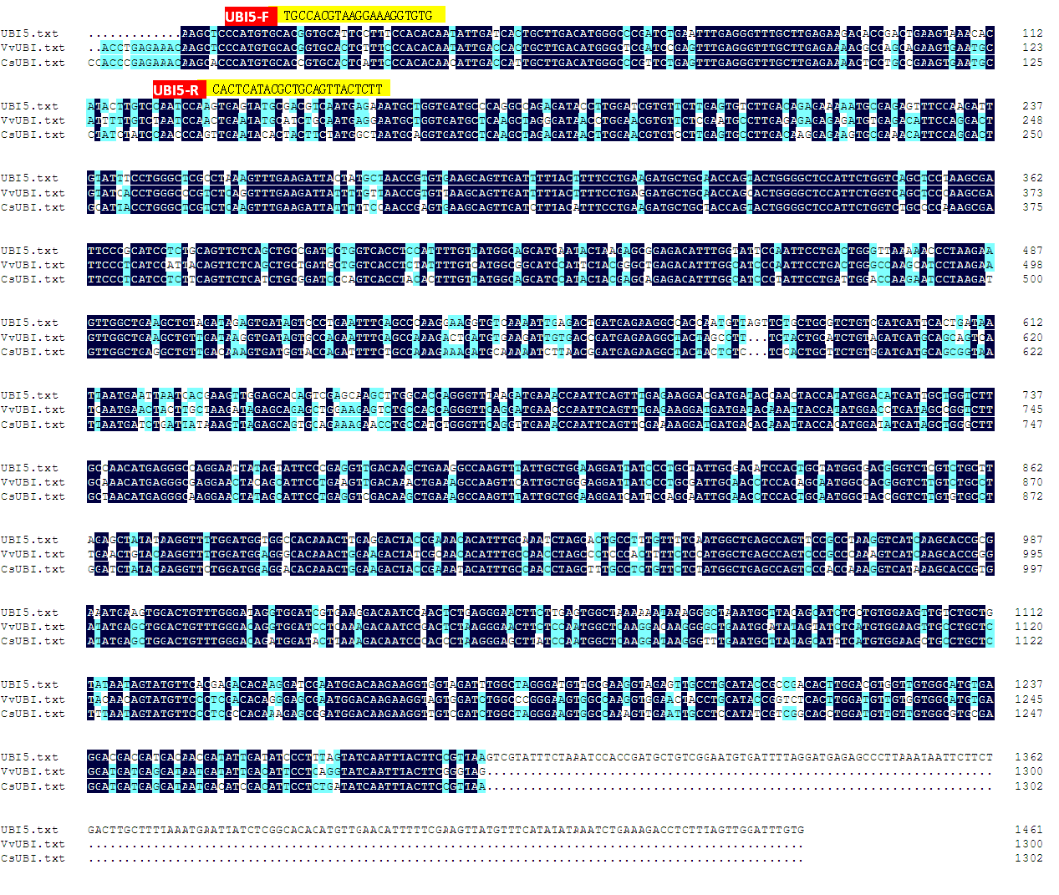
UBI5

Slide 9
EF1α1-F
ATTTATATCCTGTTTCGGTAAAGGG
EF1α1
EF1α3
EF1α1-R
GGTGCAACTGAGACCTTTCAGC
EF1α3-F
AACCACAGTATTTCTCGCAACTCTT
EF1α3-R
AAACGGTGCTCTAAAAGAAGAAGTA

Slide 10
EF1α4
EF1α4-F
TGCCACCGCTGTCCCGCACA
EF1α4-R
TGGTGTCAATGACCCCAACTCTACA

Slide 11
GAPDH1
GAPDH1-F
TAGGGATTGTAACCGTAAAGGAGC
GAPDH1-R
GTTGCCAAAACCTTCTTAGCCATCC

Slide 12
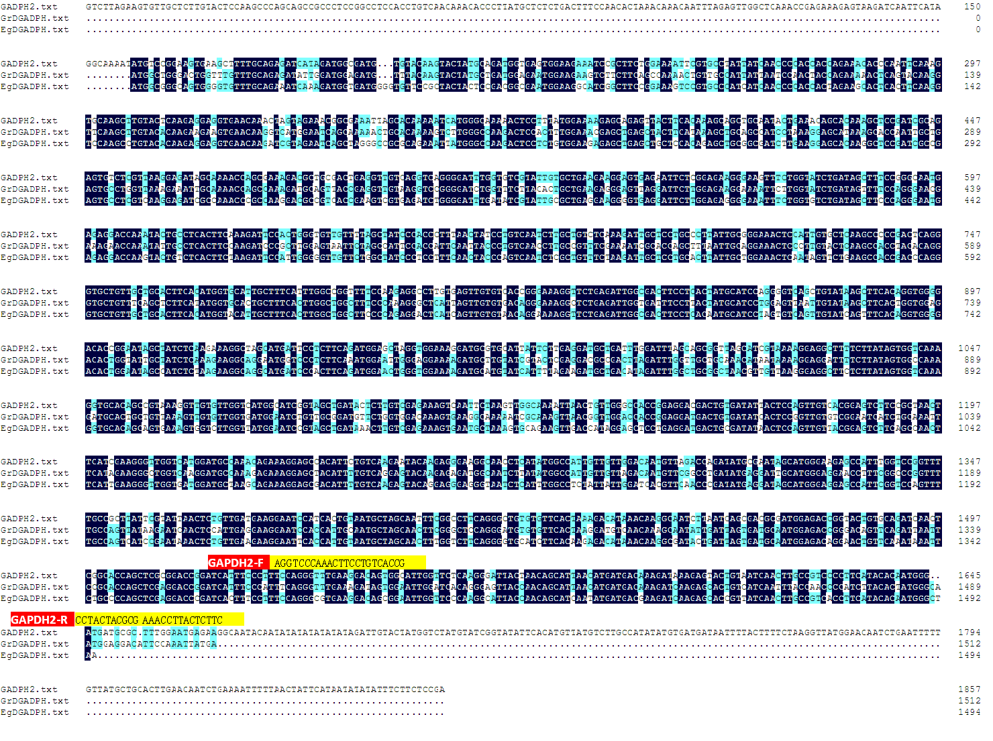
GAPDH2

Slide 13
CYP1
CYP1-F
GAAATCGGTAAAGAGTAAAAGTCAC
CYP1-R
GATGTTCCCTAGCAGGAAGGTGG

Slide 14
MDH1, MDH2
MDH1-F
CGCAGCACCGATGAGGCAAGTGA
MDH1-R
ATTTCCTATACGCCCACTCCTCT
MDH2-F
CCTCCTACGGAACTGCCCATACC
MDH2-R
GAGGTGACAAGGGTAACGCCG

Slide 15
PP2A2
PP2A2-F
ACTTAGCTTCTTACTCTACACAAGG
PP2A2-R
CCGTATAATTTGTTTGACGATAAAAA

Slide 16
RPL4
RPL4-F
CAGAGGTTACCGTCGGTGTCG
RPL4-R
TTTGGCAGCGGGATGGGCTAC

Slide 17
RPL35
RPL35-F
AGAGGCAGGGTTCTTCTGGTC
RPL35-R
ACATCCCACCCAAGGTAAAGT

