Slide 1
Suppl. Fig 1. – please see supplementary video files

Slide 2
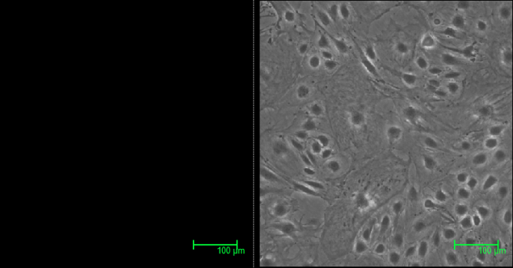
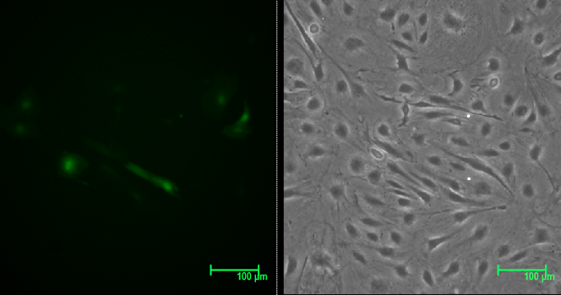
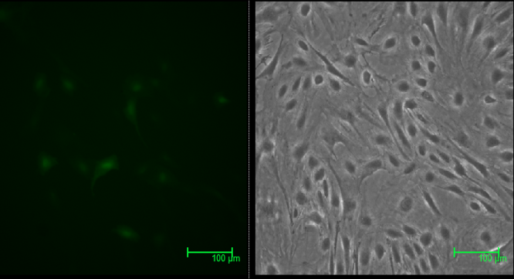
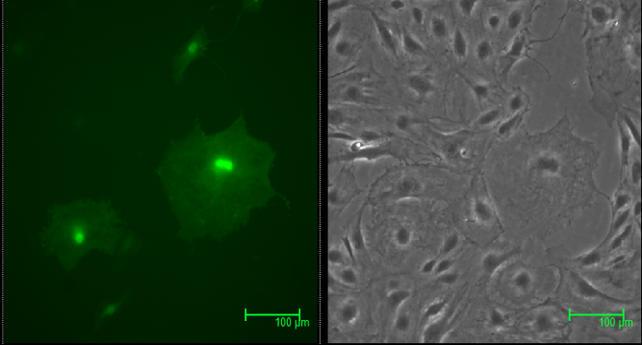
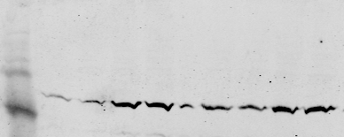

Suppl Fig.2
NV
GFP 100
GFP 200
GFP 400
kDa
Wt
C16A
25
15
RhoA
100
100
400
400
200
200
400
400
µl/ml
µl/ml
kDa
C20A
C16/20A
25
RhoA
15
endogenous
200
400
endogenous
200
400
µl/ml
µl/ml

Slide 3
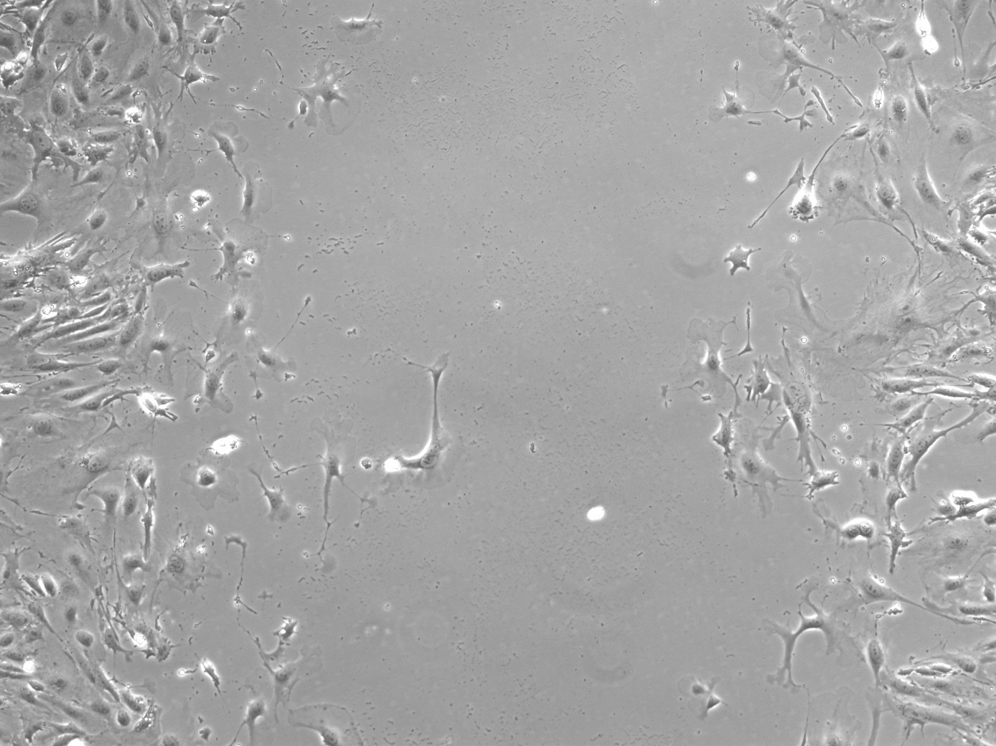
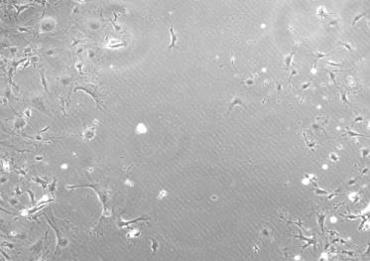
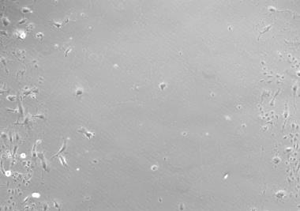
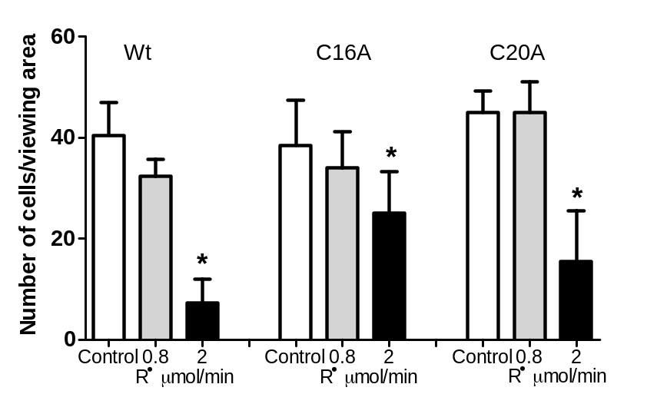
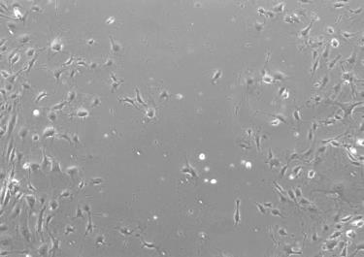
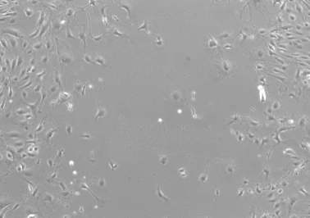
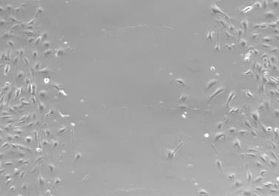
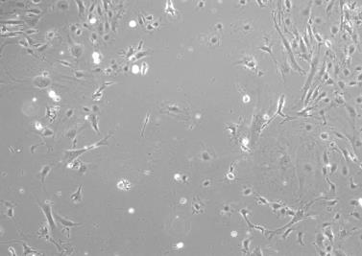
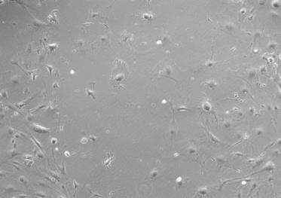
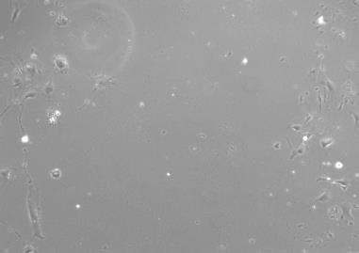
Suppl. Fig. 3
Control
R• 0.8 µmol/min
R• 2 µmol/min
Wt
10X
C16A
10X
C20A
10X

