Slide 1
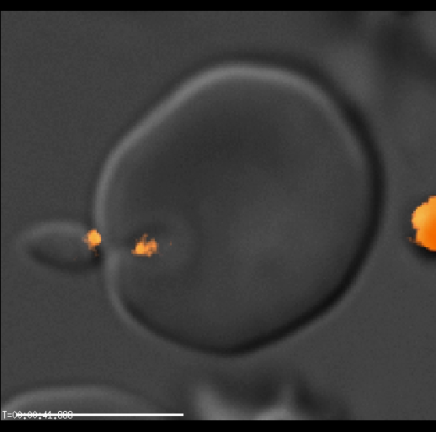
Supplementary Movie 1

