Slide 1
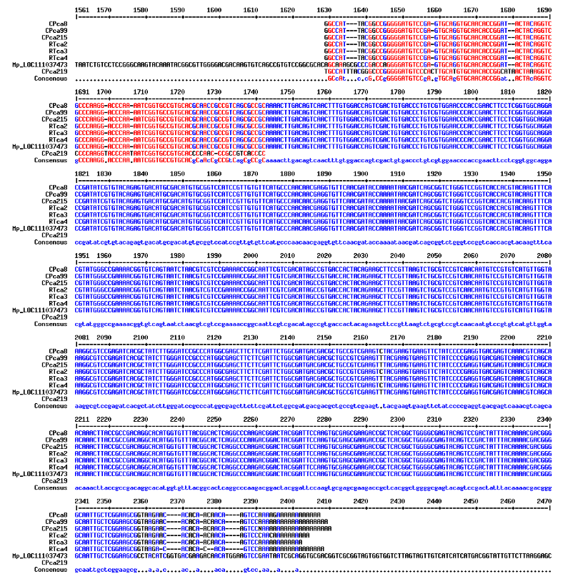
Figure S1: Multiple sequence alignment with hierarchical clustering of the cDNA sequences isolated from the yeast two hybrid screens on the M. persicae genome (Mp_LOC11103473). The M. persicae cDNA sequences were obtained from the yeast colonies growing on the selective medium [-LWHA] after screening the aphid cDNA library with the CP_{CA} (CPca sequences) or RT*_{CA} (RTca sequences). Although all cDNA sequences were of similar size, the sequence of the CPca219 clone of lower quality resulted in a shorter base-pairing with the M. persicae genome sequence. A nucleotide polymorphism was observed at position 2164.

