Slide 1
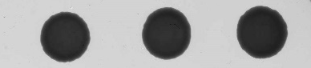
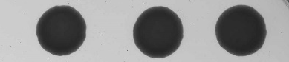
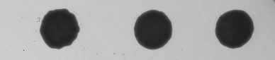
pGAD-Eph
[-LW]
[-LWH]
[-LWHA]
Empty pGBKT7
Figure S2: Transcription activation of the GAL4-responsive promoter by the Eph partial domain. The yeast strain Y2HGold was co-transformed with pGAD-Eph and the empty pGBKT7. Three colonies were allowed to grow on a medium lacking leucine and tryptophan [-LW] before being transferred onto a selective medium deprived of leucine, tryptophan, histidine [-LWH] and adenine [-LWHA]. Yeast cells were grown at 28°C for 3 days on [-LW] and for 7 days on [-LWH] and [-LWHA].

