Slide 1
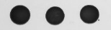
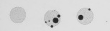
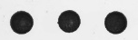
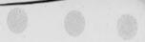
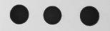
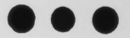




pGAD-Eph
Empty pGAD
[-LW]
[-LWHA]
[-LW]
[-LWHA]
pLexAN-CP_{Tu}
pLexAN-RT*_{Tu}
Empty pLexAN
Figure S3: Interaction between TuYV structural proteins and Eph partial domain. The yeast strain NMY51 was co-transformed with pGAD-Eph and pLexAN-CP_{Tu}, pLexAN-RT*_{Tu} or the empty pLexAN. In parallel, yeast cells were co-transformed with the empty pGAD and one of the viral pLexAN-derived plasmids mentioned above. Three colonies were allowed to grow on a medium lacking leucine and tryptophan [-LW] before being transferred onto a selective medium deprived of leucine, tryptophan, histidine and adenine [-LWHA]. Yeast cells were grown at 28°C for 3 days on [-LW] and for 7 days on [-LWHA].

