Slide 1
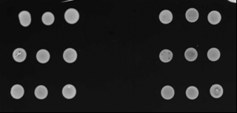
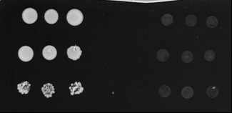
[-LW]
[-LWHA]
pGBKT7-CP_{Ca} / pGAD-CP_{Ca}
Empty pGBKT7 / pGAD-CP_{Ca}
pGBKT7-CP_{Ca} / Empty pGAD
Figure S4: Association of CABYV-CP in yeast. The yeast strain Y2HGold was co-transformed with pGBKT7-CP_{Ca} and pGAD-CP_{Ca}. In parallel, yeast cells were co-transformed with one of the former recombinant plasmid and one of the empty plasmids (empty pGAD or empty pGBKT7). Three colonies were allowed to grow at 28°C for 5 days on a medium lacking leucine and tryptophan [-LW] before being transferred onto a selective medium deprived of leucine, tryptophan, histidine and adenine [-LWHA].

