Slide 1
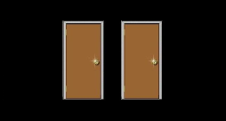
A
B
Click for next Round
+
+
+
or
+
Click for next Round
+
+
+
or
+
Wait for response
Fixation
0.5 seconds
Doors
until response
Fixation for
1 second
Feedback
4 seconds
Fixation
2-12 seconds
Wait for response
Fixation
0.5 seconds
Doors
until response
Fixation for
1 second
Feedback
4 seconds
Fixation
2-12 seconds

