Slide 1
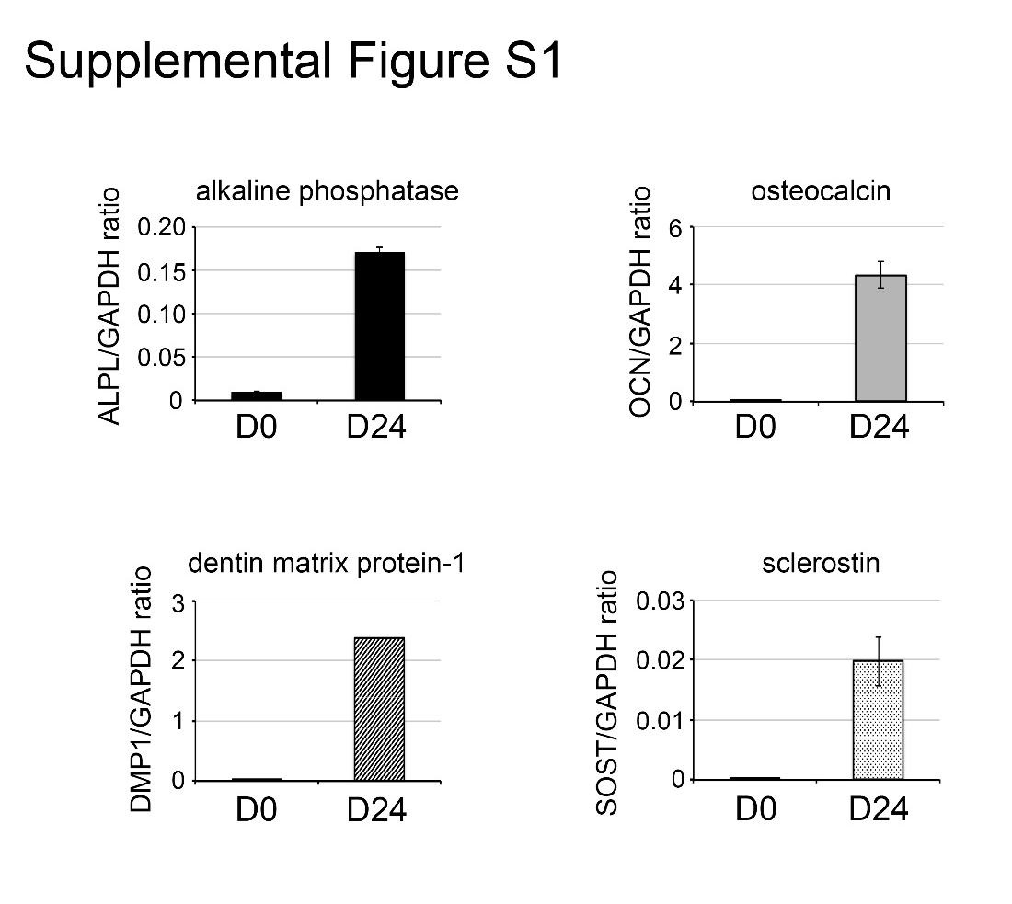
Real-time RT-PCR for the expression of osteoblast differentiation markers, in a second set of D0 and D24 osteoblasts.

