Slide 1
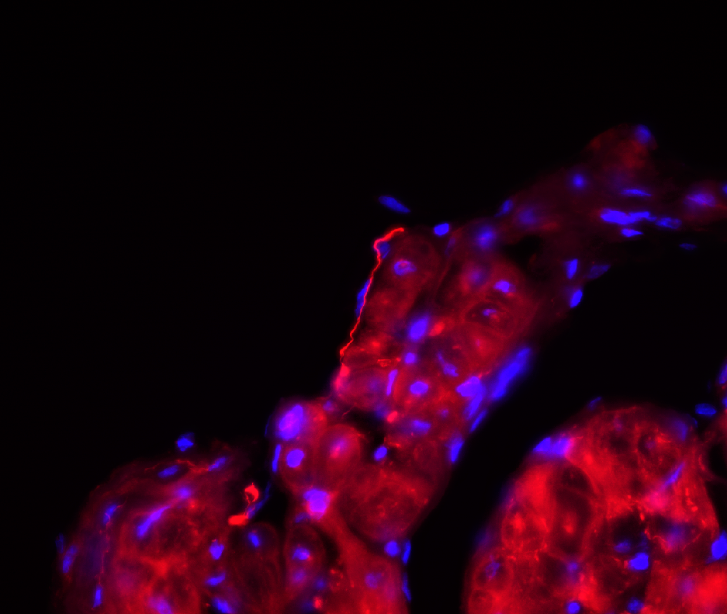
Supplementary Fig. 1
25 µm
Right atrial trabeculation stained for Ang II (red). A non-varicose angiotensinergic fiber is visible running in parallel with the endocardial surface. Myocytes also show Ang II-positivity. Nuclear staining by DAPI (blue), confocal microscopy.

