Slide 1
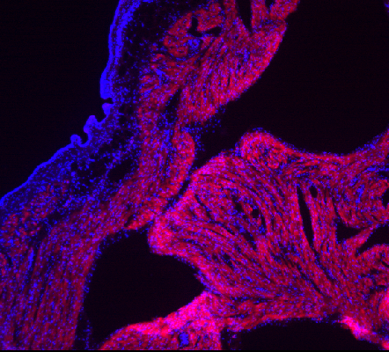
Supplementary Fig. 2
ep
m
2
t
1
200 µm
Right atrial wall stained for Ang II (red). Boxed areas 1 and 2 indicate endocardium with Ang II and tyrosine hydroxylase-positive endings protruding into the endothelium and correspond to article Fig. 1e and supplementary Fig. 3. Nuclear staining by DAPI (blue), confocal microscopy; ep, epicardium; m, myocardium; t, trabeculation

