Slide 1
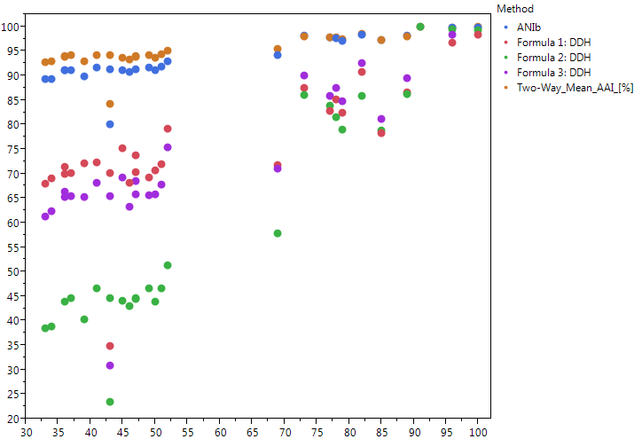
DNA-DNA Hybridization at 70°C

