Slide 1
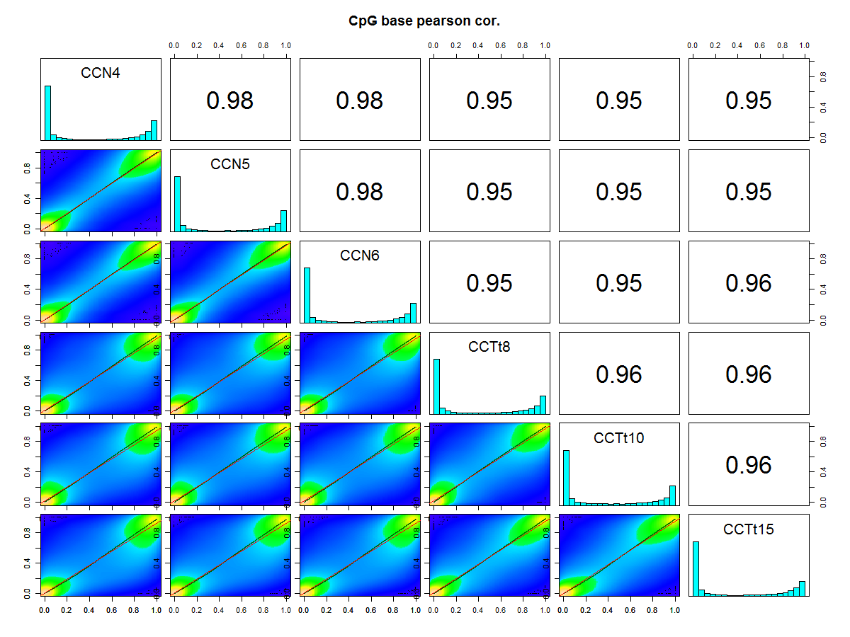
CCN1
CCN2
CCN3
CCTt1
CCTt2
CCTt3
Fig. S1

Slide 2
(a) Mst1r
n.s.
(b) Slpi
n.s.
(c) Extl1
n.s.
Relative expression
( Mst1r / rRNA )
Relative expression
(Slpi / rRNA )
Relative expression
( Extl1 / rRNA )
Tumor
Mutation－
Tumor
Mutation ＋
Tumor
Mutation－
Tumor
Mutation ＋
Tumor
Mutation－
Tumor
Mutation ＋
Fig. S2

Slide 3
(a) Dnmt1
(b) Dnmt3a
(c) Dnmt3b
*
**
**
Relative expression
( Dnmt1 / rRNA )
Relative expression
( Dnmt3a / rRNA )
Relative expression
( Dnmt3b / rRNA )
Hepa1c1c7
Hepa1-6
Hepa1c1c7
Hepa1-6
Hepa1c1c7
Hepa1-6
(d) Tet2
(e) Tet3
n.s.
Relative expression
( Tet2 / rRNA )
**
Relative expression
( Tet3 / rRNA )
Hepa1c1c7
Hepa1-6
Hepa1c1c7
Hepa1-6
Fig. S3

